Slide 1
Welcome to Year 3
Cornflower Class
With Mrs Edwards (Mon-Tue)
And Mrs Pickard (Weds-Fri)

Slide 2
 | Monday | Tuesday | Wednesday | Thursday | Friday
8.40 – 8:50
8:50 – 9:15 | Guided Reading | Guided Reading | Guided Reading | Guided Reading | Guided Reading 9:00 class prayers
9:20 – 10:10 | Maths | Maths | Maths | Maths | Maths
10:10 – 10:30 | WSA | Class Prayers with Yr4 | Rejoice/Golden Assembly | KS2 Assembly | Music
10.30 - 10.45 | BREAK
10.45 – 11:45 | English | English | English | English | SPAG
11:45 – 12:15 | RE | Topic | RE Spelling test Multiplication tests | Set home learning & Handwriting | French
12:15 –13:15 | LUNCH
13:15 – 14:15 | RE | Topic | RE | Computing | Science
14:15 – 15:15 | PE - outdoor Show and Tell | Art/DT | PE- indoors | 14:45-3:15 Circle Time Show and Tell | 14:45 Hymn Practice Golden time

Slide 3
Homework
The children will write/stick any details needed in their homework books.
Spellings: Word list. Look/Cover/Write/Check Sheet.
Maths: Mathletics or a sheet to consolidate learning in class.
English/Topic: Research, Purple Mash or sheet to consolidate learning in class.
Daily reading and times tables practise.
All homework to be handed in on Wednesdays.
Homework for Mrs Edwards handed in on Tuesdays.

Slide 4
Ties and Shoelaces
Please continue to teach your child to tie their ties and shoelaces.
Please continue to encourage children to dress/undress independently.

Slide 5
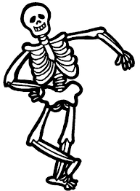
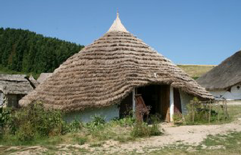
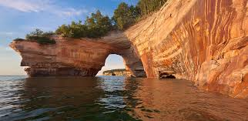
Autumn Topics
Geography: Our Local Area
History: The Stone Age
Science: Rocks and Soils, Volcanoes,Skeletons
Healthy eating
DT: Making sandwiches
Art: Stone Age paintings
RE: Homes and Advent
Judaism

Slide 6
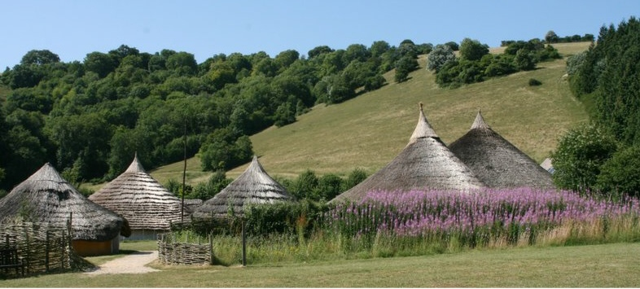
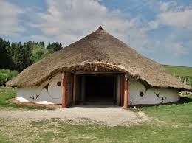
Welcome to our Stonehenge Exhibition
Well done for all your hard work
Butser Farm Trip- 13th November

Slide 7
Communication
We are available after school if you have any concerns or if that is not convenient write a note in your child’s homework diary.
We hope your children have had a wonderful beginning to Year 3 and we look forward to an exciting year together

