Slide 1
RE mock analysis – common misconceptions / errors self diagnosed

Slide 2
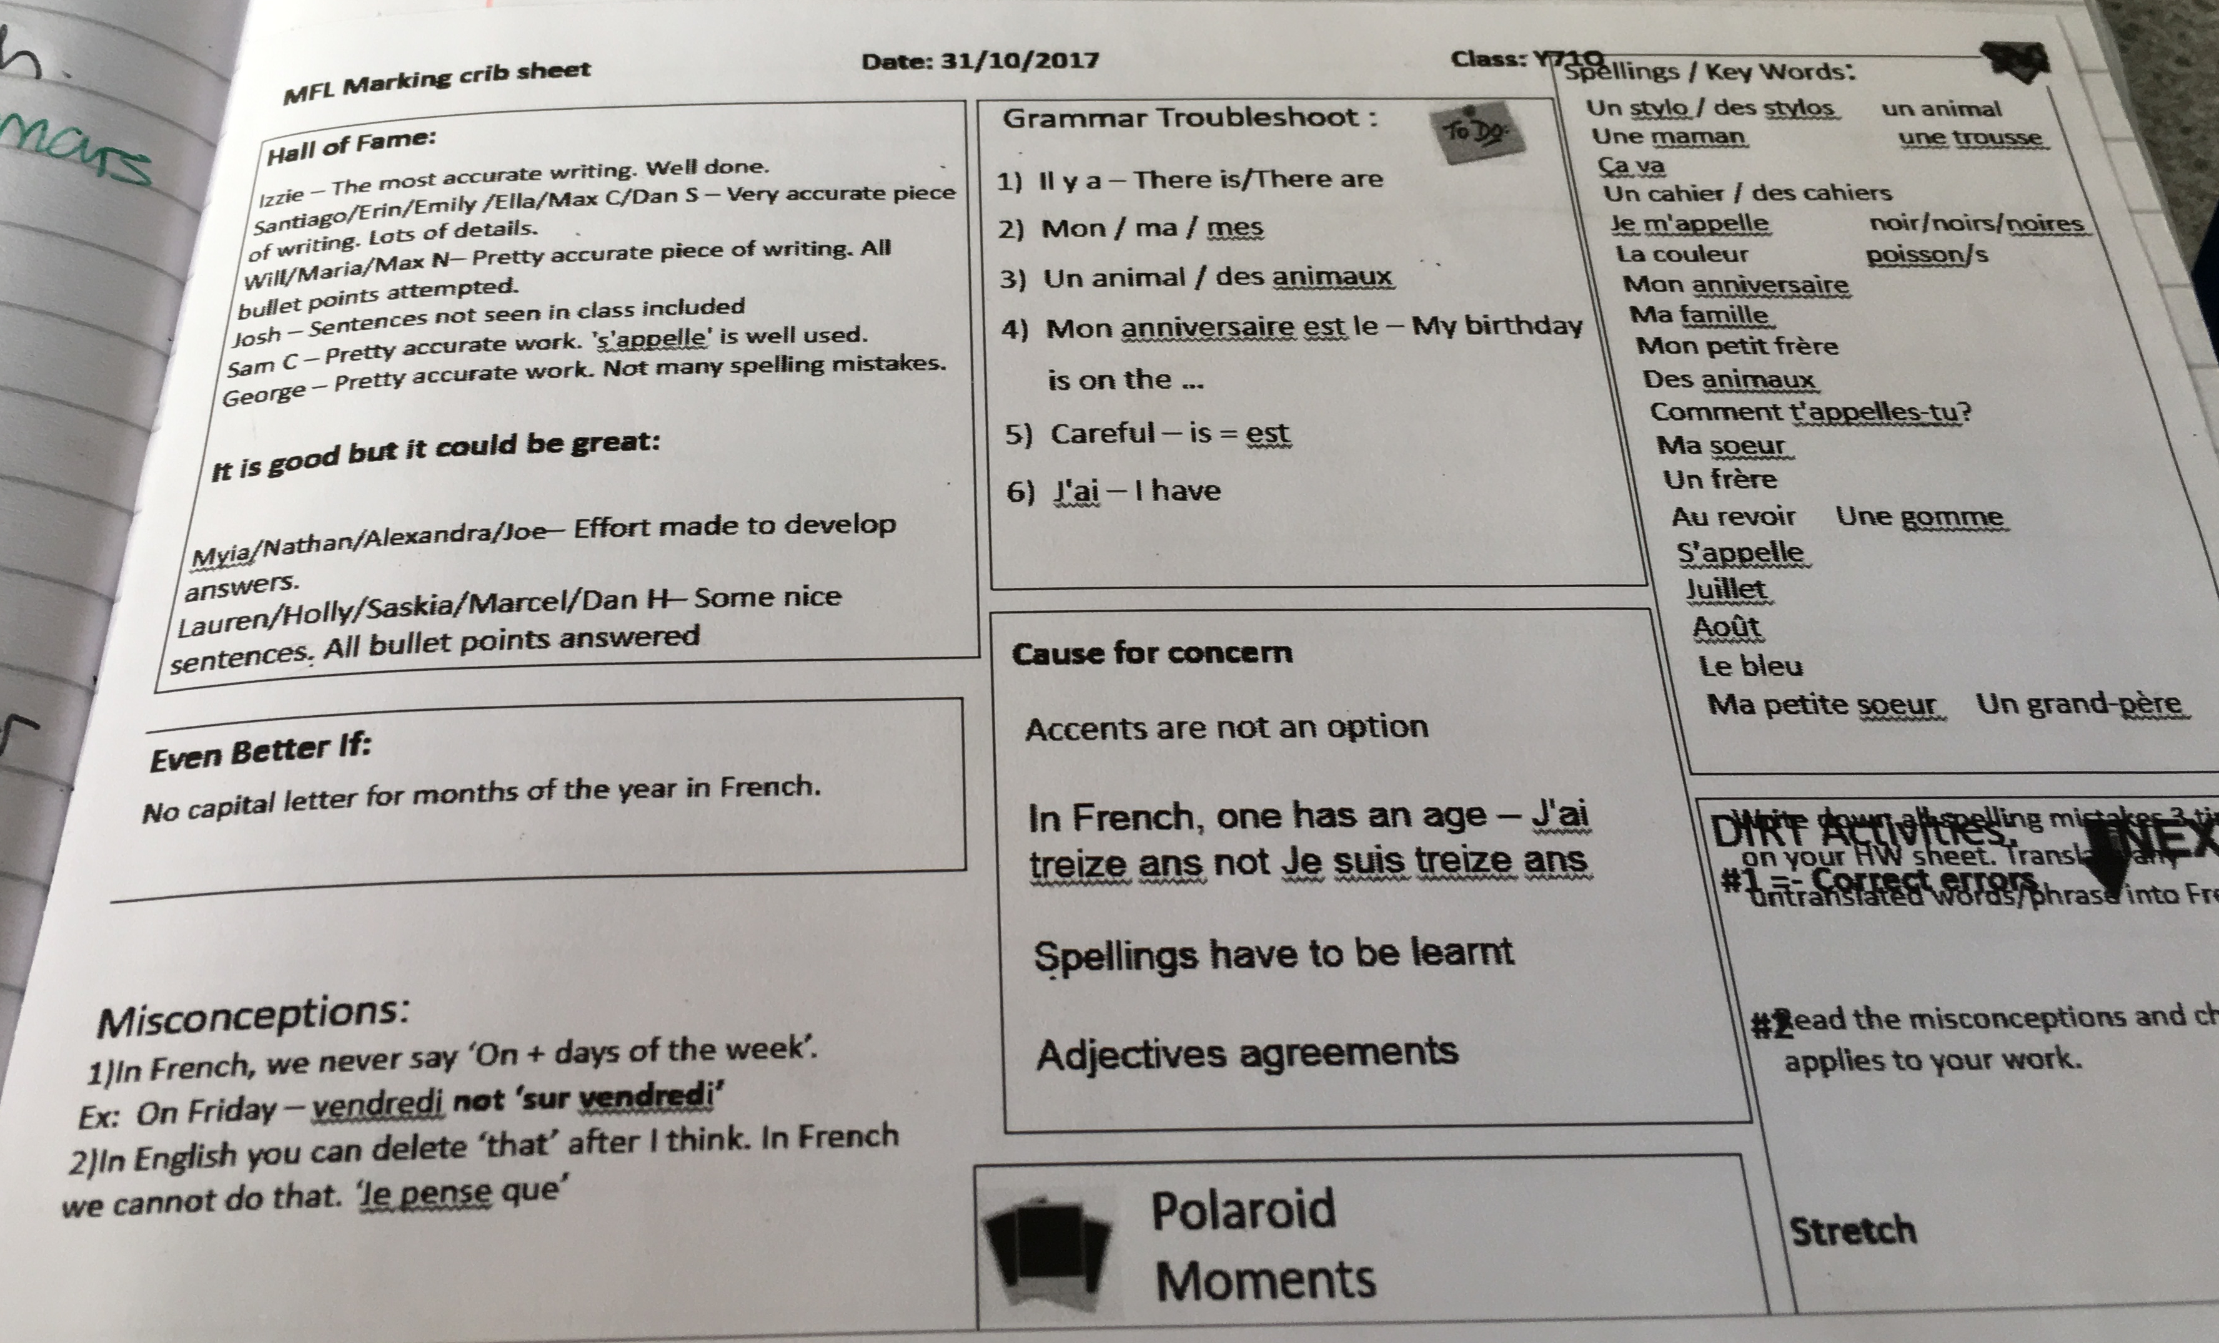
MFL: class feedback of common misconceptions, grammar points, tips and key words

Slide 3
Common misconceptions: Whole class feedback with model examples

