Slide 1
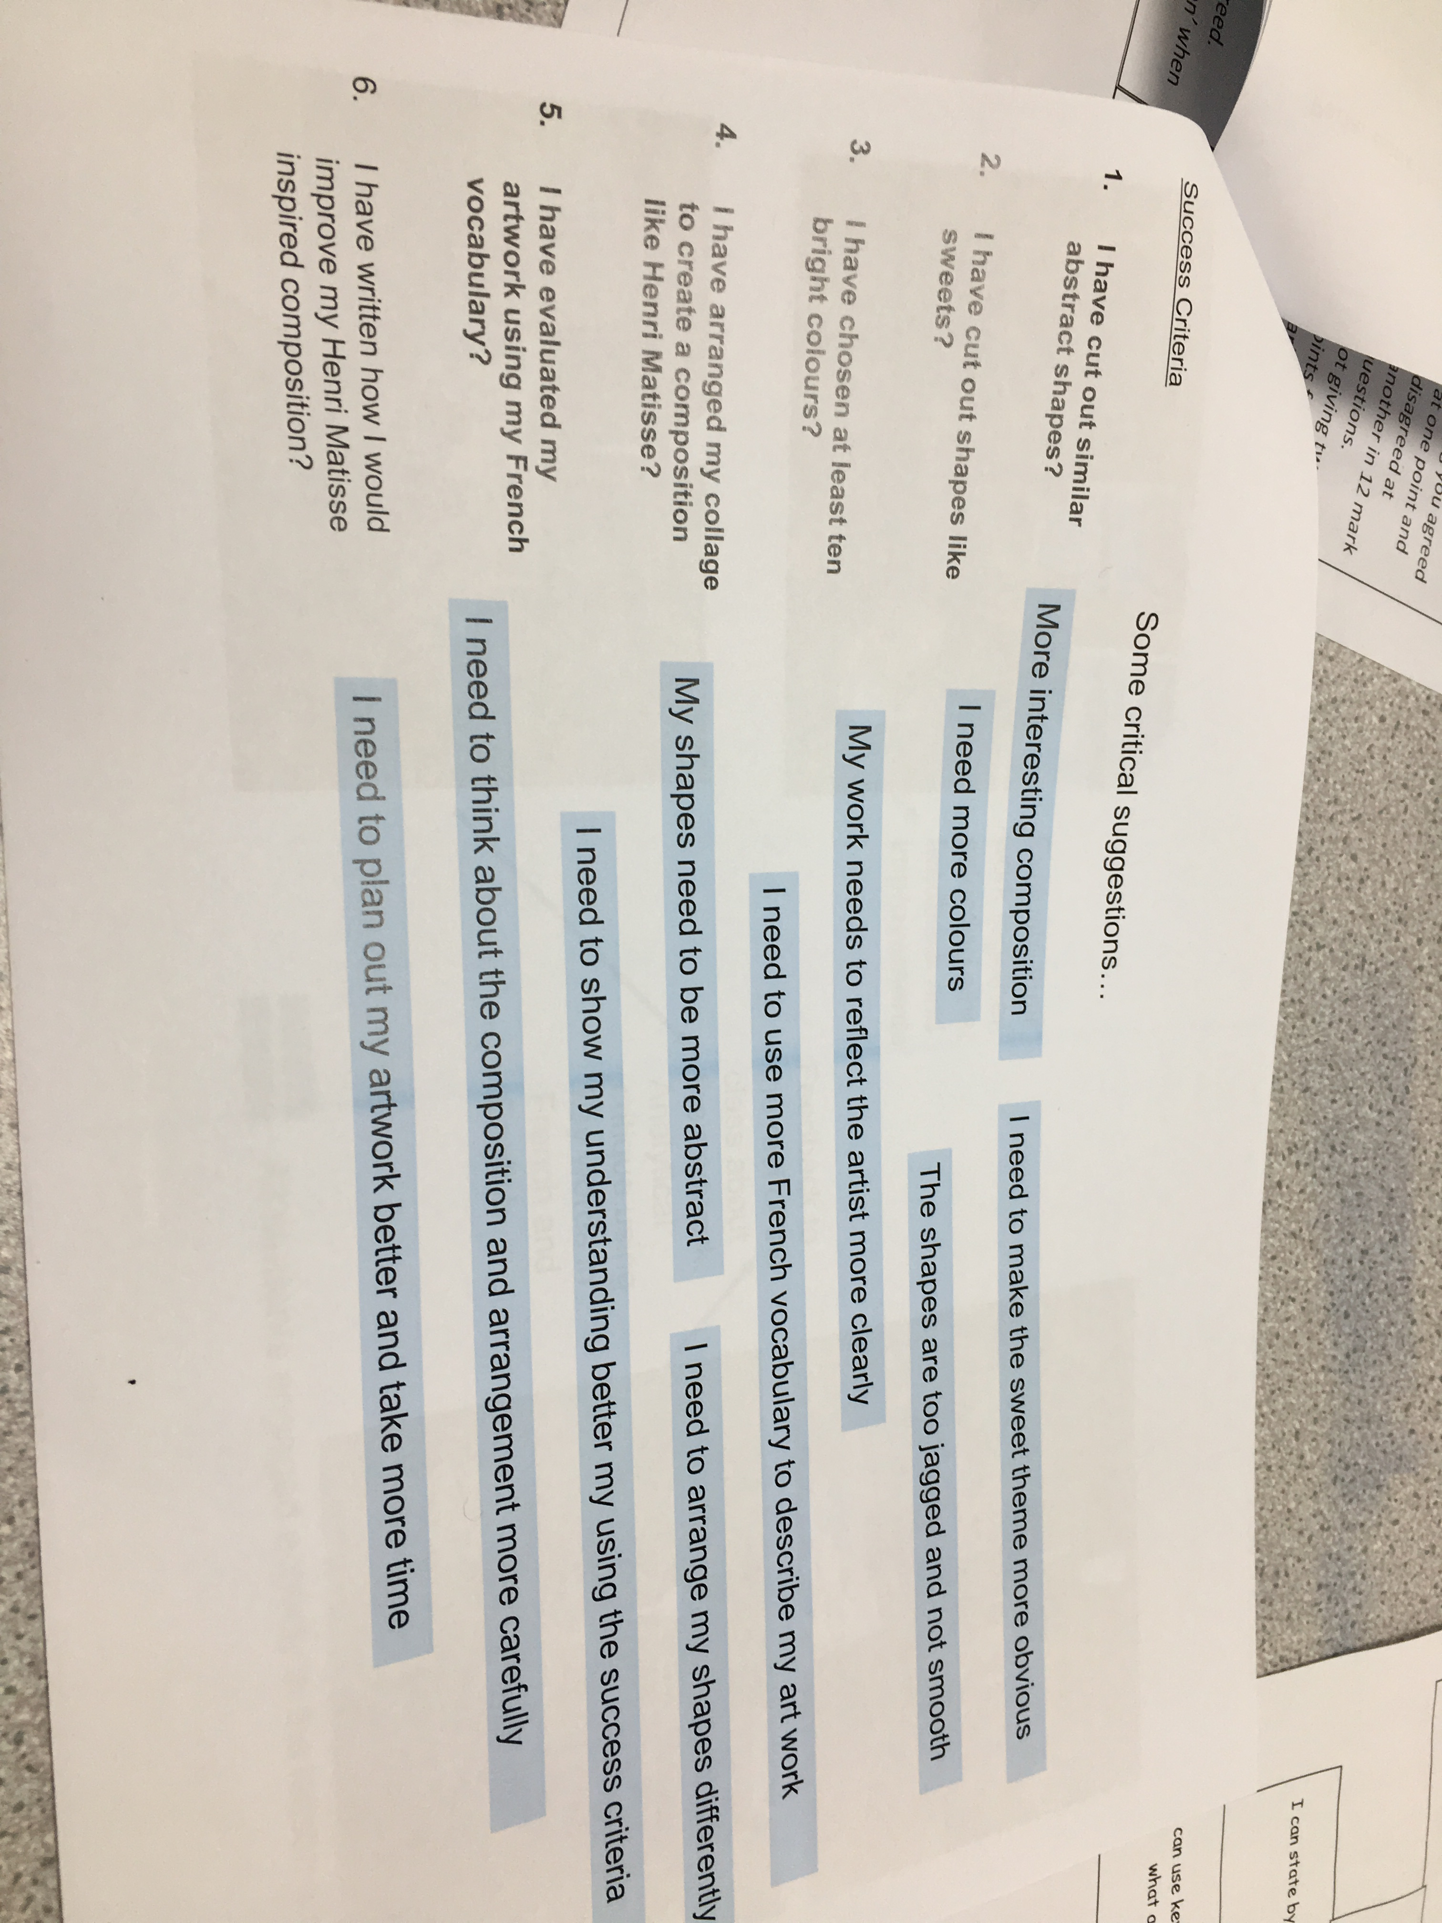
Critical comments to scaffold meaningful target setting against success criteria

