Slide 1
DT: Students set their own personal targets on “padlet”

Slide 2
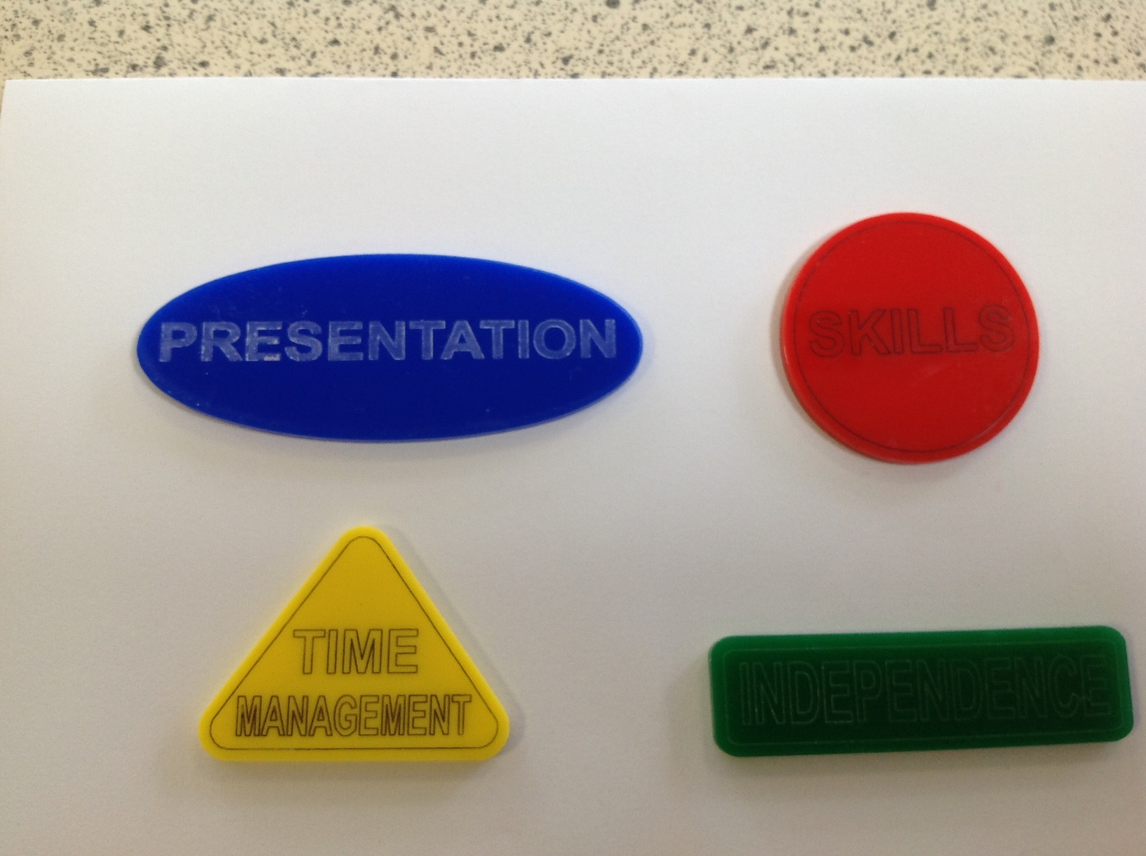
Students take a token to remind themselves of their personal focus/target

Slide 3
Students discuss “www” and “ebi” mid-practical for their target to ensure they are making progress

