Slide 1
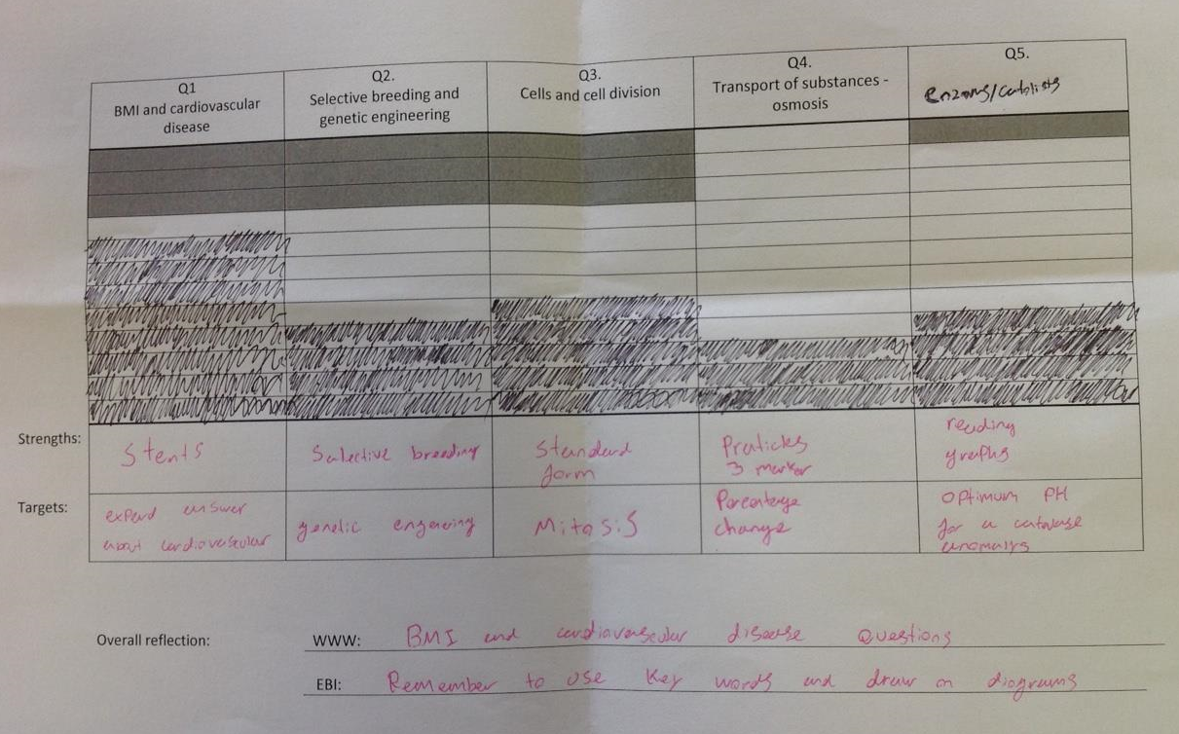
Visual analysis & target setting

Slide 2
