Slide 1
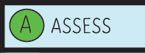
1. Watch me, help me, show me
A way of introducing new learning in 3 simple phases whilst also assessing pupil learning diagnostically prior to them commencing the independent task to deepen understanding.

Slide 2
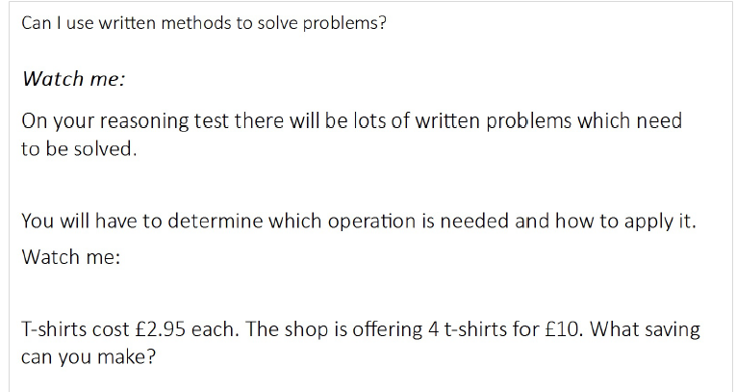
Stage 1: Watch me
Teacher models the new learning by demonstrating the process whilst facilitating pupil involvement.

Slide 3
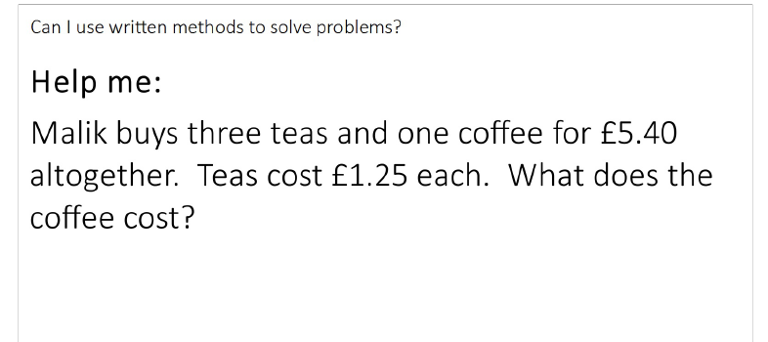
Stage 2: Help me
Teacher models again the learning but deliberately draws out common misconceptions for pupils to all join in and correct.

Slide 4
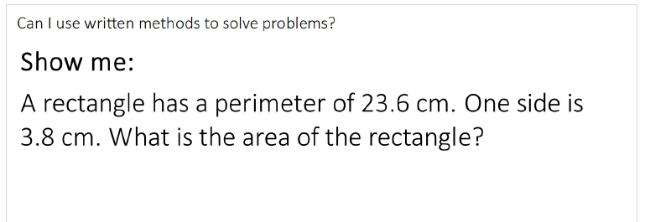
Stage 3: Show me
Pupils given TIME to demonstrate their understanding on mini whiteboards. Question has variation built in and ALL pupils complete question which is checked on mini whiteboards BEFORE independent task commences.
Those pupils who are not confident or whom make mistakes at this point form a cut away group on the carpet.

