Slide 1
1. Warm up
Don’t assume prior knowledge or attainment.
Strategies:
Pre teach
Baseline tasks
Quick quiz

Slide 2
1. Warm up: Pre teach
Notes:
Ks4 hw for ks5 students - particularly for those who hadn’t done GCSE, encouraged to make notes on topics before the lesson

Slide 3
1. Warm up: Pre teach
A
Doing things better because of technology
Notes:
Flashback topics and exam questions on showbie

Slide 4
1. Warm up: Pre teach
Students set key terms to learn/look up prior to the lesson.
Summary video used to aid recall of Year 10 topic & accelerate recall
M
Doing things differently because of technology
Notes:
Business studies – videos to watch before

Slide 5
1. Warm up: Baseline tasks
Baseline task allows teacher to clearly see where students should start within the lesson
Notes:
Prior knowledge was drawing cubes…some students get the next stage easily without input …baseline test allows teacher to clearly see where students should start within the lesson

Slide 6
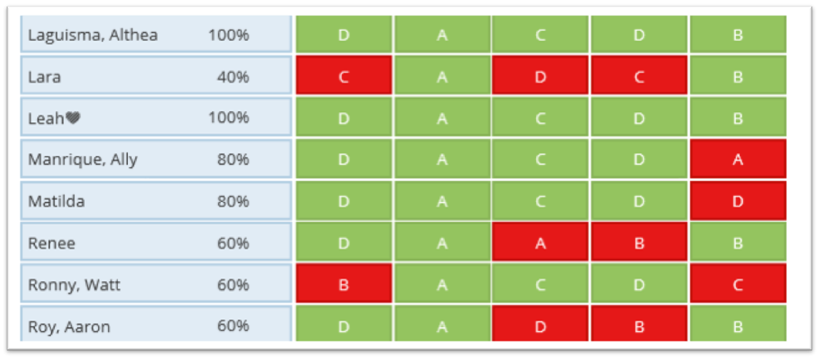
1. Warm up: Quick quiz
Using Socrative to check what students know
I
Inconceivable without technology
Notes:
English - highlighted all knew verbs so didn’t need as much attention during the input

