Slide 1
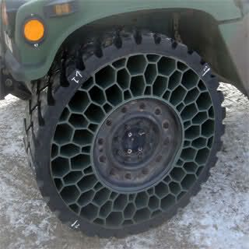
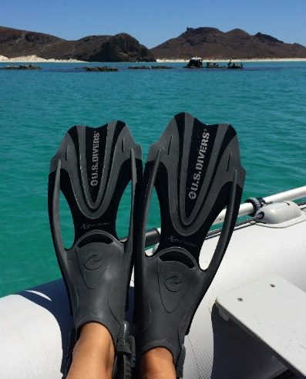
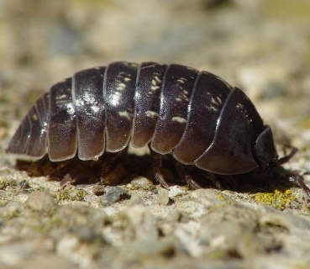
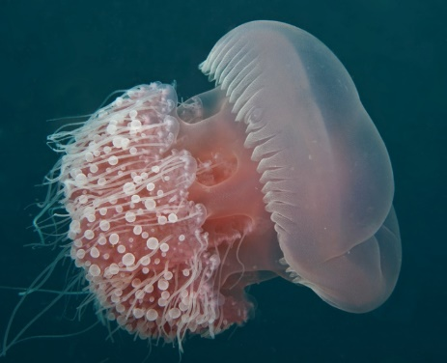
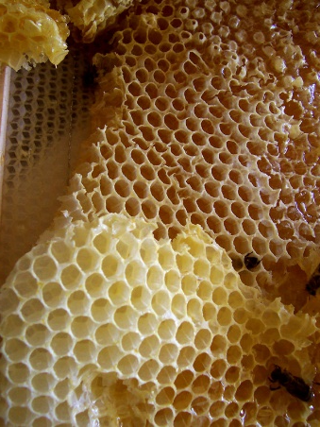
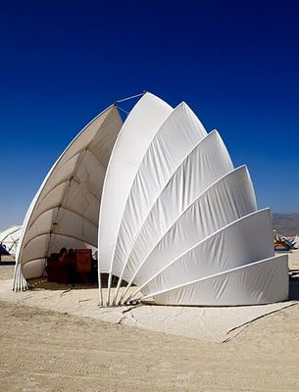
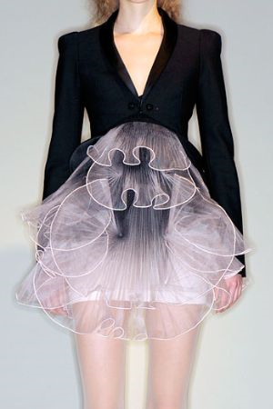
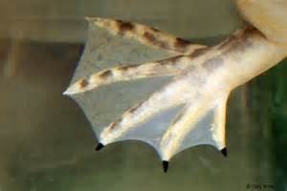
STARTER
BIOMIMICRY- WHAT INSPIRED EACH DESIGN?
A
E
C
B
D
On learning tools
S
T
R
U
C
T
U
R
E
Ikea Shelving Project
Notes:
Students had to guess what inspired each product and then we talked about how the inspiration helped the function or aesthetics of the product (eg an airless tyre cant get punctures).

