Slide 1
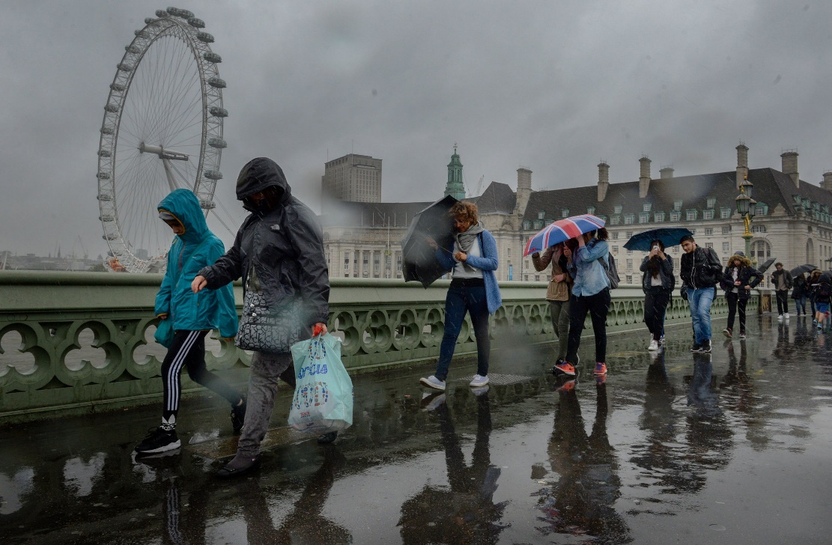
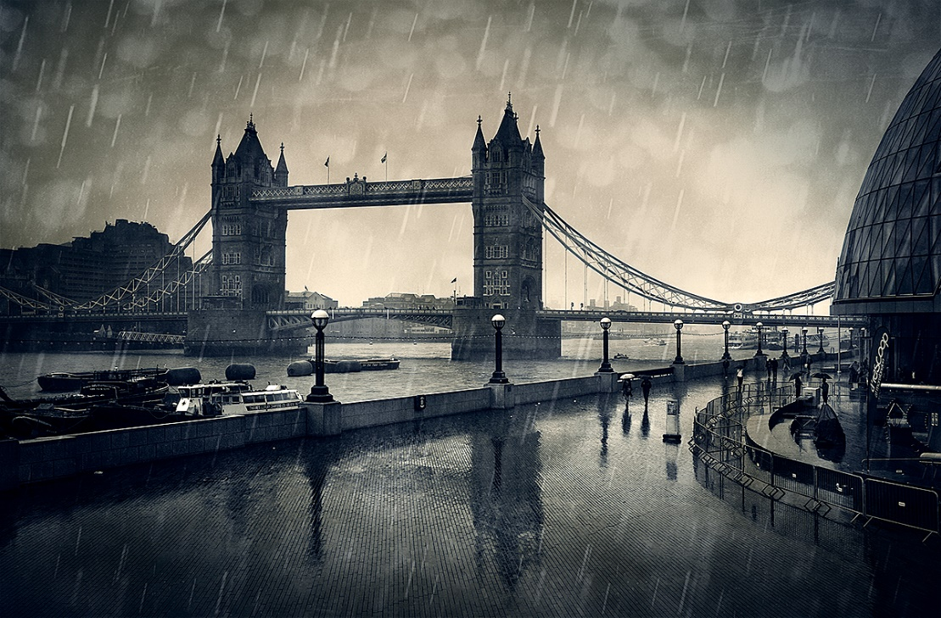
Starter
As you look at the pictures and listen to the sounds, create a spider diagram of:
- words/phrases that you would use to describe life on the streets in these conditions.
Challenge: Can work through the features of ACOASTMAP when generating your ideas?
Notes:
Sound of heavy rainfall playing

Slide 2
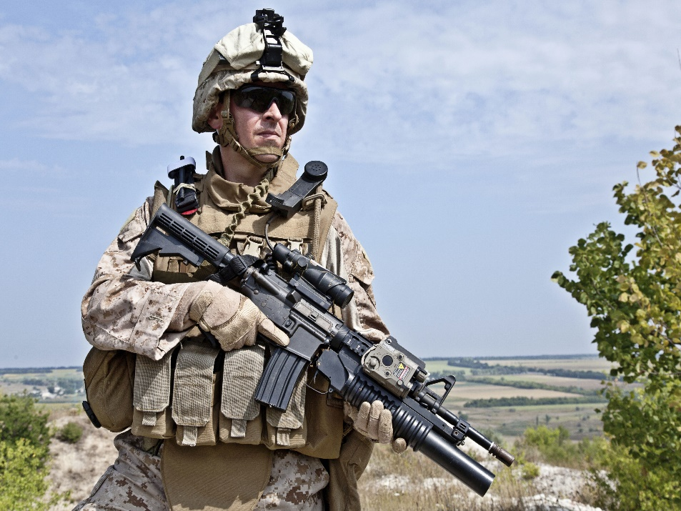
Starter
How might these three pictures, relate to what we will be reading today?
Write down some ideas on your iPads

