Slide 1
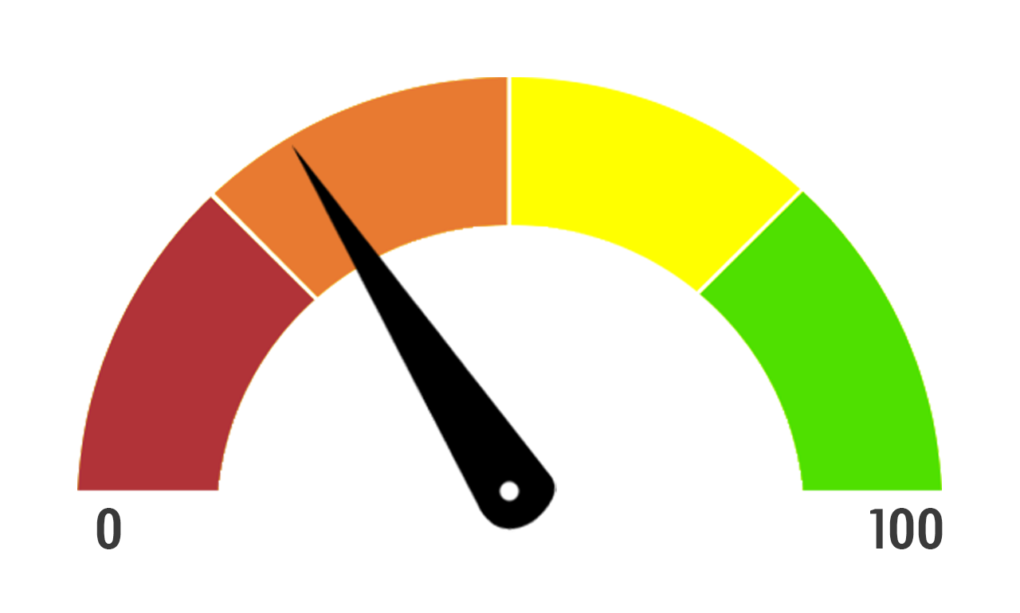
Assessometer
Planning tool for students to consider all the possible responses to a question. (relative effectiveness, extent to which they agree/disagree, positive/negative effects)
Students use the assess-o-meter to weigh up the relative significance of these points
Can be checked against success criteria
Students draw an arrow on their assess-o-meter to reflect what they feel is the most significant argument.
Notes:
This is a planning tool for students rather than the teacher. Before tackling a task, students are given time to consider all the possible responses to a question. For example, rate of effectiveness, differing opinions or beliefs, positives and negative.
Once completed, students conclude by reflecting on what they feel is he mot significant point
ompleted too?

Slide 2
Question: Assess the effectiveness of holistic strategies used to protect a stretch of coast from erosion. (12)
Case study:
Key terms defined:
Effective to a large extent
Effective to some extent
Not effective
Really effective
Conclusion:
Knowledge
A01:
Given detail of the scheme
Key terminology used
Defined key terms
Connections
A02:
Linked points to why it is effective
Social / economic / environmental links
Links to new ideas
Evidence
A02:
Facts
Statistics
Place names
Judgement
A02:
Assessed SEE
Assessed long term / short term
Winners and losers
Overall conclusion
Assess
O-meter

Slide 3
Notes:
Here is an example from geography where the question asks for the importance of lithology. For a 12 mark question, students often dive n answer before planning, this tool allowed them to look at all factors from not important to important to a large extent plus other factors....they then concluded their answer and ensured they met the AOs

