Slide 1
RETRIEVE
Can you find information in the text?
What do certain words mean? (Dictionary)
Look through the text carefully and highlight or underline the words which answer the questions.

Slide 2
INTERPRET
How are the characters feeling?
Why did they do or say that?
What might happen next?
Unlock information from the clues given in the text.

Slide 3
CHOICE
Which words help you understand what is happening?
What techniques has the author used to describe?
How has the author organised or presented the text?
Think carefully about the author’s choice and what they have done to make the text interesting and enjoyable to read.

Slide 4
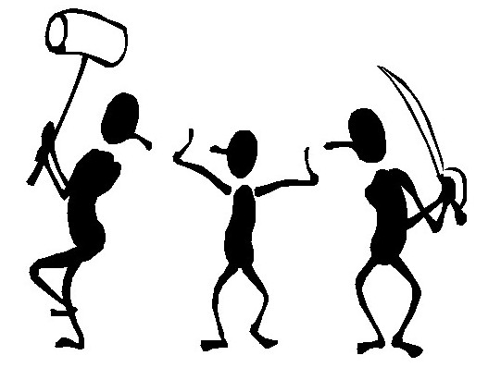
VIEWPOINT
How does the viewpoint change your understanding of the text?
What is the author’s opinion about the text topic?
How has the author tried to change your opinion or persuade you?
Look for persuasive devices, first and third person, and strong, emotional language.

Slide 5
PERFORM
What do the words mean?
How can you make your performance entertaining?
Look at the words, structure and punctuation which the author has used. Use the tone of your voice to make it exciting. Be confident!

Slide 6
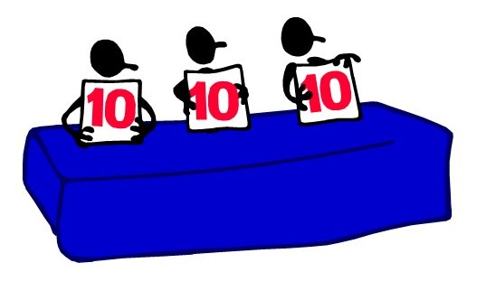
REVIEW
What is your opinion of the text?
Who would you recommend it to?
What did you enjoy? Why?
How could the text be improved?
Give an overview of the text without giving too much away. Be honest and give clear reasons for your opinion, using examples.

