Slide 1
Aims
To discuss why challenge is important in primary science lessons.
To explore practical ways of introducing challenge into primary science lessons.

Slide 2
Why introduce challenge into science lessons?

Slide 3
Science is challenging when…

Slide 4
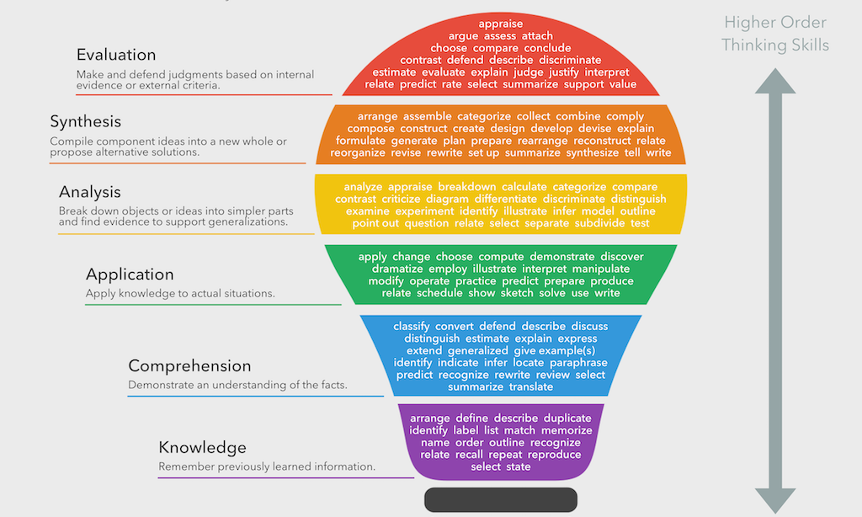
Blooms Taxonomy
Create

Slide 5
Blooms Taxonomy
The Ogden Trust resources
Higher order thinking skill | Question cues
Analysis | Analyse, separate, order, explain, connect, classify, arrange, divide, compare, select, explain, infer
Synthesis | Combine, integrate, modify, rearrange, substitute, plan, create, invent, what if, compose, prepare, generalise, rewrite
Evaluation | Assess, decide, rank, grade, test, measure, recommend, convince, judge, explain, discriminate, support, conclude, compare, summarise

Slide 6
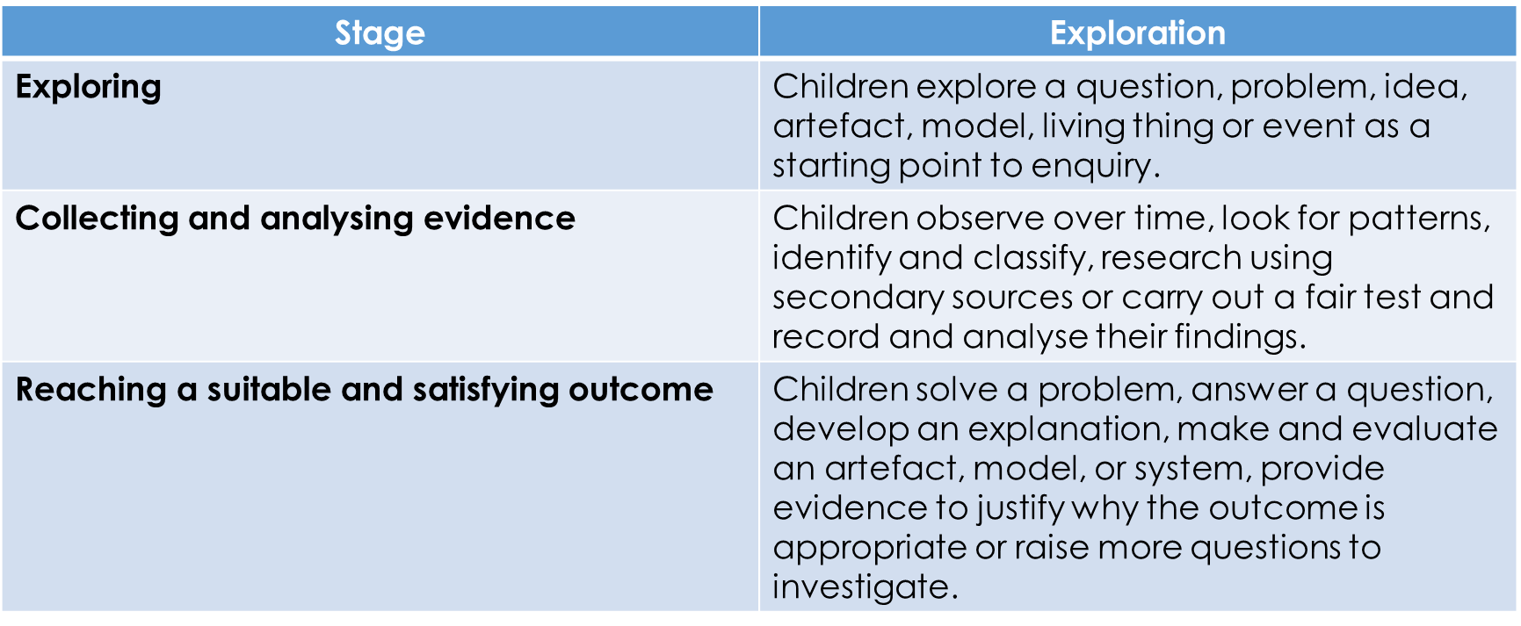
Challenge in primary science lessons…
Explicit 3 stage approach to teaching science…

Slide 7
Challenge in primary science lessons…
Type of Enquiry | Description | Opportunities for challenge
Observing over time | Children observe or measure how one variable changes over time
Identifying and classifying | Children identify features or tests that help them to distinguish between different things | Venn/Carrol diagrams. Create your own sorting criteria Branching databases
Pattern Seeking | Children observe and record phenomena, carry out surveys or collect data from secondary sources and then identify relationships between data in their findings. | Can you find any patterns?
Research | Children use secondary sources of evidence to answer their questions. | Finding evidence to support/refute scientific ideas. Researching how scientific ideas have changed over time.
Fair and Comparative Testing | Children observe or measure the effect that changing one variable has on another, while attempting to keep other variables constant. | What are we changing? (independent variable) What are we measuring? (dependent variable) What are we keeping the same? (control variables)
Notes:
7

Slide 8
Challenge in primary science lessons…
Content
Broaden
Deepen
Don’t move on
Working scientifically
Potential to develop more rapidly
CIEC/Progression Grids
Increasing independence autonomy

Slide 9
Challenge in primary science lessons…
Child-led enquiry
Independence and autonomy create challenge.
What are you going to do?
How are you going to find out the answer?
James Nottingham – The Learning Pit
Stepping back doesn’t mean not doing anything – you’re just as engaged but in a different way.

Slide 10
Suggested phases of child-led enquiry:
Topic set by teacher. Question set by teacher. Tools and resources provided by teacher. Similar investigation modelled by teacher.
Topic set by teacher. Question set by teacher. Tools and resources provided by teacher. Instructions given but not modelled.
Topic set by teacher. Question set by teacher. Children choose own tools and resources from a selection with some unsuitable items included.
Topic set by teacher. Children set own question – teacher facilitates. Children choose own tools and resources – teacher guides.
Teacher provides simple picture or prompt idea. Children choose a suitable question and own tools and resources. Teacher as ‘helpful technician’.

Slide 12
Challenge in primary science lessons…
Examples…
Can you make the bulb light up?
Can you follow the instructions to make a scribble bot?
Use the resources on your table to demonstrate how the Moon, Earth and Sun move…

Slide 13
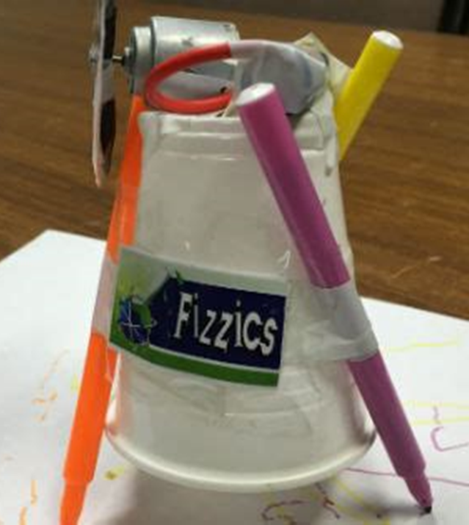
Scribblebots!
Follow the instructions on your table to build a scribblebot.
You will need to work as a team.
You will need to use and apply everything you have learnt about electricity this half term.
Can you complete the challenge questions as well?

Slide 14
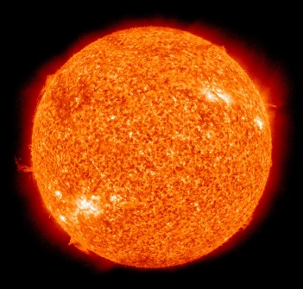
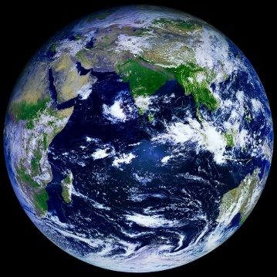
Use the resources on your table to demonstrate how the Moon, Earth and Sun move…
You will need a narrator and a camera person!
To be successful…
Decide which things are going to represent the Moon, Earth and Sun.
Decide how they move in relation to each other.
Decide who is going to do what.
Practise before you video!

Slide 15
Clue 1
The Sun is the largest thing in the solar system.
The moon is smaller than the Earth.
Clue 2
The Earth goes round (orbits) the Sun.
The moon goes round (orbits) the Earth.

Slide 16
Clue 3
The Sun isn’t spinning.
The Earth and Moon are spinning
Clue 4
The Earth is far away from the Sun.
The moon is close to the Earth.

Slide 17
Magpie from Maths!
Get them to think up their own ones!
Your turn…
Always, sometimes, never | True of false | If …. is the answer what could the question be?

Slide 18
Magpie from Maths!
Different enquiries to answer the same question.
How long does it take for an iron nail to rust?
Challenge 1 – Children set up an observation over time to explore how quickly an iron nail will rust, then make an initial prediction and record their findings.
Challenge 2 – Children set up an observation over time to find out whether the rusting process can be slowed down or prevented.
Challenge 3 – Children observe over time whether metals other than iron rust and whether other materials rust.

Slide 19
Challenge in primary science lessons…
Where are the opportunities in the NC? Are they seized upon?
UKS2
using test results to make predictions to set up further comparative and fair tests
reporting and presenting findings from enquiries, including conclusions, causal relationships and explanations of and degree of trust in results, in oral and written forms such as displays and other presentations
Spoof newspaper reports, sci-fi stories, story adaptations
identifying scientific evidence that has been used to support or refute ideas or arguments.
What evidence is there to prove the Earth is a sphere?
What evidence is there that the Earth goes round the Sun?
How do we know that exercise is good for us?
How do we know that sugar is bad for us?

Slide 20
Challenge in primary science lessons…
Where are the opportunities in the NC? Are they seized upon?
LKS2
setting up simple practical enquiries, comparative and fair tests
reporting on findings from enquiries, including oral and written explanations, displays or presentations of results and conclusions
using results to draw simple conclusions, make predictions for new values, suggest improvements and raise further questions
identifying differences, similarities or changes related to simple scientific ideas and processes
The Ogden Trust – ideas over time
using straightforward scientific evidence to answer questions or to support their findings.

Slide 21
Challenge in primary science lessons…
Using demonstrations/hands-on activities to challenge children…
Why and How?
Marvin and Milo
Can you blow the screwed up piece of paper into the bottle? Why? Why not?

Slide 22
Challenge – PSTT TAPs
Database of Focused Assessment Tasks
Differentiation guidance
Assessment Indicators

Slide 23
Challenge – PSTT TAPs
Adapting the activity
Support: with support (TA / scaffolding) discuss and decide what will make a good way to test and what needs to be done to keep the comparisons of 2 nappies fair. Record their results as a table
Extension: Independently plan a valid fair test, present the conclusion referring to the interpretation of the data. Evaluate the effectiveness and reliability of the test.

Slide 24
Focused Assessment task
Assessment Indicators
Not yet met: Say what is being changed. Needs support to explain what variables are kept the same and why.
Meeting: Clearly explains the plan for the test and identifies the variables (what to change, what to measure/observe, what important factors to keep the same). Makes a reasonable attempt to control these.
Exceeding: Works systematically and identifies a range of factors to keep the same. Uses repeat readings and explains how this improves reliability.

Slide 25
Rich Maths and Writing Tasks

Slide 26
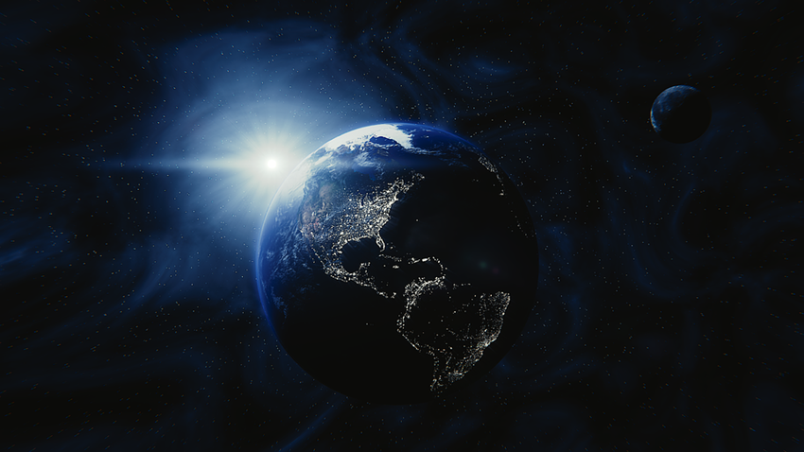
Challenge in primary science lessons…
Year 6 – Light
How far is the Earth from the Sun?
The speed of light is 299,792,458 metres per second!
It takes 8 minutes for the Sun’s light to reach the Earth.
How would you work this out? Record it in your books!

Slide 27
Where are there meaningful links?
Year 6 – Light
What are the properties of light?
What type of shape could you make with light beams?
Polygons
How would you position your torches to make the following 2d shapes?
a square, rectangle, a right-angled triangle, an equilateral triangle, an isosceles triangle and a scalene triangle.
Photograph where you put the torches each time.

Slide 28
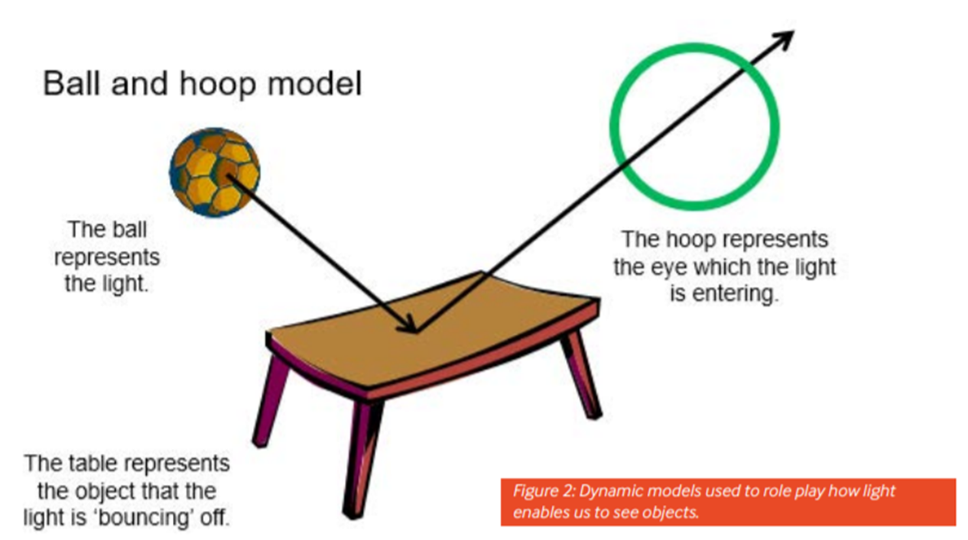
Can you create a model?

Slide 29
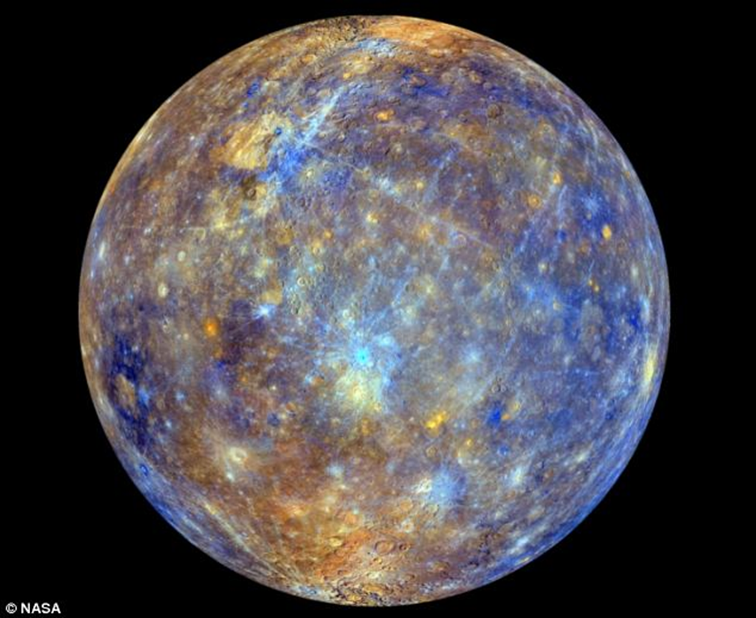
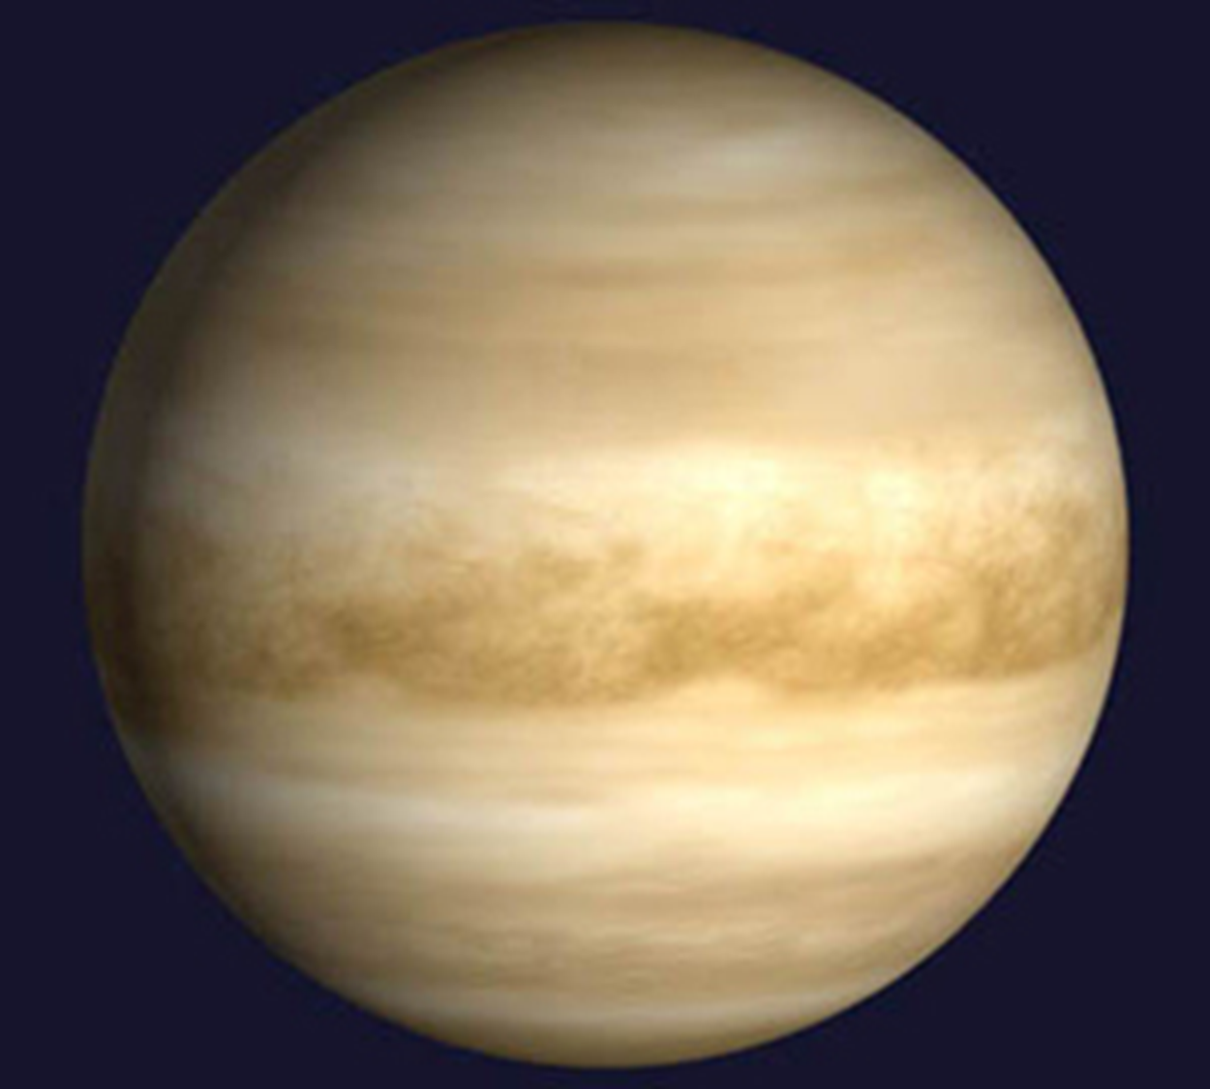
Can you create a model?
Can you create a way of showing how far the different planets are from the Sun?
Solar system in your pocket
Toilet roll solar system
Can you create models to show the relative sizes of the different planets?
Playdough planets

Slide 30
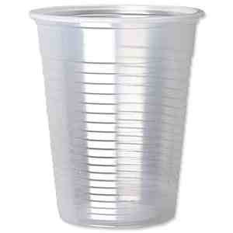
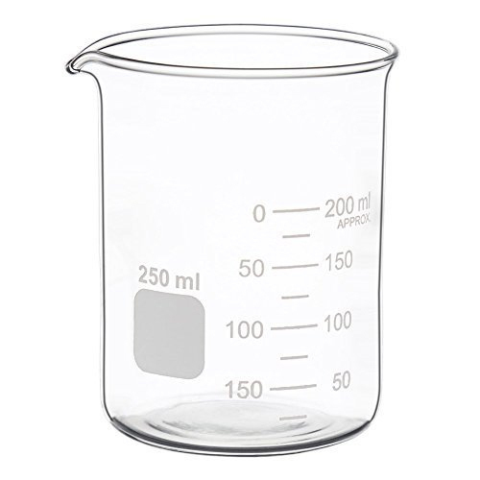
Equipment Challenges
Use the resources on your table to find out how much water you would need to fill the exactly cup half full…
You have 10 minutes…

Slide 31
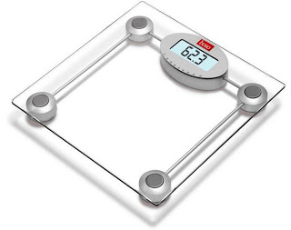
Equipment Challenges
Find something in the room which weighs exactly 500g.
This Photo by Unknown Author is licensed under CC BY

Slide 32
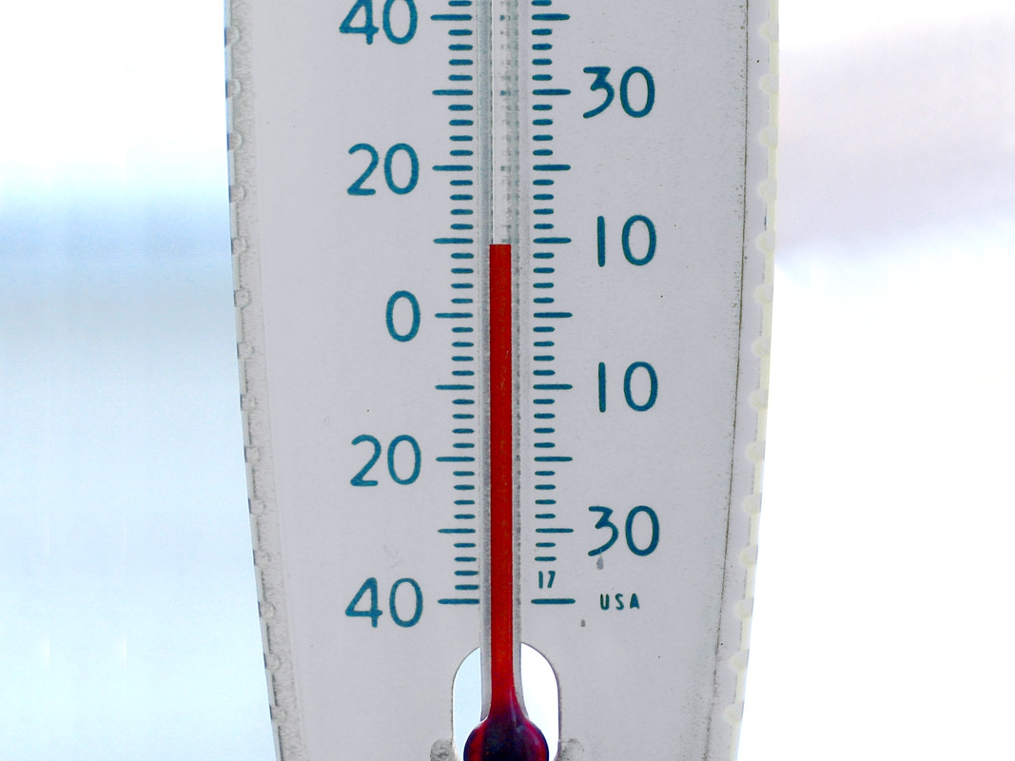
Equipment Challenges
Which liquid is the coldest? Hottest?

Slide 33
How can we use Explorify to introduce challenge?
Problem Solvers
Big questions
What if…
PMI
Bright ideas time
Whole class or group/individual challenge?

Slide 34
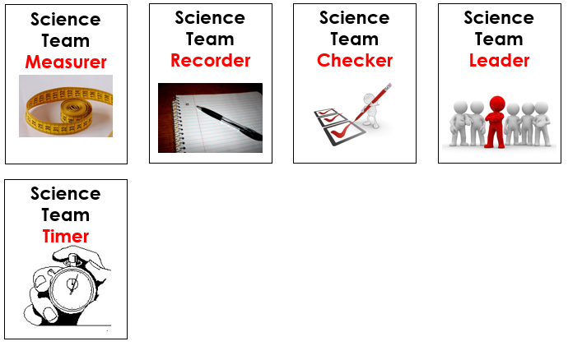
Science Team Roles

