Slide 1
Anxiety and the Adolescent Brain
Ali Damario
Xavier Catholic Education Trust

Slide 2
In this session…
The Adolescent Brain
What is anxiety and when should I be concerned?
Using tools from Cognitive Behaviour Therapy to support young people
The role of perfectionism and procrastination in exam anxiety
The power of Mindfulness in reducing anxiety

Slide 3
What percentage of young people (aged 11-16) are estimated to have a diagnosable mental health issue?
5%
11%
14%

Slide 4
What percentage of young people are estimated to have a diagnosable with a mental health issue?
5%
11%
14%
Notes:
Based on research by NHS Digital 2018. Equal for girls and boys, but boys were more likely to have a behavioural disorder, and girls more likely to have an emotional disorder such as anxiety or depression.

Slide 5
What is the estimated proportion of the population that will experience a mental health issue at some point in their lives?
1/5
1/8
1/3

Slide 6
What is the estimated proportion of the population that will experience a mental health issue at some point in their lives?
1/5
1/8
1/3

Slide 7
What percentage of mental health issues are established before the age of 14?
20%
30%
50%

Slide 8
What percentage of mental health issues are established before the age of 14?
20%
30%
50%
Notes:
And 75% before the age of 25.

Slide 9
What is the average length of time from onset of symptoms of a mental health issue to diagnosis?
2 months
6 months
10 years

Slide 10
What is the average length of time from onset of symptoms of a mental health issue to diagnosis?
2 months
6 months
10 years

Slide 11
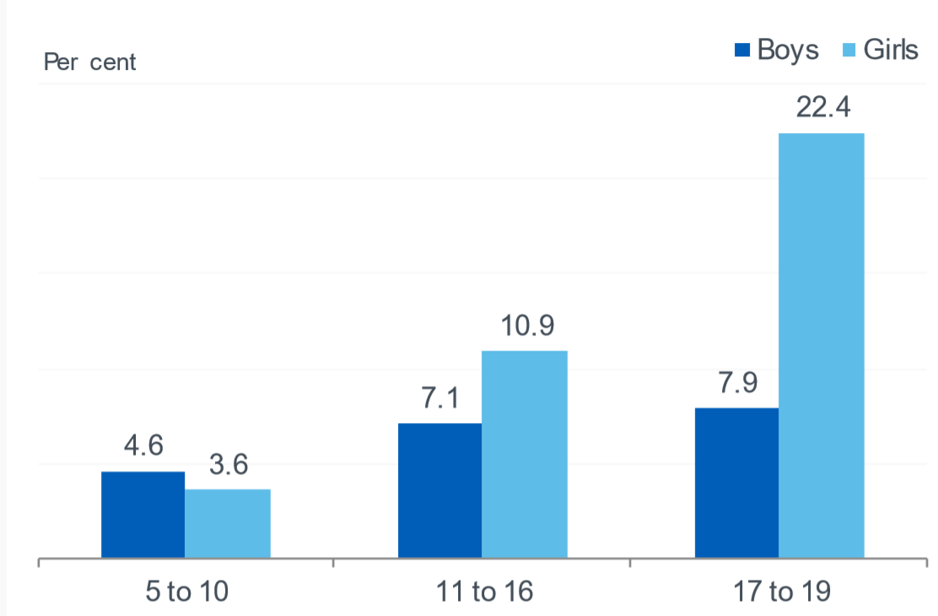
Prevalence of Emotional Disorders

Slide 12
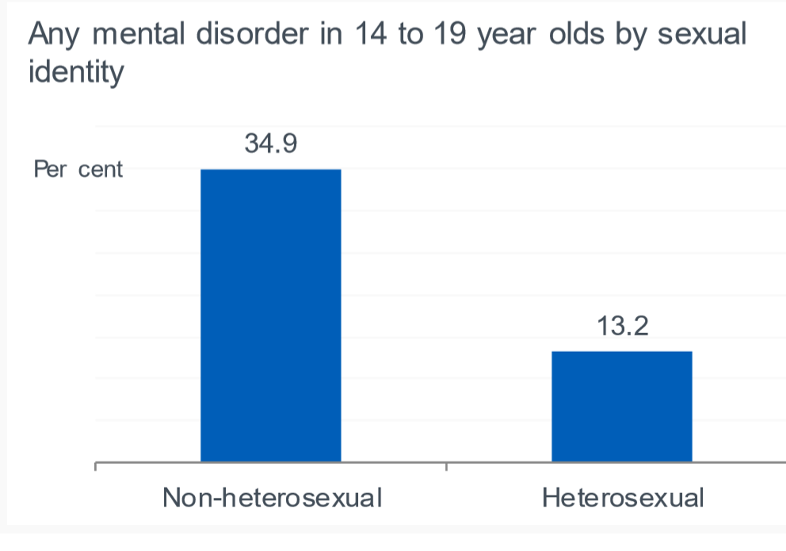
At risk groups…

Slide 13
Emotional disorders over the last 20 years…
Notes:
5-15 year olds for any emotional disorder
Significant increase but perhaps not as much as you might expect given some of the stories in the media

Slide 14
The Adolescent Brain
Notes:
Ask for ideas from audience

Slide 15
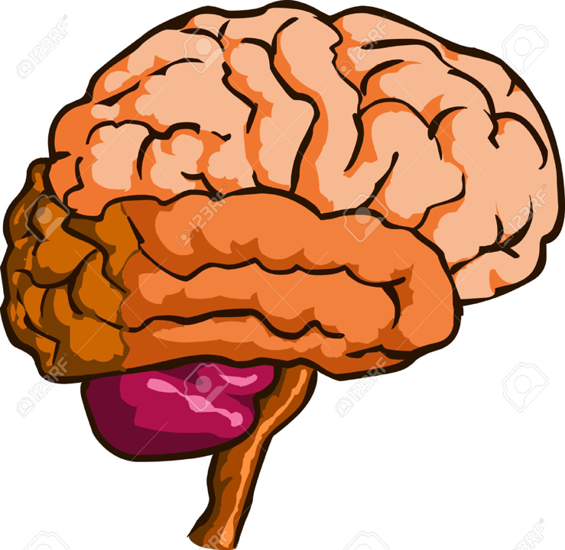
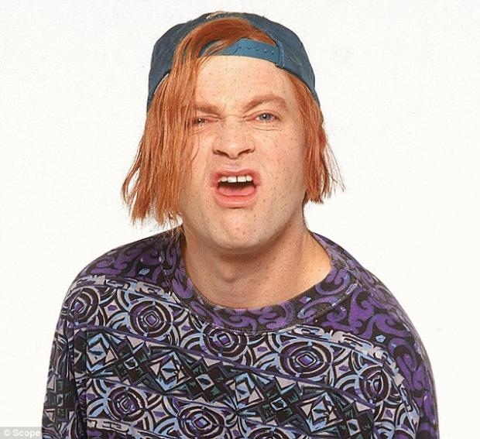
THINKING, REASONING, LOGIC, PLANNING
IMPULSE CONTROL
EMPATHY
EMOTIONS
REFLEXES
Notes:
Limbic system fully developed from birth to allow fight or flight (survival)
PFC not fully developed until the mid-twenties
Means adolescents more likely to take risks, poor impulse control, less able to see from others perspective
Neural pruning- developing at the fastest rate since they were babies (link to how babies go through sleep regressions, lots of crying, etc. before learning new skills)

Slide 16
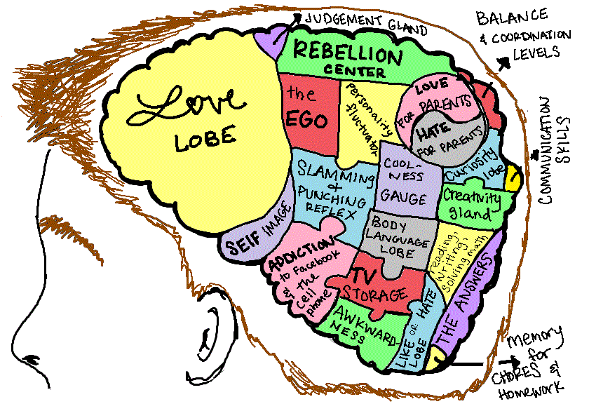
Adolescent Brain Development
Prefrontal cortex not fully developed
Increased dopamine receptors
Drive to be independent from parents
Risky, thrill-seeking, irresponsible behaviour!
Notes:
Pre-frontal cortex which is in change of planning, organising, decision making is not yet fully developed
Teenage brain has increased dopamine receptors compared to an adult brain – reward and pleasure – teenage brain is wired to seek novelty and pleasure
Drive to be independent from parents, but more susceptible to peers due to poor reasoning skills…
Add in the hormones, which make all teenagers grumpy and difficult…

Slide 17
What is Mental Health?
Notes:
Ask for ideas from audience

Slide 18
What is Mental Health?
"Mental health is not just the absence of mental disorder. It is defined as a state of well-being in which every individual realizes his or her own potential, can cope with the normal stresses of life, can work productively and fruitfully, and is able to make a contribution to her or his community.“
-World Health Organisation
Notes:
Tall order for anyone
We cannot be mentally healthy all of the time

Slide 19
Notes:
Focus should be on mental health, not mental illness
Promote well-being
There is a requirement to ensure that children have exercise to support their physical health daily, and yet we do little to support their mental health.
Mental health ‘downs’ need to be normalised and children need to be given strategies to cope

Slide 21
Notes:
We all have mental health animation
5 minutes
9:30-9:35

Slide 22
Everyday Feelings vs. Overwhelming Feelings
Everyday Feelings
Overwhelming Feelings
Come and go
They are a normal reaction to what’s going on in our lives
They are always changing and don’t hang around for too long
Hang around for a long time
Change the way we feel and behave
May stop us from doing the things we want to in life
Known as mental health issues/ illness/ disorders

Slide 23
What is making teenagers feel so anxious?
Notes:
Hands up
9:35-9:40

Slide 24
Anxiety

Slide 25
Notes:
Anxiety is something that is a really common everyday feeling, but sometimes when people have overwhelming feelings of anxiety, that are interfering with their ability to function, it could be classed as an anxiety disorder.
Either way, we are going to talk about anxiety and some ways to cope.

Slide 26
What is Anxiety?
Anxiety is a general feeling of apprehension or worry and is a normal reaction to stressful situations
Anxiety disorders are characterized by excessive feelings of panic, fear, or irrational discomfort in everyday situations
Notes:
AD

Slide 27
What is anxiety?
Notes:
Draw on the body outline
9:40-9:47

Slide 29
THINKING, REASONING, LOGIC, PLANNING
EMOTIONS
REFLEXES
Notes:
Limbic system fully developed from birth to allow fight or flight (survival)
PFC not fully developed until the mid-twenties
Means adolescents more likely to take risks, poor impulse control, less able to see from others perspective

Slide 30
When the anxiety response is helpful…and not…

Slide 31
What is making teenagers feel so anxious?
Notes:
Discussion in groups

Slide 32
Normal anxiety
Age | Normal fear
Birth- 6 months | Loud noises, loss of physical support, rapidly approaching objects
7- 12 months | Strangers, unexpected objects, separation from parents
1- 5 years | Strangers, monsters, the dark, animals, separation from parents, toilets, loud noises
6- 12 years | Supernatural, bodily injury, disease, burglars, failure, criticism, punishment
12- 18 years | Performance in school, loss of peer relationships, appearance
Notes:
Interestingly, leading cause of suicide in young men and women aged between 15-25 is academic pressure.

Slide 33
Common characteristics of Anxiety Disorders…
When children and young people have an anxiety disorder, there are likely to be the following present;
Overestimation of danger
Underestimation of capacity to cope
Notes:
AD

Slide 34
Signs of Anxiety
Physical Symptoms | Behaviour | Emotions | Thoughts
Stomach aches | Avoidance | Worry | ‘I’m going mad!’
Tiredness | Ritualistic/ safety behaviours | Anger | ‘I’m going to faint’
Headaches | Pessimism | Panic | ‘I’m going to have a heart attack’
Feeling sick | Restlessness | Irritability | ‘People will think I’m stupid’
Feeling faint | Difficulties sleeping | Feelings of impending doom | ‘Something terrible is about to happen!’
Weight change | Perfectionism |  | ‘Everyone will laugh at me’
 | Difficulties coping with change
Notes:
AD

Slide 35
When to be concerned…
Adolescence is a time filled with change, and challenge, so stress and anxiety is a normal response. Ask yourself the following;
Is the worry unrealistic and excessive?
Is it impacting upon their ability to function?
Notes:
AD

Slide 36
What can we do to help? CBT
Notes:
9:55

Slide 37
Who is scared of spiders??
Notes:
Who is scared
Who isn’t
Why
Why
What does it tell us about anxiety?

Slide 38
Notes:
Work through example using the spider

Slide 39
Exam Anxiety
‘I’m going to fail’
‘Everyone else is more prepared than me’
‘I’ll forget everything’
‘I’m going to faint in the exam’
‘I don’t have enough time to learn everything’
‘I’m going to let everybody down’

Slide 40
I’m going to fail
Procrastinate
Anxious, sick, full of dread

Slide 41
Common Thinking Errors
Perfectionists
Procrastinators
If it’s not perfect, I won’t be happy with myself
I always have to do my best
Failure is unacceptable (marks less than 90% or thereabouts = failure).
It’s too hard
I’m not in the right mood today
I have lots of time left!
I will feel like doing it later

Slide 42
Thought challenging
What is the evidence for that thought?
What is the evidence against that thought?
What is a more balanced thought?
What would my friend say to me?
What would I say to my friend if they had that thought?
Notes:
Give lists of socratic questions

Slide 43
If I prepare, it’s unlikely I’ll fail
Revise and prepare
Focused, calm, in control
Notes:
Work through example using the spider

Slide 44
Try it out…
In pairs, one person talk about something that has been on your mind this week…
Ask your partner the 5 questions to help them to challenge their thoughts
How did it feel?
Did it help?
Notes:
10:10- 10:20

Slide 45
What can I do?
Not expecting you to be a therapist
Talk to the child to see if you can identify faulty thoughts.
Encourage them to test out their thoughts
Provide self-help CBT materials and direct them to online services and apps
Educate them about anxiety
Normalise -not going mad!
Notes:
AD
Not asking you to do therapy

Slide 46
Looking after our mental health…
Mindfulness (Omvana, Headspace, Calm)
Gratitude/ positive diary
Sleep!
Positive self-talk
Make time for fun
Nutrition and avoid energy drinks!

Slide 47
If you’re worried about a young person…
Inform HoY/ SENCo of your concerns
Could access support in school through Chaplain/ ELSA
If showing signs of moderate/ severe depression or anxiety, refer to CAMHS (SENCo can do this, or through GP)/ Mind Matters
Notes:
SM
Moderate/ severe- having significant impact on their ability to function/ suicidal or hopeless thoughts/ other concerning behaviours

Slide 48
MindEd

Slide 49
Support for young people…
www.youngminds.org.uk
https://kooth.com/
https://www.thecalmzone.net/
NHS Tyne and Wear
Samaritans – 116 123
Mee Too

