Slide 1
Student support & wellbeing
Monday 27th January
”Coming together is a beginning; keeping together is progress; working together is success."
Henry Ford

Slide 2
Agenda
9:00 – 9:20 | Liturgy
9:20 – 10:30 | Anxiety and the Adolescent Brain - Ali Damario
10:30 - 10:45 | Break
10:45 - 12:15 | Quality first teaching for all - Charlie Allison
12:15 - 13:15 | Lunch
13:15 - 15:25 | Department reflection time

Slide 3
Anxiety and the Adolescent Brain
Ali Damario
Xavier Catholic Education Trust

Slide 4
In this session…
The Adolescent Brain
What is anxiety and when should I be concerned?
Using tools from Cognitive Behaviour Therapy to support young people
The role of perfectionism and procrastination in exam anxiety
The power of Mindfulness in reducing anxiety

Slide 5
What percentage of young people (aged 11-16) are estimated to have a diagnosable mental health issue?
5%
11%
14%

Slide 6
What percentage of young people are estimated to have a diagnosable with a mental health issue?
5%
11%
14%
Notes:
Based on research by NHS Digital 2018. Equal for girls and boys, but boys were more likely to have a behavioural disorder, and girls more likely to have an emotional disorder such as anxiety or depression.

Slide 7
What is the estimated proportion of the population that will experience a mental health issue at some point in their lives?
1/5
1/8
1/3

Slide 8
What is the estimated proportion of the population that will experience a mental health issue at some point in their lives?
1/5
1/8
1/3

Slide 9
What percentage of mental health issues are established before the age of 14?
20%
30%
50%

Slide 10
Maximising Impact for SEND Learners
Charlie Allison
Xavier Catholic Education Trust

Slide 11
Each coloured shape stands for a number from 1 - 9 Can you work out which stands for what?

Slide 12
The Solution

Slide 13
Aims
To reflect on what Wave 1 QFT means and how it impacts on SEND learners.
To reflect on how to best use adults in your classroom.
To structure support in lessons which encompasses;
Creating independence
Excellent questioning
Scaffolding Learning
Supporting the most able
Groupings

Slide 14
Every Teacher is a Teacher of SEND
SEND Framework
DfE 2014

Slide 15
Key Highlights of SEND 2014
Every teacher is a teacher of SEND
Modification not differentiation(resources/time)
EHCPs
Focus on Independence Targets and preparation for a mainstream world.
Student voice
Wave provision
Highlighting QFT

Slide 16
QFT for SEND Learners
Grid challenge;
What strategy for which need?
Which ones are your "go to" quick wins?
Which ones do you know are personal weaknesses or ones you do less often?

Slide 17
The DISS Report 2009
(Deployment and Impact of Support Staff)
IofE, University of London.
2003-2009
Named as one of the most influential reports on the impact on Education in the last 40 years.
Measured the impact of LSAs on teachers, teaching and pupils' learning, behaviour and academic progress in everyday classroom settings.

Slide 18
Themes
Little allocated time for feedback or planning with teacher.
Vast majority of support was for poor attaining, low ability or SEND children.
The more support children have from LSA's the less individual attention they receive from the teacher.
LSA focus on task completion rather than learning and understanding.
LSA's often reactive instead of proactive.

Slide 19
And surprisingly.......
"Contrary to commonsense views about LSA support (i.e. more adult support for those who need it most helps them to progress), we found that a negative relationship between the amount of LSA support received and the progress made by pupils in mainstream primary and secondary schools. These results were not attributable to pupil characteristics, such as their prior attainment or SEN status, and nor could we explain them in terms of decisions made by LSAs. Instead, it is the way schools and teachers deploy and prepare LSAs – factors that are out of LSAs’ control – that best explain the surprising results."
- Blatchford.

Slide 20
Approximately how many fewer peer interactions does an EHCP child have?

Slide 21
Approximately how many fewer peer interactions does an EHCP child have?
50%

Slide 22
Approximately how many of an EHCP child's interactions are with an LSA?

Slide 23
Approximately how many of an EHCP child's interactions are with an LSA?
25%

Slide 24
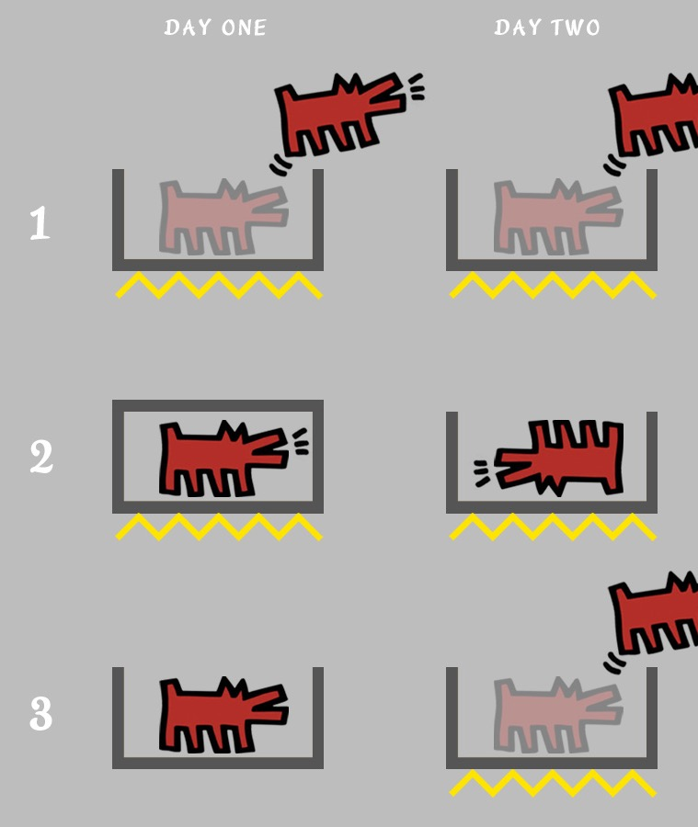
Seligman’s Dogs Experiment.

Slide 25
Learned Helplessness
Level of help increases
Child Completes less
LSA completes more
Child effort decreases
Child attainment decreases

Slide 26
Scaffolding for SEND learners
Recognise the task as a series of learning goals.
Observe the process as each part is completed.
Only intervene if the child cannot overcome their difficulty.
Give specific help or feedback when the child needs it.
Provide the minimal amount of help.

Slide 27
Scaffolding for SEND learners
Greater independence.
Greater resilience.
Develop the idea that failure is an opportunity to learn.
A deeper engagement and love of learning.
Accessing learning via the teacher.
More peer interaction.
Less stigmatisation.

Slide 28
Zone of Proximal Development

Slide 29
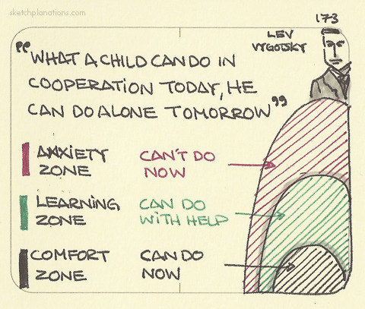

Slide 31
Learning Triads or Quads
Group children together where two are of equal ability, and one is finding the work harder.
Avoid groups with one very able learner.
How do you group to ensure they are learning from those more able, equal peers, teaching less able and from personal research? Is it possible?

Slide 32
Creating Independence
LSA's were found to have three types of conversations with SEND children...
Task completion.
Off task conversation.
Closing down conversation.

Slide 33
Scaffolding…

Slide 34
Process .v. Product Criteria
Break it down into observable steps that start with a verb.
Identify steps in the process that are measurable.
The product is the sandwich, the process is making it in steps. The process criteria being met is more important than the product criteria being met….

Slide 35
Maximising Impact and Learning.
If participation is hampered by language, learning, self-esteem and confidence the student needs a Support Role.
If support is needed in learning from making mistakes or getting things wrong the student needs a Repair Role.
If the child needs to think about learning strategies and organisation in order to progress the student needs an Heuristic Role.

Slide 36
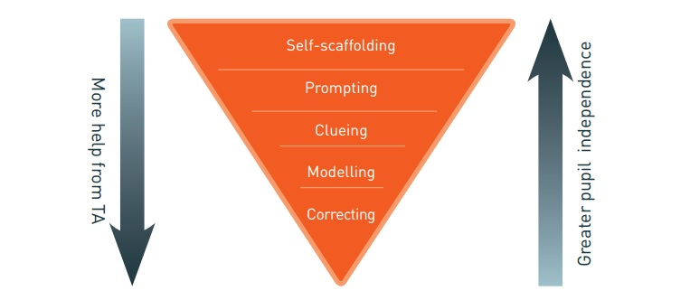
Scaffolding Learning.

Slide 37
Correcting…
Closed questioning.
Giving the child the right answer.
Moving on quickly.
DONT do this!!!!

Slide 38
Modelling…
A new idea or strategy is modelled.
Step by step instructions.
Recap input.
Reading instructions again with inference.
Writing frames or sentence starters.
Used when a child cannot see they have gone wrong.
Commentate whilst working through the problem.

Slide 39
Clueing
Give clues as to what to do next.
Asking W Questions. What, When, Where, Why How.
Giving examples.
What are the first letters?
What do we call that?
Reminders of previous learning

Slide 40
Prompting…
Encouragement to start the task.
Giving and encouraging thinking time.
Do not give away answers or methods but promote thinking through such as ….what method will you use? What will you do first?
Directing towards resources.
Use the words ‘you’ and ‘think’ in the prompting.

Slide 41
Questioning and Self-help
Approaching the task. Have you read the information? Have you got what you need? How might you start? What’s your first step?....
How to solve a problem. Have you done this before? What have others done? What did the teacher say? Where can you find out?...
Evaluate. Are you able to do it? Have you been successful? What has worked? Is it right? Does it need correcting?...
Can you develop another example or question for someone else to solve?

Slide 42
Self-scaffolding…
Independent learners who need no adult assistance.
Know how to learn well.
Problem solve freely.
Give counter arguments.
Can review validity of counter arguments.
Can evaluate the task.

Slide 43
Pre-teach, Post-teach
Opportunities
Homework
Using mastery sequence, increase input modelling and clueing.

Slide 44
Scaffolding Learning.

Slide 45
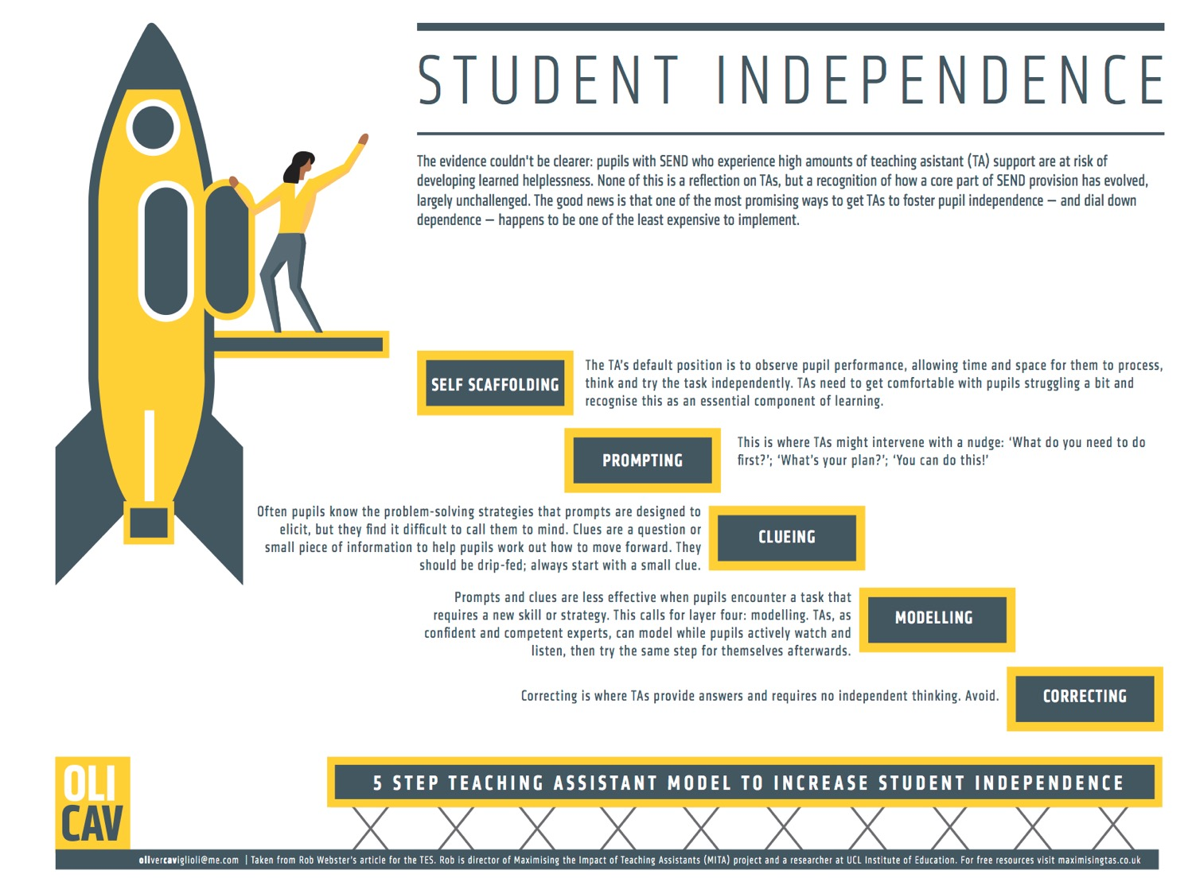

Slide 46
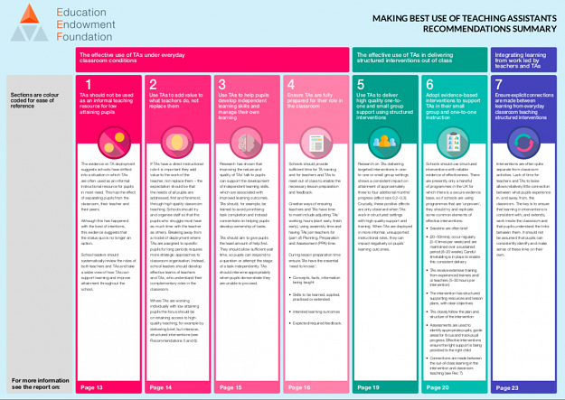

Slide 47
Summary...
Consider deployment for student benefit.
Make time for planning and empowering LSA's.
Combine pre-teaching, post-teaching methods, with stretch and challenge...be creative.
Communicate on process criteria.
Push into ZPD.
Reduce "Learned Helplessness" and identify when it is taking place.
Refer to scaffolding terminology and embed in your practice and direction of LSA's.
Remove the chairs.
Employ M,C,P,S feedback codes.
Give time; for answers, for tests, for processing.
Reasonable adjustments.
Modify.
Empower!

