Slide 1
Supporting ADHD Learners
Charlie Allison
SEND Lead

Slide 2
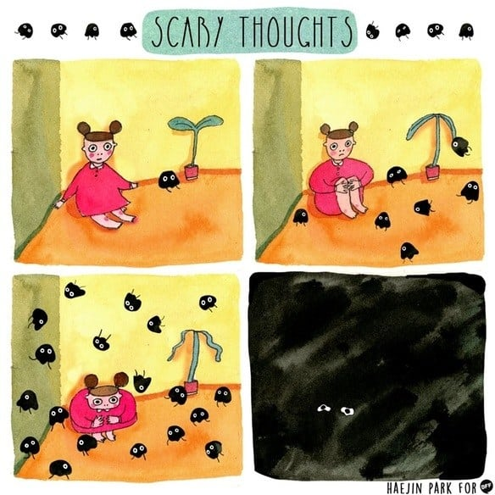
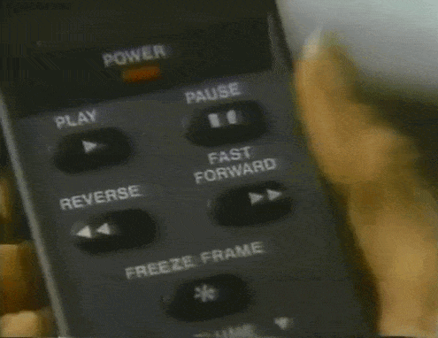
ADHD

Slide 3
https://attentionuk.org/frequently-asked-questions/does-adhd-make-people-bad/

Slide 4
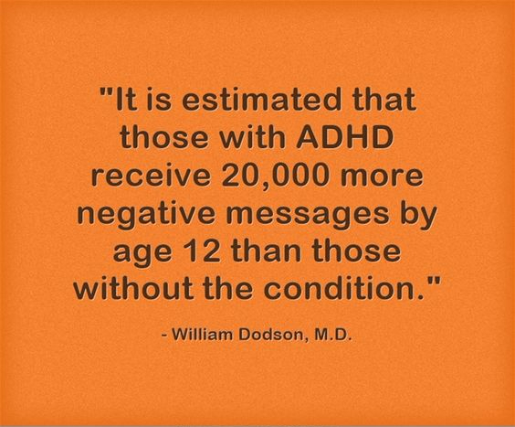

Slide 5
attentionuk

Slide 6
Examples
Q. Restaurant
Q. Rugby World Cup

Slide 7
ADHD looks like........
Impulsive Behaviour.
Over-explaining all their ideas so seems inarticulate.
Thinking and problem solving but getting bogged down in other thoughts which leads to.....
Unproductivity in written work.
Forgetting instructions
Poor self esteem
Struggling with tasks if they aren't stimulating enough and then not doing the work.
Anxiety about the work, doing, starting or finishing.
Disengagement or poor behaviour choices due to overload.
Notes:
http://maximisingtas.co.uk/assets/content/mptascaffoldingcard.pdf

Slide 8
ADHD children can excel at.....
Being problem solvers
Being warm and generous
Having a great sense of humour
Being determined
Entrepreneurial Skills
Creative Thinking
Originality

Slide 9
Behaviour
B = f(P + E)

Slide 10
What works in class?
Short chunked work.
Short instructions.
Visual instructions.
Patience
Kindness
Confidence building.
Valuing their opinions and ideas.
Celebrating their uniqueness and creativity.
Embracing that in their learning.
Recognising their skills.
Slowing down.
Reducing stimulation or environmental factors.
Short amount of work pitched exactly at the right challenge level.
Open ended challenges
Allowing them to choose from options.
Repeating everything.
Personal checklist
Rest breaks and movement breaks
Realisitic expectations for sitting!

Slide 11
What works in class?
Short chunked work.
Short instructions.
Visual instructions.
Patience
Kindness
Confidence building.
Valuing their opinions and ideas.
Celebrating their uniqueness and creativity.
Embracing that in their learning.
Recognising their skills.
Slowing down.
Reducing stimulation or environmental factors.
Short amount of work pitched exactly at the right challenge level.
Open ended challenges
Allowing them to choose from options.
Repeating everything.
Personal checklist
Rest breaks and movement breaks
Realisitic expectations for sitting!

Slide 12
SEND – Things to Consider
Mandy Hughes

Slide 13
Things to Consider…
Monitoring Skills for Learning
It may be appropriate for some SEN students to get a C

Slide 14
Things to Consider…
Reasonable adjustments
Some SEN students get a 3 for Behaviour
How can they be supported to get a 2?

Slide 15
Things to Consider…
Mastery Grids
There are a very small number of students who are performing below the emerging criteria

Slide 16
Things to Consider…
Why?
The SEN team are duty bound to report progress to the LEA that is accurate and reflects ability
We have students here who are on the border line of mainstream education and an accurate picture supports us in ensuring correct provision

