Slide 1
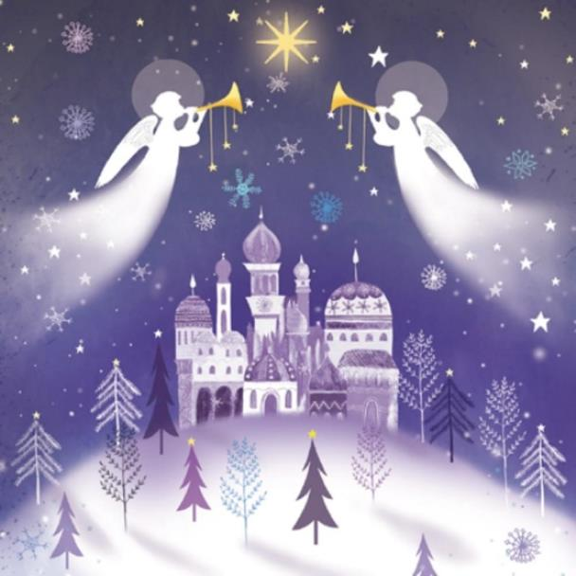
Why do you think we see so many angels at Christmas time?
Can you name the times when angels appear in the Christmas story?

Slide 2
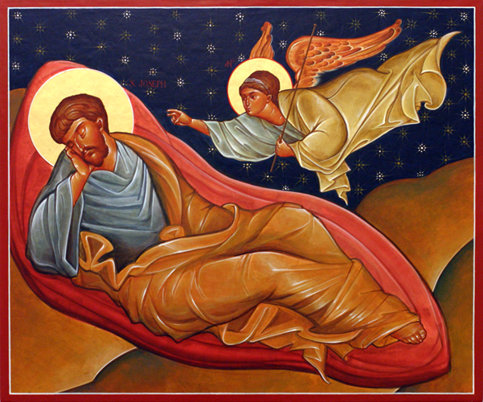
Gospel – Matthew 1:18-25 – The angel appears to Joseph in a dream

