Slide 1
PowerPoint 1 Anne Frank Day Assembly

Slide 2
“Although I'm only fourteen,
I know quite well what I want,
I know who is right and who is wrong. I have my opinions,
my own ideas and principles,
and although it may sound pretty mad from an adolescent,
I feel more of a person than a child,
I feel quite independent of anyone.”

Slide 3
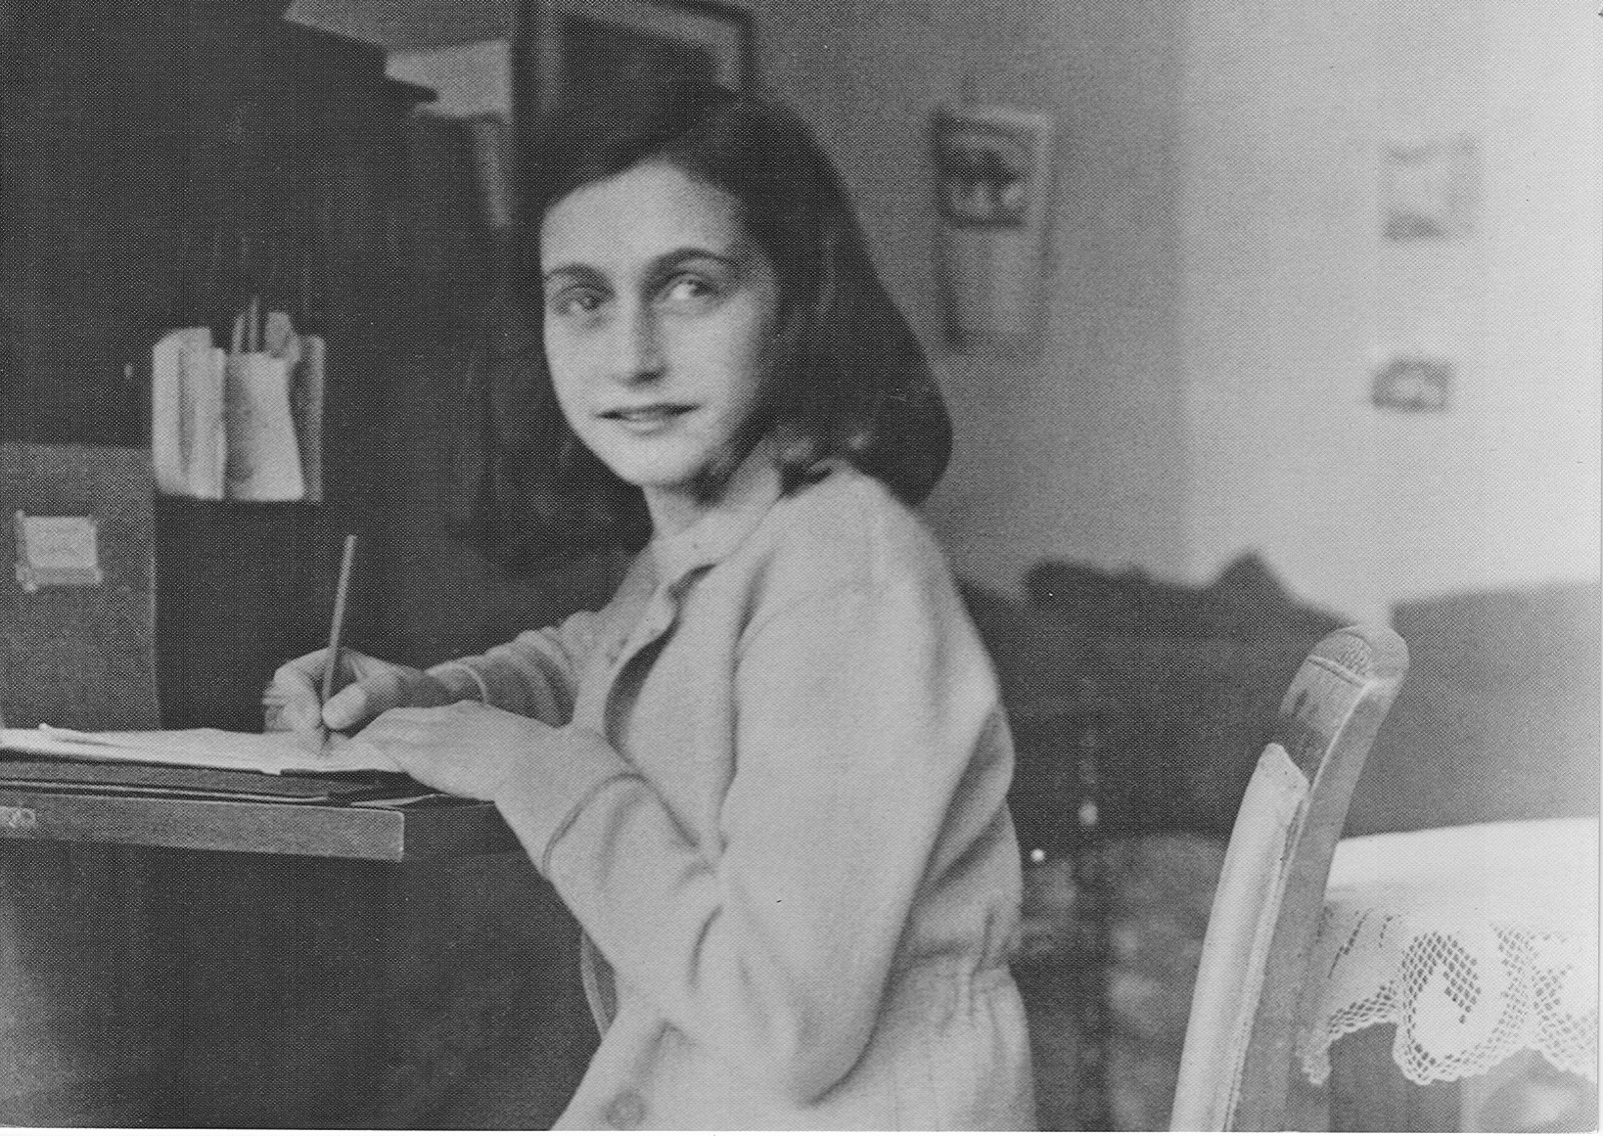
©Anne Frank Fonds, Basel, Switzerland

Slide 4
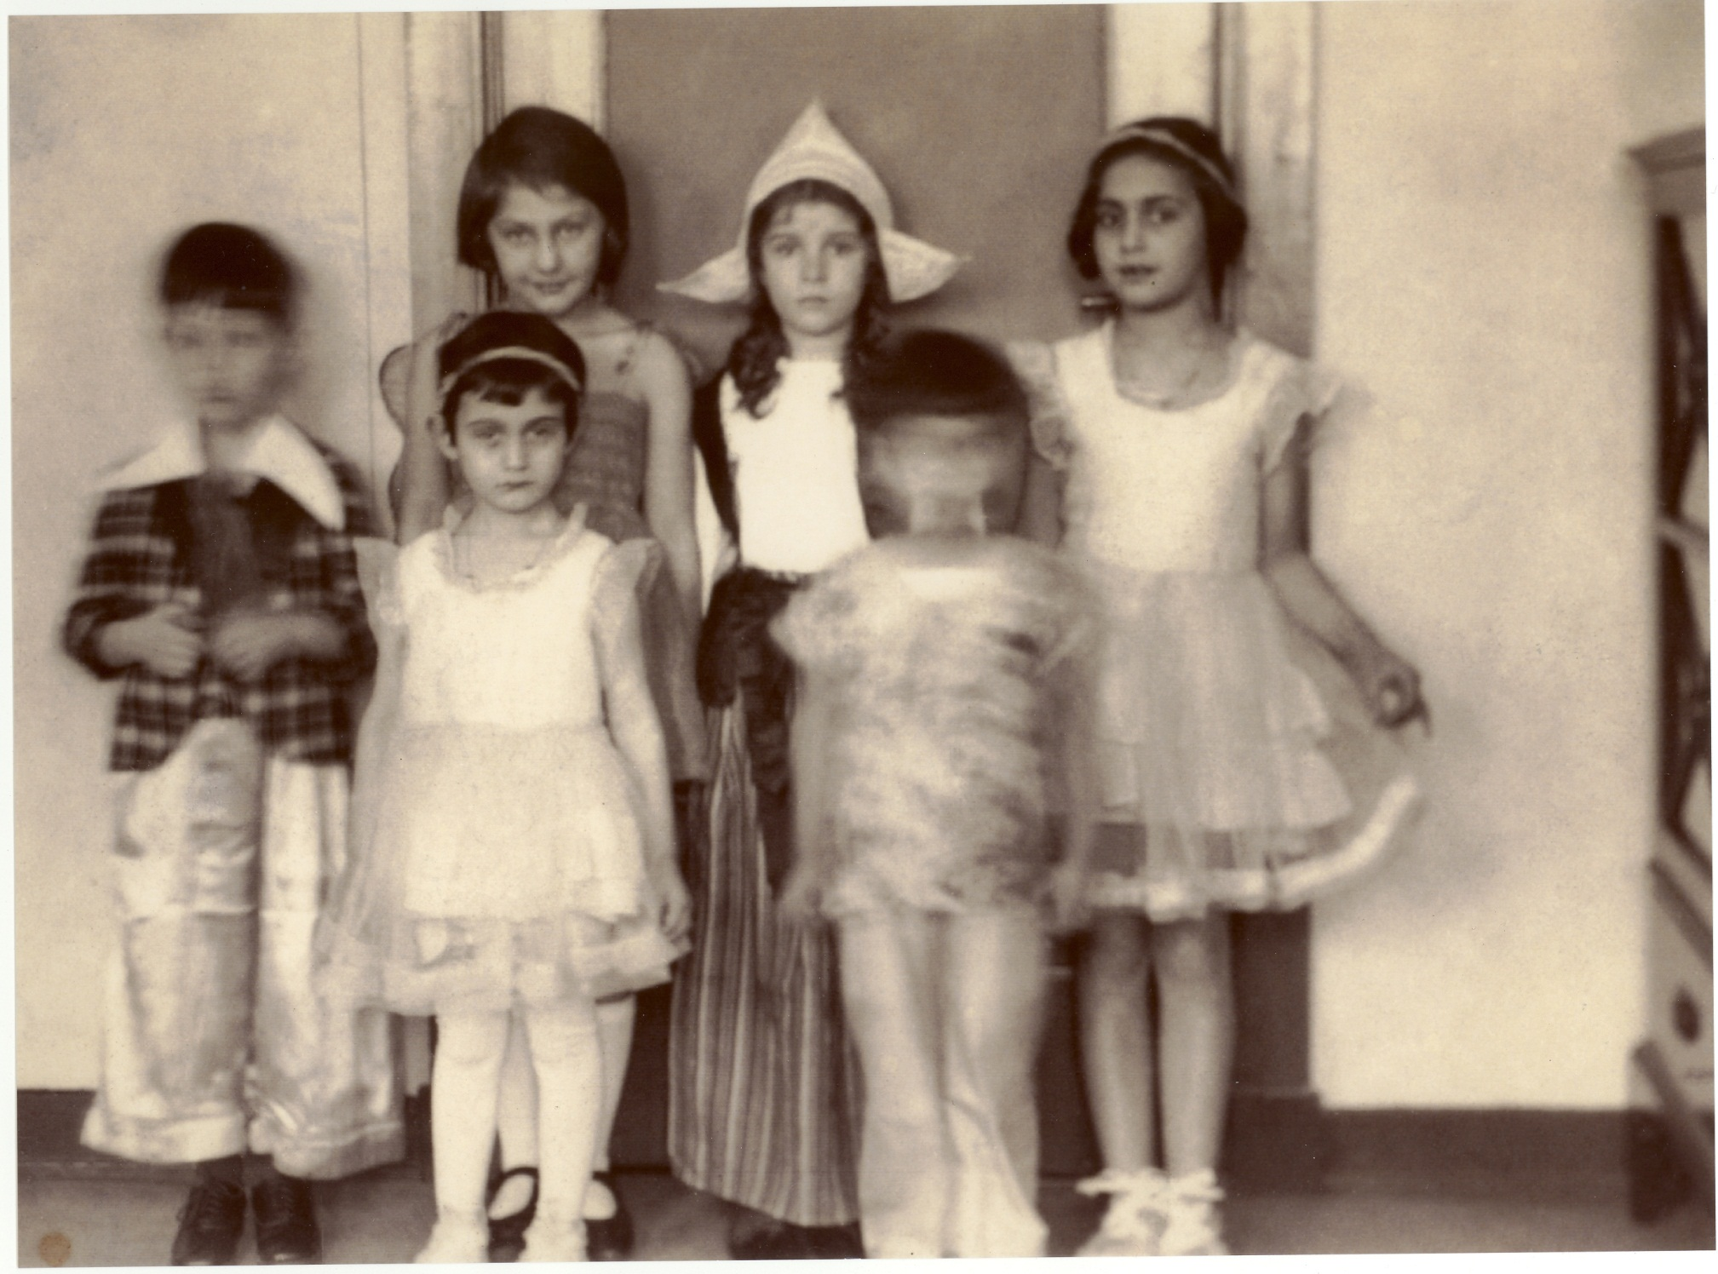
Anne Frank was born on
June 12th 1929.
She would have been
87
this week.
©Anne Frank Fonds, Basel, Switzerland
Notes:
Anneliese Marie Frank was born on 12th June 1929 in Frankfurt am Main in Germany. She was the second daughter of Otto and Edith Frank. Their first child was called Margot. Otto Frank was a business man who had been a soldier in the German army in the first world war. They led a comfortable life.
However, after the First World War, Germany had become very poor and many people were unemployed. Some chose to support a political party called the National Socialist Party, or Nazi Party, led by Adolf Hitler. Hitler and the other Nazi leaders wanted to restore German to being a strong country. They also hated the Jews and made people believe that they had helped make the country poor.
Many people thought that this troubling time would pass and that things would return to normal, but Otto Frank decided to move his family to safety in Amsterdam in Holland. This picture of was taken soon after they moved. Anne is at the front on the left. Margot at the back on the right.
Things weren’t easy for the family. They had to learn a new languge and the girls had to make new friends. But they soon started to get used their new life.
Image: Anne and Margot Frank at a birthday party

Slide 5
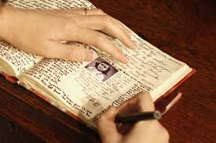
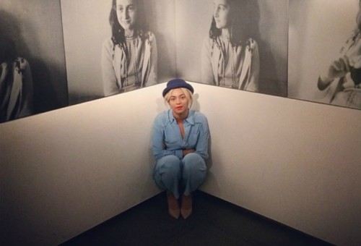
On her 13th birthday Anne Frank was given a diary in which she recorded her thoughts and feelings before and whilst in hiding.

Slide 6
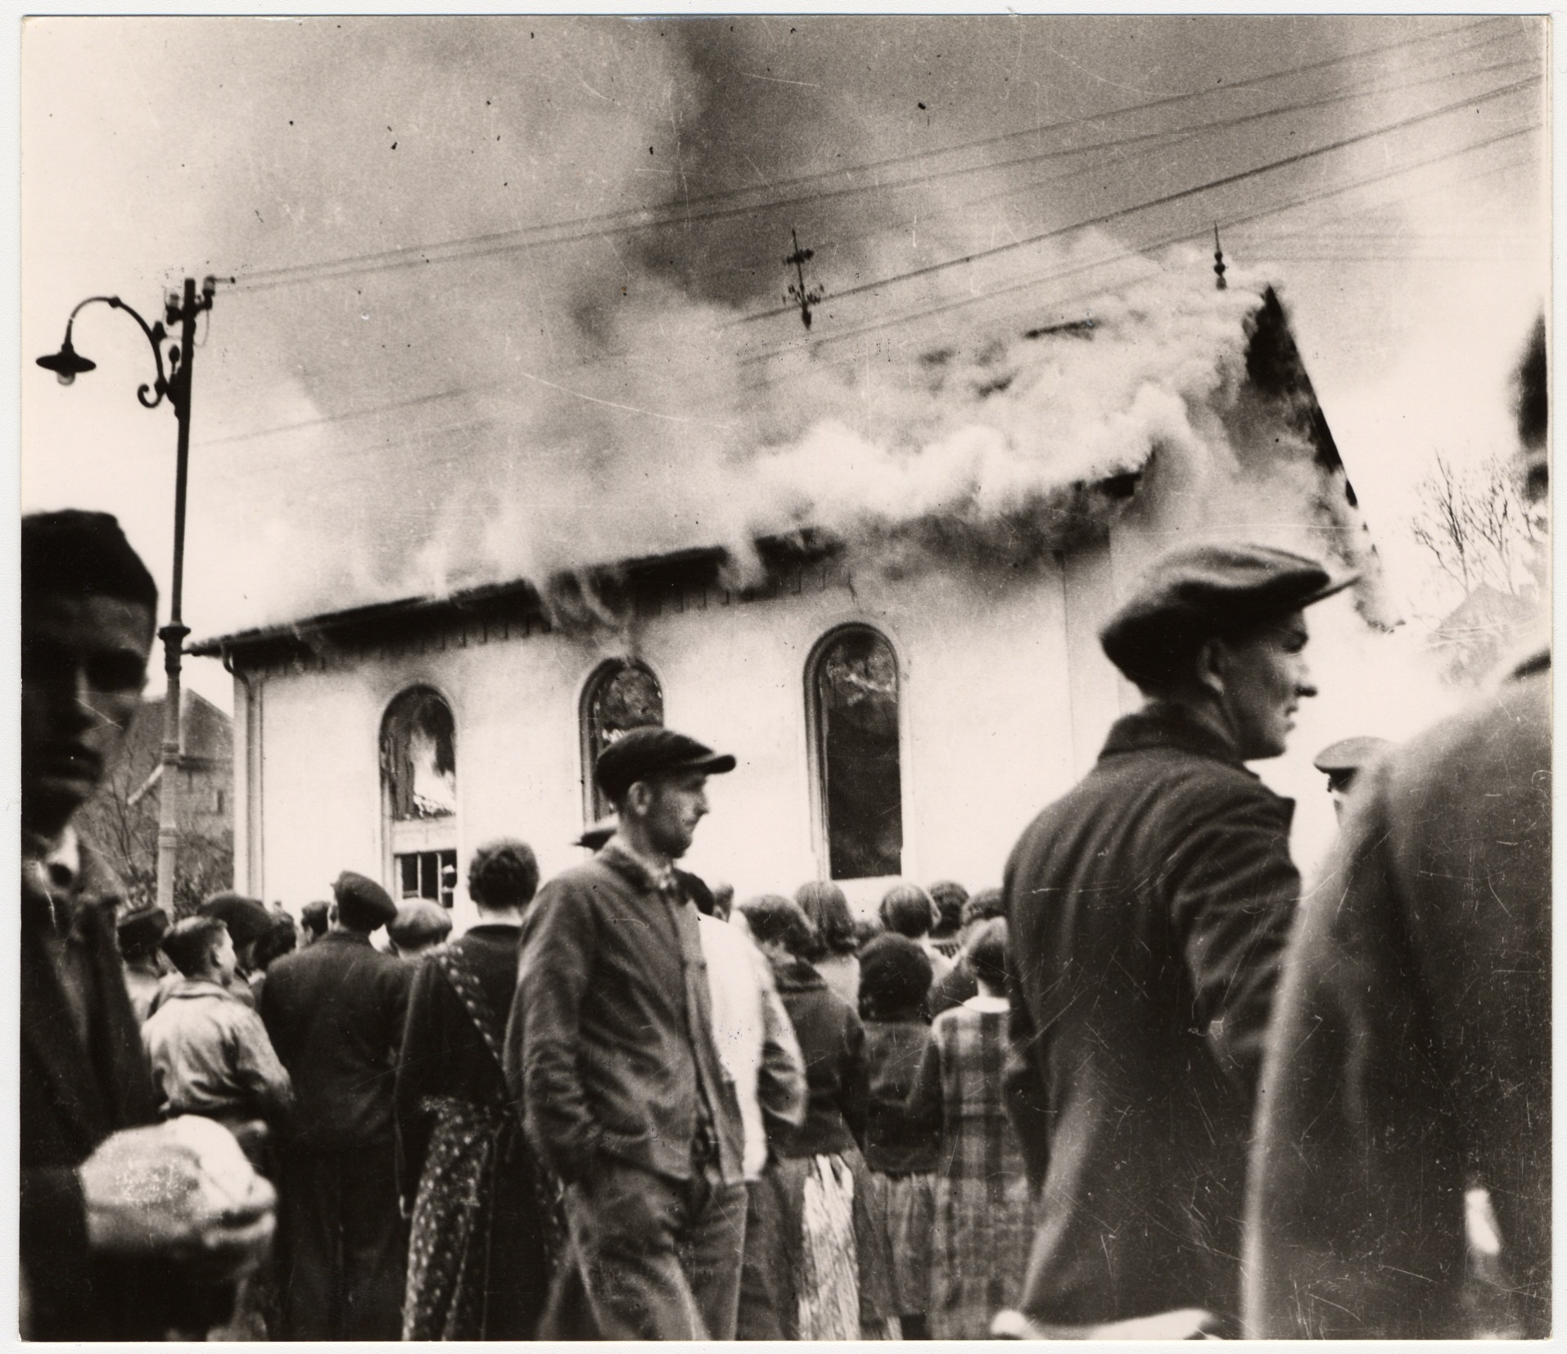
KRISTALLNACHT IMAGE
“We’ve been strongly reminded of the fact that we’re Jews in chains, chained to one spot, without any rights, but with a thousand obligations”
Notes:
In Germany and Austria – which in 1938 was occupied by Germany - things were much harder for Jewish people. Laws were passed that stopped them owning businesses, from marrying people who weren’t Jews, even from riding on trams and going to the cinema or park.
Then in autumn 1938, things became worse still. On 9th November, thousands of Jewish people were arrested and taken to concentration camps and the Nazis organised a wave of violence against Jewish people, their shops, their synagogues and their homes. This night was later called Kristallnacht, or the ‘night of the broken glass’.
By now, it was almost impossible to leave Germany for Britain or America, but some people still managed to send their children to safety abroad. Britain agreed to take hundreds of children on what were called the Kindertransport – Child Transports. Most of these children never saw their parents again.
Image: A burning synagogue on Kristallnacht

Slide 7
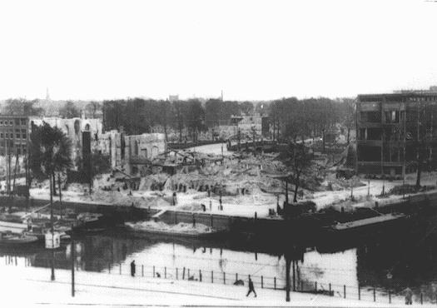
“We must put our feelings aside; we must be brave and strong, bear discomfort with- out complaint, do whatever is in our power and trust in God. One day this terrible war will be over. The time will come when we’ll be people again and not just Jews!”
INVASION OF HOLLAND IMAGE
Notes:
In September 1939, Germany declared war on neighbouring Poland. Britain and France were allies with Poland and the Second World War began. The German army quickly defeated Poland and other eastern European countries and then occupied, Holland, Belgium and finally France.
Life for Anne and her family was no longer safe. Anne’s parents tried to reassure the children and to keep things normal and on 12th June 1942, Anne had a birthday party where they played films and she was given a special new diary that she had seen in a shop nearby. She started writing in it straight away.
‘I hope I will be able to confide everything to you, as I have never been able to confide in anyone, and I hope you be a grate source of comfort and support’
But what had happened to Jews in German had started to happen to Jews in Holland. Anne Frank wrote about this in her Diary:
‘Our freedom was severely restricted by a series of anti-Jewish decrees: Jews were required to wear a yellow star; Jews were required to turn in their bicycles; Jews were forbidden to use trams; Jews were forbidden to ride in cars, even their own; Jews were forbidden to go to theatres, cinemas or any other forms of entertainment; Jews were forbidden to use swimming pools, tennis courts, hockey fields or any other to sit in their gardens or those of their friends after 8.00 p.m.’
But things were to get even worse. Not long after Anne’s birthday, a letter arrived addressed to Margot who had just turned 16. It demanded that she report for transport to a labour camp far away in eastern Europe. All young Jewish people received an identical letter, and many did report as requested, perhaps thinking that by going along with what the authorities wanted, things would not be as bad as some of the rumours were saying. But Otto Frank had been preparing for this moment and he immediately rushed his family across the City into a secret hiding place behind his offices on a street called Prinsengracht.
Image: Rotterdam after bombing by the German airforce in 1949

Slide 8
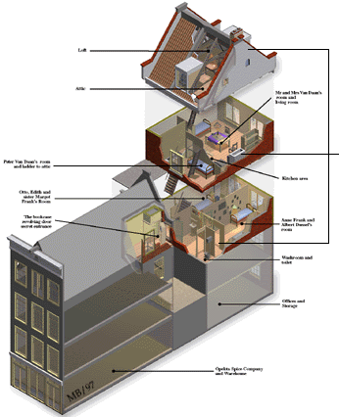
“Bep and Miep went shopping with our ration coupons, Father worked on our black-out screens, we scrubbed the kitchen floor, and were once again busy from morning to night. Until Wednesday, I didn’t have a chance to think about the enormous change in my life.
Then for the first time since our arrival in the Secret Annexe, I found a moment to tell you all about it and to realize what had happened to me and what was yet to happen”
Notes:
“The Annex is an ideal place to hide in. It may be damp and lopsided, but there's probably not a more comfortable hiding place in all of Amsterdam. No, in all of Holland.” Anne Frank
The hiding place is relatively spacious. The Frank family lives in two rooms on the first floor and they are soon joined by another family, the Van Pels’s who live in two other rooms on the second floor. The space used by Hermann and Auguste van Pels also serves as the common living and dining room. The people in hiding can reach the attic via Peter Van Pels’s tiny bedroom. Supplies are stored in the attic.
In November 1942, an eighth person joins the people in hiding: Fritz Pfeffer. He is a dentist and a friend of both the Franks and the Van Pels family. Margot begins sleeping in her parent’s room and Anne has to share the room next door with Fritz Pfeffer.
The people in hiding have to stay indoors around the clock. They must also be extremely quiet during the day when people are at work in the warehouse downstairs. Because the waste pipes for the toilet run right through the warehouse, the toilet is flushed as little as possible.
Everything the families need; food, clothes, books and magazines for the children, is brought to the annexe by one of four helpers who were people who Otto Frank worked with. They put their own lives at very great risk by helping the family throughout their time in hiding.
The atmosphere is oppressive and uncomfortable and Anne seeks privacy in the attic, where she is often joined by Peter Van Pels who she starts to develop strong feelings for. Anne dreams of freedom, peace and the future she hopes to one day have when the war is over– maybe as a famous writer or journalist.
Image: The Anne Frank House

Slide 9
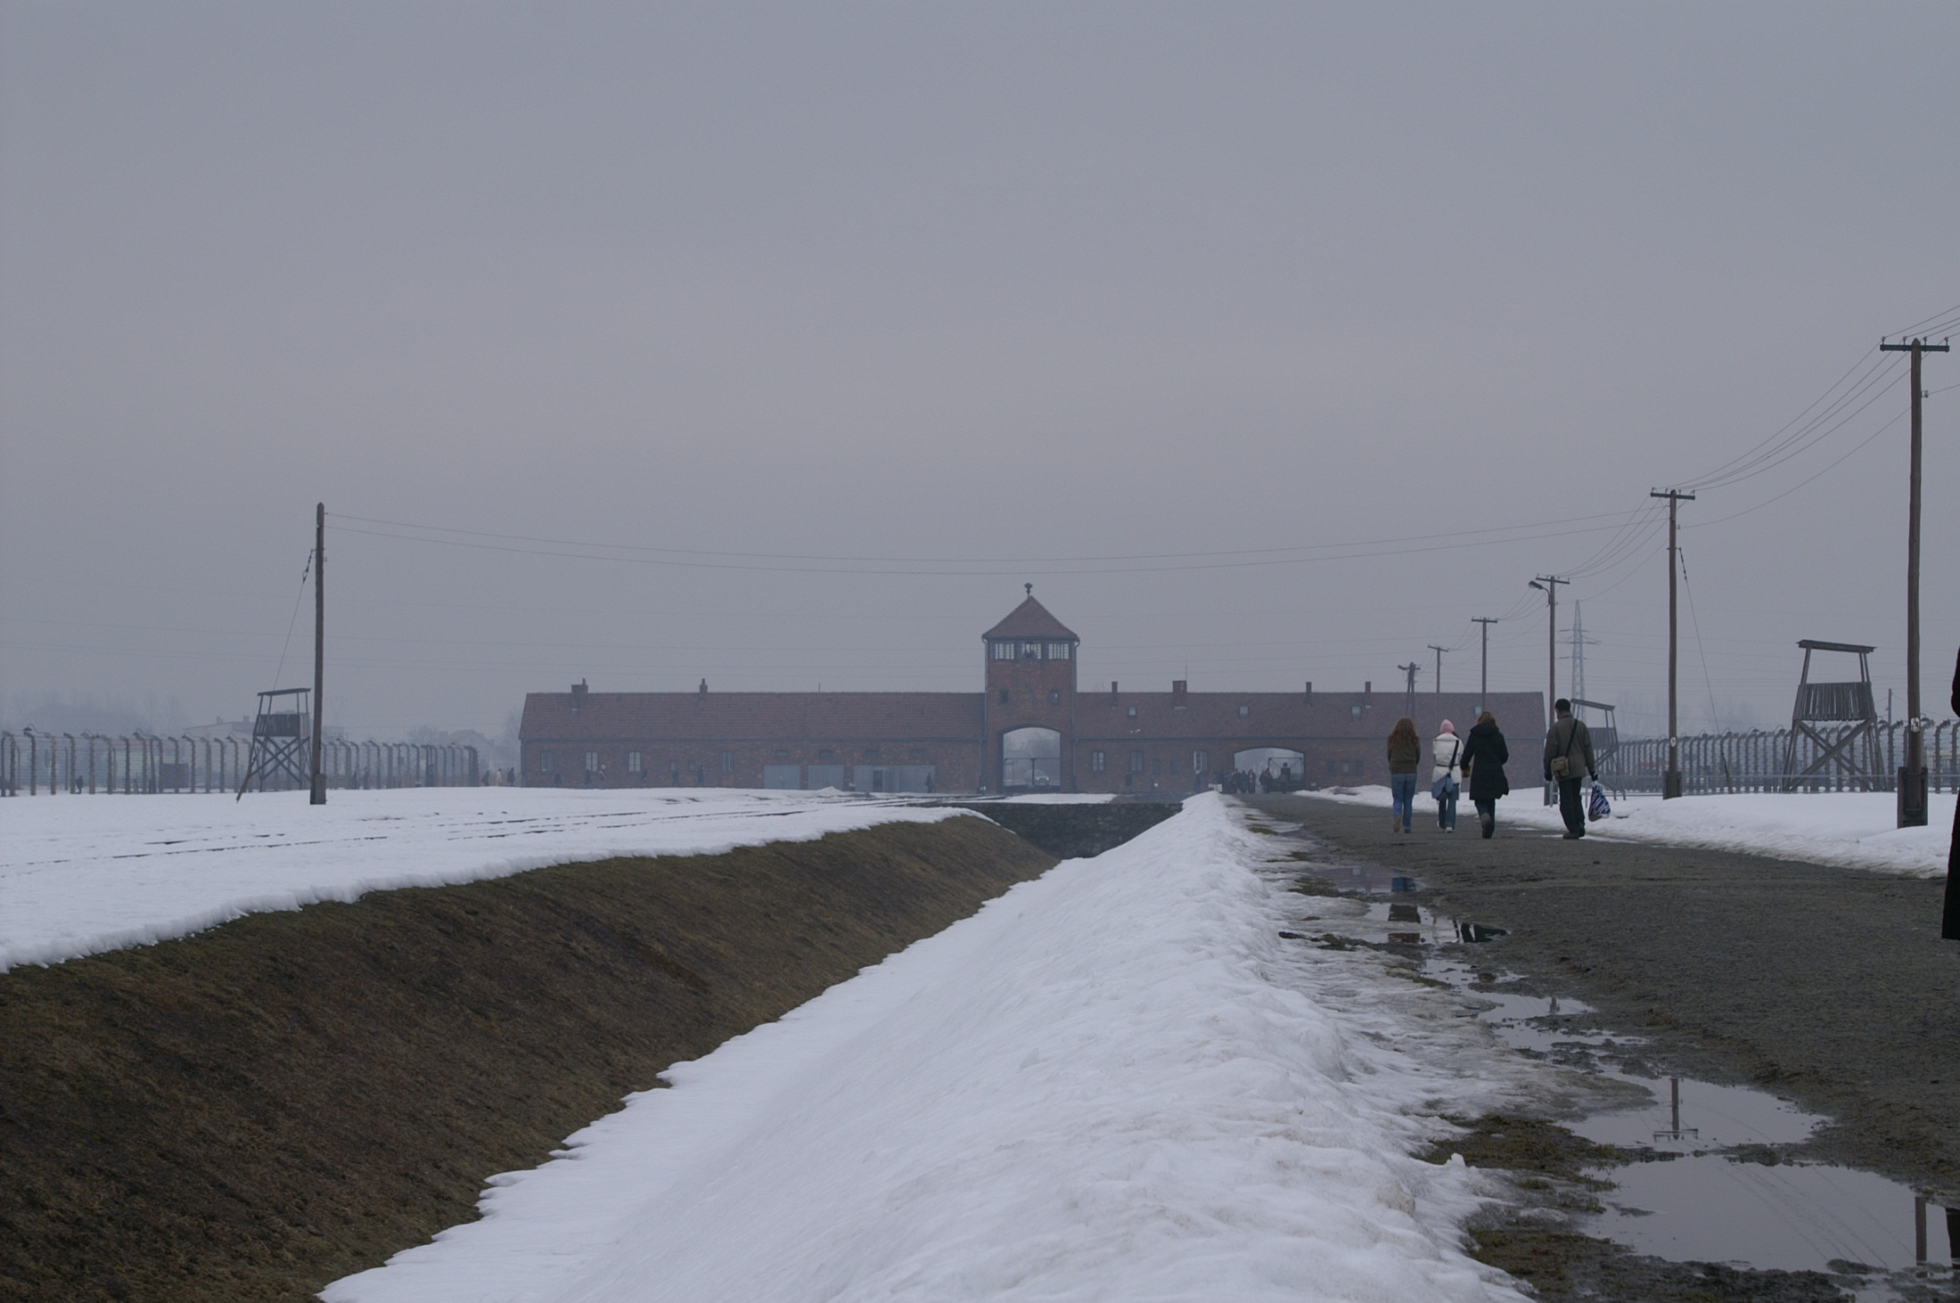
“No one is spared. The sick, the elderly, children, babies and pregnant women – all are marched to their death. And all because they’re Jews”
Notes:
On 4th August 1944, the bookcase was pushed aside and police officers stormed into the annexe, arresting all of the inhabitants.
They were taken to prison in Amsterdam before being transported to a transit camp in Holland. The Frank family were then taken train to Auschwitz concentration camp in Poland. The journey lasted 3 whole days and nights of appalling discomfort with hundreds of people crammed together without food or water in trucks meant for cattle not people. Many died before reaching Poland.
On arrival at Auschwitz on 8th September 1944, Anne was faced with a scene of terror. This was a place where many millions of people were killed either in gas chambers, or through brutality, disease and starvation. She was separated immediately from her father and then from her mother when she and Margot were transported away from Auschwitz to Bergen Belsen, another concentration camp in Germany. Anne’s mother died at Auschwitz in January 1945, Margot Frank died at Bergen Belsen in March 1945 a few days before her sister. The war ended not long afterwards, by which time, all of people in hiding had died except for Otto Frank who survived and returned to Holland.
In the Holocaust, over 6 million Jewish people died along with countless gypsies, disabled people, communists, homosexuals, jehovahs witnesses and others who the Nazis regarded as untermenschen or sub-human.
Image: Auschwitz-Birkenau Concentration Camp, Poland

Slide 10
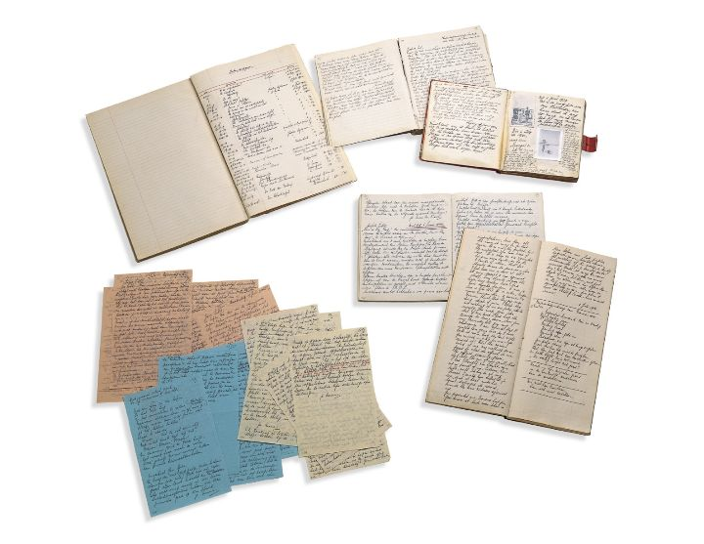
Following Anne's death in Bergen-Belsen in 1945, her father, Otto Frank, chose to publish her diary in order to help challenge the hatred that had killed his daughters.
Her diary has since sold more than 30 million copies worldwide and has been translated into 67 languages.

Slide 11
What is life like for young people in the UK today?

Slide 12
The Anne Frank Trust is on a mission to create
The world’s biggest digital diary
Anne Frank was the author of one of the most widely read diaries in the world
Her voice has spanned decades. Now its your turn to have your say!

