Slide 1
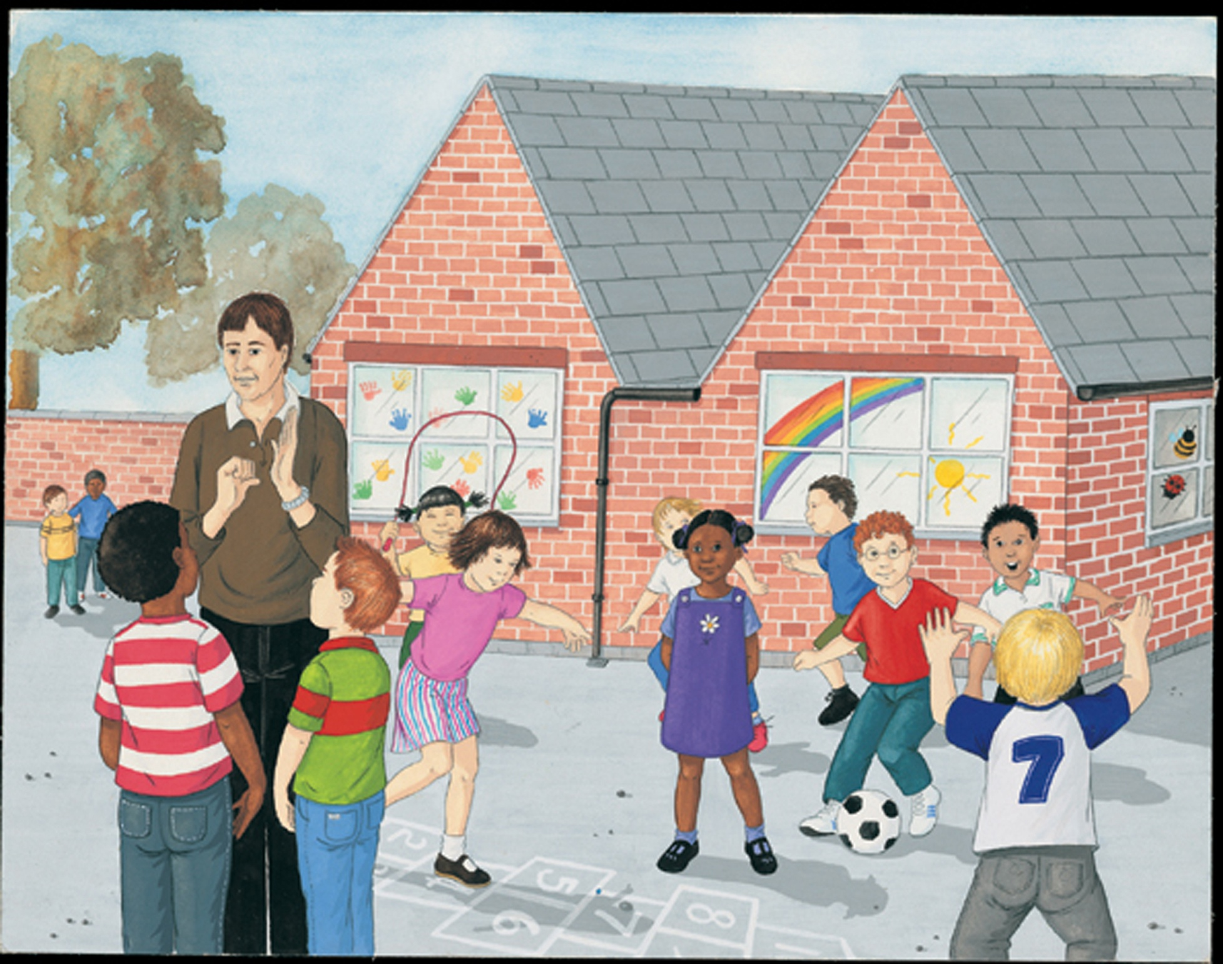
Belonging

Slide 2
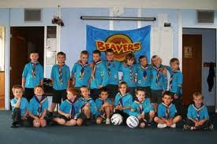
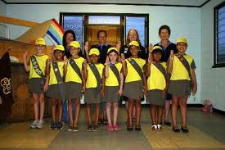
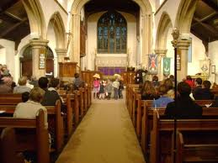
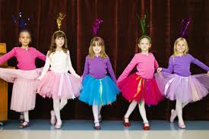
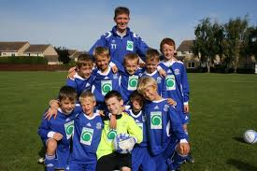
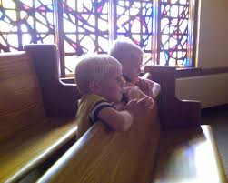
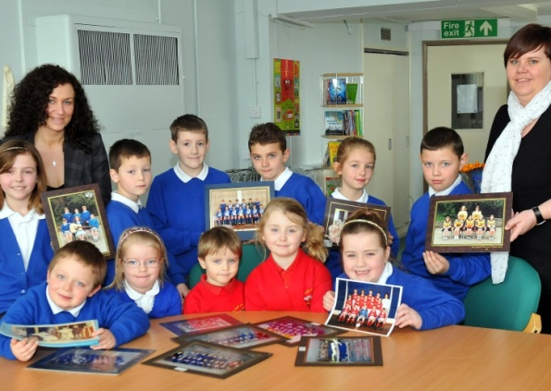
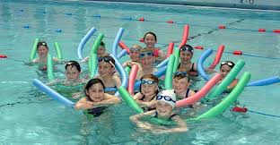
We belong to different groups

Slide 3
What groups or clubs do you belong to?
All children here belong to St Charles Borromeo Catholic Primary School.

Slide 4
How does it feel to belong to the group?
What do you do in the group that you are in?
What helps people feel like they belong?

Slide 5
How would someone know that you belonged to the group?

Slide 6
How could we help a new child in our school feel like they belong?

Slide 7
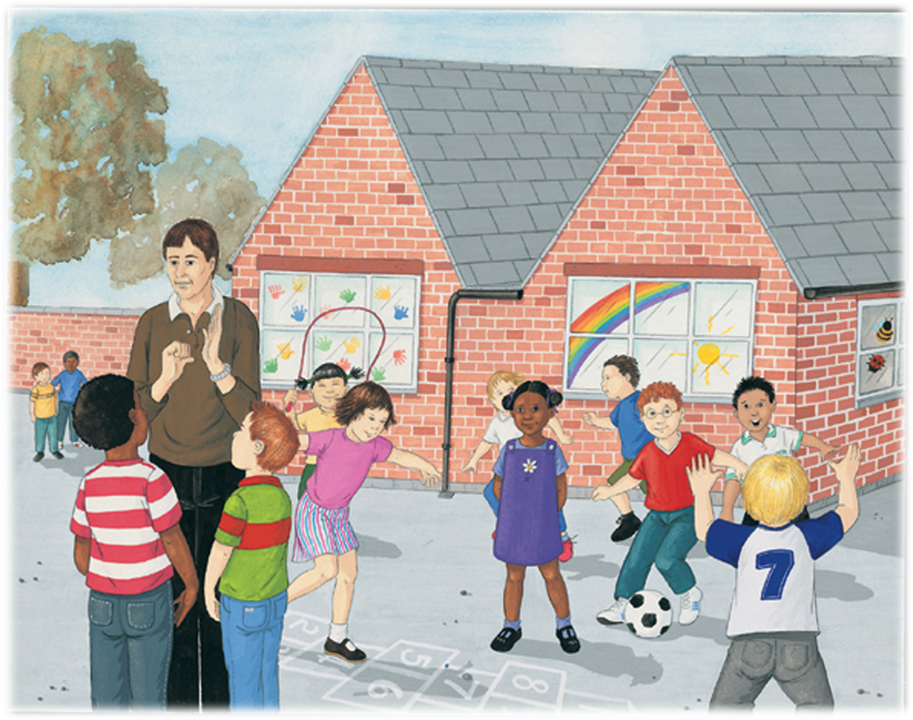
Look at this picture… Can you spot the different ways of belonging?
The teacher signing
The classroom with everyone’s artwork handprints in the window
Children with their arms round each other
A team playing together
A pair of girls playing hopscotch together

Slide 8
Another special group we belong to is our family.

Slide 9
13 Then little children were brought to Jesus for him to place his hands on them and pray for them. But the disciples rebuked those who brought them. 14 Jesus said, "Let the little children come to me, and do not hinder them, for the kingdom of heaven belongs to such as these." 15 When he had placed his hands on them, he went on from there. Matthew 19: 13-15

