Slide 1
Jason Robinson

Slide 2
https://www.youtube.com/watch?v=6DFluKXQfiw

Slide 3
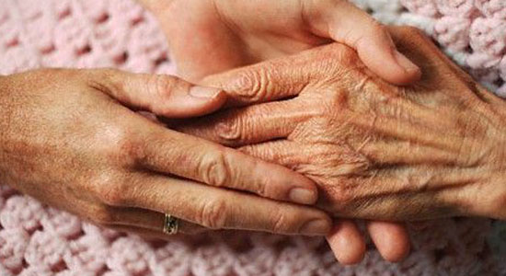
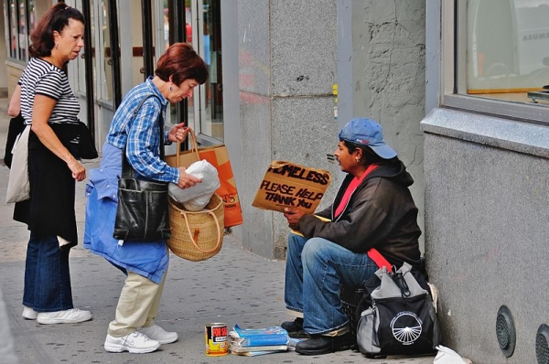
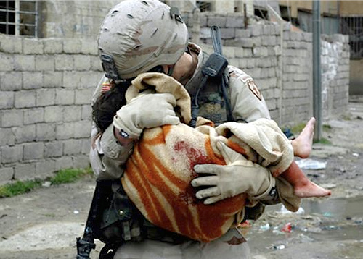
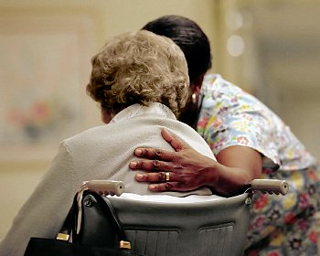
How can you show compassion to others?

