Slide 1
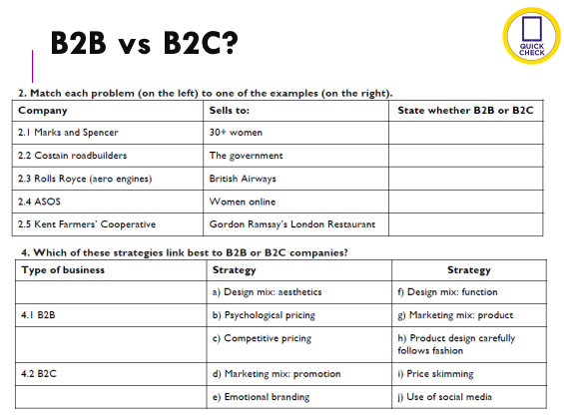
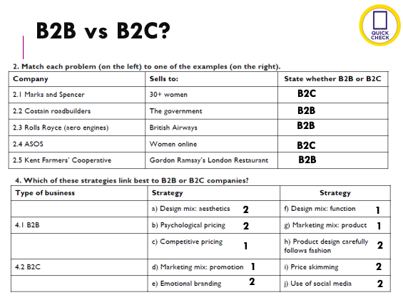
Self Assessment - Business
Mark scheme and model answer for students to mark their own work
Students encouraged to pause video then answers are given on next slide of PP

