Slide 1
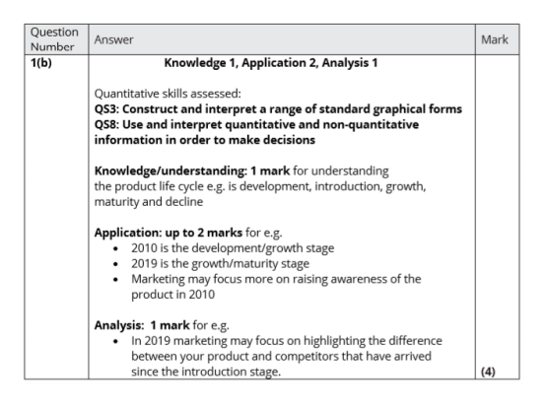
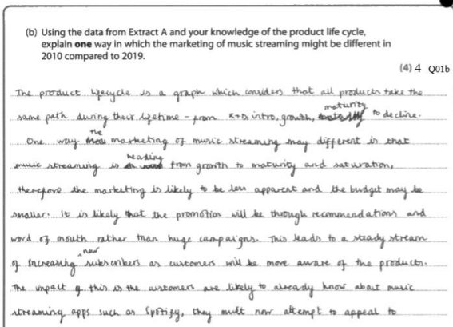
Self Assessment - Business
Mark scheme and model answer for students to mark their own work

