Slide 1
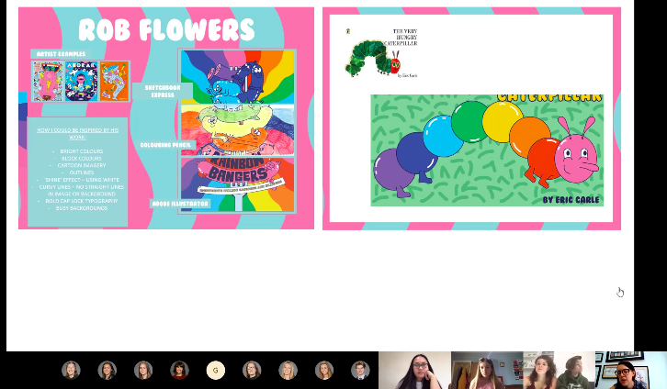
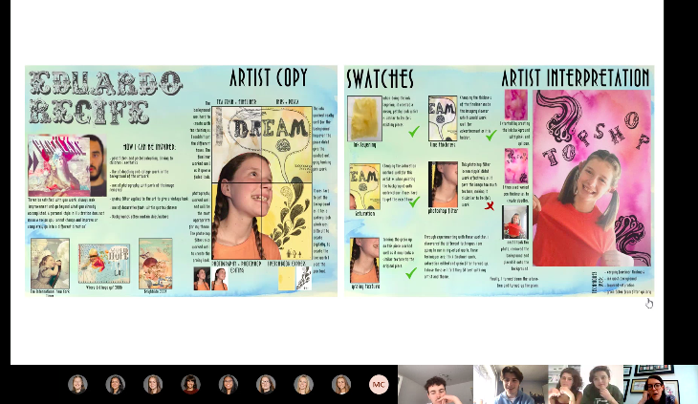
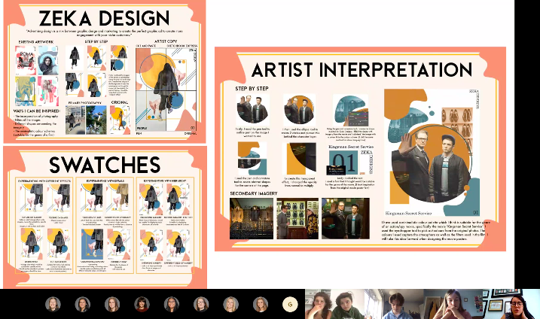
Comparative judgement - Graphics
Students are sent the mark scheme before the meeting
Students discuss and compare exemplar work

