Slide 1
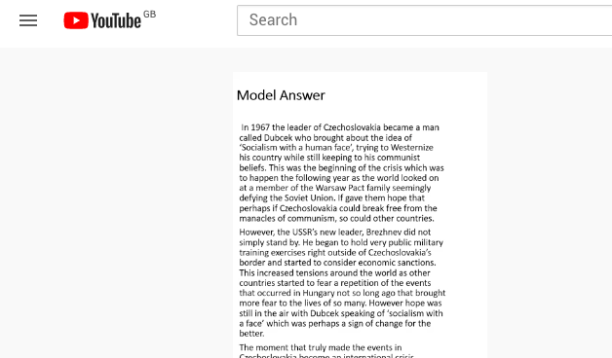
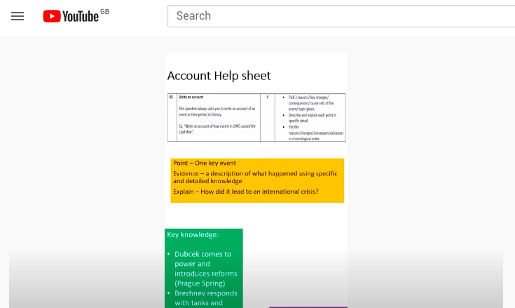
Feedback Videos - History
Feedback videos created as part of whole class feedback
Students directed to 1 of 3 videos addressing common misconceptionsbased on priority

Slide 2
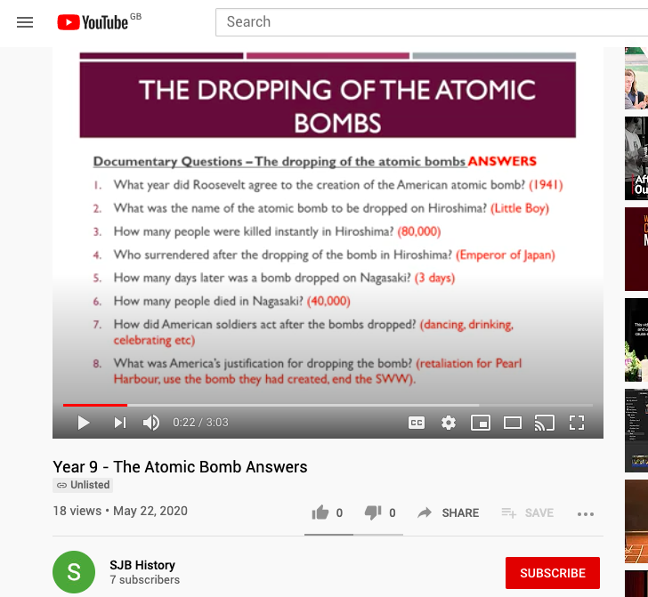
Feedback Videos - History
Video of answers able to give a more detailed response
Puts ownership on students to mark their own

