Slide 1
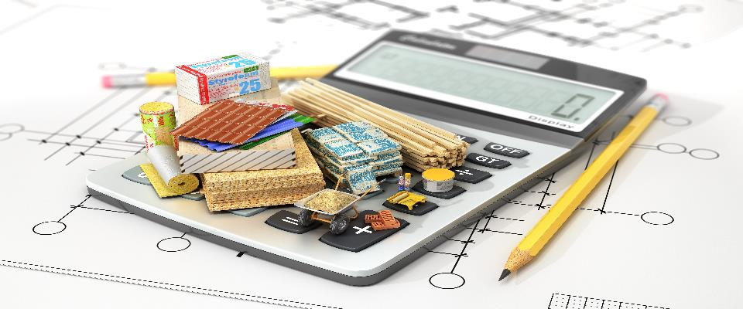
PLAN Primary Science – Supporting Assessment
Y1 Everyday Materials - Olivia
© Pan London Assessment Network (PLAN) July 2019
This resource has been developed by the Pan London Assessment Network and is supported by the Association for Science Education.

Slide 2
PLAN Primary Science - Supporting Assessment
PLAN Primary Science is a set of resources produced to enable teachers to have a clearer understanding of National Curriculum expectations for meeting the standard. Annotated collections of children’s work provide examples of what working at the expected standard for primary science might look like for the knowledge and conceptual understanding statements of the programmes of study (POS).
It is not the intention of these resources to specifically exemplify the working scientifically statements. However, aspects of working scientifically have been shown as an integral part of the teaching and learning of the knowledge and concepts.
The resources provided have been cross moderated multiple times before publishing so that they can be used with confidence by teachers and subject leaders.
Each collection of work shows one example of how a pupil has met National Curriculum statements for a particular area of content but these are not intended to be the definitive way of teaching these statements.

Slide 3
Structure of the resources
Each resource contains the relevant National Curriculum statements for the unit of work and prior learning, a planning matrix, annotated work and a summary sheet. The matrix provides an interpretation of the key learning of the National Curriculum statements, and suggestions of key vocabulary. In order to be meet the expectations pupils must firstly understand the key concept and then be provided with opportunities to apply that knowledge. This is a key planning tool.
 |  | Key Learning | Possible Evidence
Secure | Show understanding of a concept by using scientific vocabulary correctly | Overview paragraph describing curriculum Key vocabulary – list of words | Possible ways to demonstrate key learning, particularly correct usage of vocabulary
 | Apply knowledge in familiar related contexts across a range of enquiry types | Suggestions of contexts to use. | Possible ways to demonstrate that a pupil has gone beyond recall of facts and can apply the key learning, for example using the vocabulary and basic principles to produce explanations, usually within Working Scientifically contexts.

Slide 4
Contents of the materials
Please note: The NC statements for each topic area for the relevant year group are stated on the slide. Only the statements in bold on that slide have been exemplified. In these cases the teachers have chosen to split the statements within the topic area to teach at different times.
The prior NC statements relevant to the topic area are also stated and use to determine pupils’ knowledge at the start of the unit.
Each slide has been annotated with coloured text. Please see key below:
Red Commentary to explain how evidence meets/does not meet NC statements
Blue Commentary to highlight features of working scientifically
Green Pupil Speak
Grey Other relevant information eg. vocabulary used

Slide 5
Year 1 statements
Pupils should be taught to:
distinguish between an object and the material from which it is made (1-Everyday materials)
identify and name a variety of everyday materials, including wood, plastic, glass, metal, water, and rock (1-Everyday materials)
describe the simple physical properties of a variety of everyday materials (1-Everyday materials)
compare and group together a variety of everyday materials on the basis of their simple physical properties (1-Everyday materials)
Notes:
I

Slide 6
Later Statements
Pupils do not need to be taught content they will learn in later year groups. They can be challenged by applying the content for their year group in broader contexts.
In Year 2 pupils will be taught to:
identify and compare the suitability of a variety of everyday materials, including wood, metal, plastic, glass, brick, rock, paper and cardboard for particular uses (2-Everyday materials)
find out how the shapes of solid objects made from some materials can be changed by squashing, bending, twisting and stretching. (2-Everyday materials)

Slide 7
 | Assessment guidance | Key learning | Possible Evidence
SECURE | Shows understanding of a concept using scientific vocabulary correctly | All objects are made of one or more materials. Some objects can be made from different materials e.g. plastic, metal or wooden spoons. Materials can be described by their properties e.g. shiny, stretchy, rough etc. Some materials e.g. plastic can be in different forms with very different properties. Key vocabulary Object, material, wood, plastic, glass, metal, water, rock, brick, paper, fabric, elastic, foil, card/cardboard, rubber, wool, clay, hard, soft, stretchy, stiff, bendy, floppy, waterproof, absorbent, breaks/tears, rough, smooth, shiny, dull, see through, not see through | Can label a picture or diagram of an object made from different materials Can describe the properties of different materials
 | Applying knowledge in familiar related contexts, including a range of enquiries | Classify objects made of one material in different ways e.g. a group of object made of metal Classify in different ways one type of object made from a range of materials e.g. a collection of spoons made of different materials Classify materials based on their properties Test the properties of objects e.g. absorbency of cloths, strength of party hats made of different papers, stiffness of paper plates, waterproofness of shelters | Can sort objects and materials using a range of properties Can choose an appropriate method for testing an object for a particular property Can use their test evidence to answer the questions about properties e.g. Which cloth is the most absorbent?
Notes:
Update with final version

Slide 8
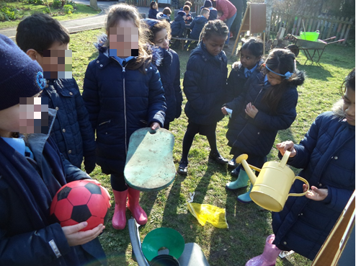
Looking for different materials outside
identify and name a variety of everyday materials, including wood, plastic, glass, metal, water, and rock
Whilst outside in groups the children were shown a material and then they hunted in the school grounds to find objects made of that material.
I was looking for plastic, metal, foam and fabric. There were lots of plastic things. They were all very different. My friends found wood and rocks.
Olivia identifies and names a wide range of materials.

Slide 9
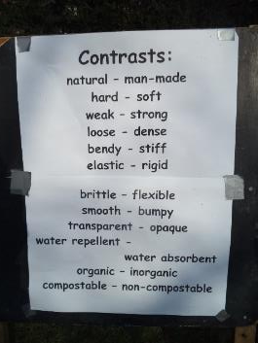
Looking for different materials outside (contd.)
identify and name a variety of everyday materials, including wood, plastic, glass, metal, water, and rock
describe the simple physical properties of a variety of everyday materials
They were then given some property vocabulary to help them talk about their finds.
Natural/manmade is a tricky concept for year 1 and not required.
Some plastic was a bit bendy – like the ball. Some was very rigid like the watering can. It was all water repellent.
2nd May
This lesson was taught by the school gardener who later buried materials with the children to discover if they were compostable. They also discussed organic produce whilst growing vegetables.
Olivia is beginning to describe the properties of some materials.

Slide 10
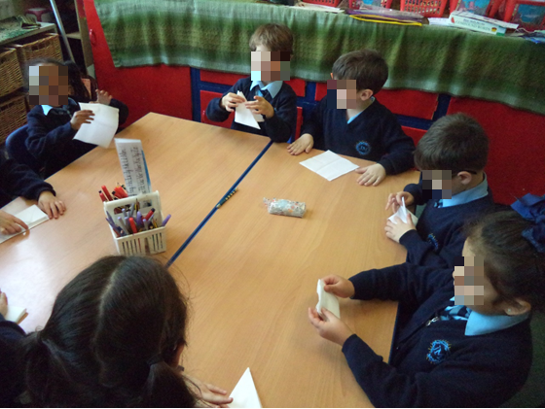
Exploring tissues
distinguish between an object and the material from which it is made
identify and name a variety of everyday materials, including wood, plastic, glass, metal, water, and rock
describe the simple physical properties of a variety of everyday materials
compare and group together a variety of everyday materials on the basis of their simple physical properties
The children were given a tissue to explore. They were asked to think of words to describe a tissue and think of different ways it could be used.
Tissue is much softer than paper; it is flexible, not waterproof, opaque, smooth and a little bit delicate.
You can use it to dry wet hands because it absorbs water. You can fold it into small squares because it is very soft and flexible and you can cover a window if you don’t want anyone to see inside.
Olivia uses a good range of vocabulary to describe the properties of the tissue.

Slide 11
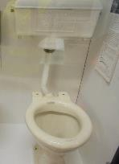
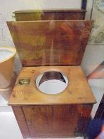
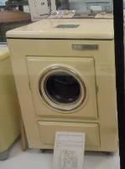
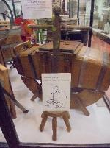
History trip to a museum
distinguish between an object and the material from which it is made
identify and name a variety of everyday materials, including wood, plastic, glass, metal, water, and rock
During a history trip to look at household objects in a museum the children looked at objects from the past and present. The teacher asked the children to look at the different materials used.
The toilet in the past was made of wood. Nowadays, it is made out of plastic or ceramic.
In the olden days, many things were made out of wood or metal. Nowadays, we use many more materials such as plastic, glass, fabric and metal too.
Olivia distinguishes between the object and the material from which it is made. She names a range of everyday materials.

Slide 12
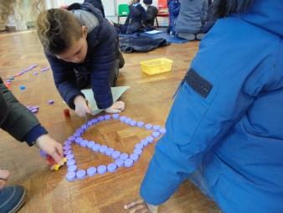
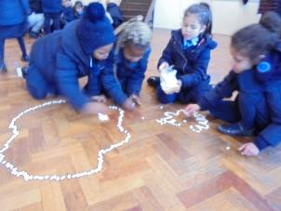
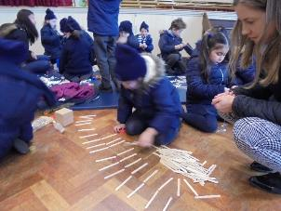
Making large pictures
distinguish between an object and the material from which it is made
identify and name a variety of everyday materials, including wood, plastic, glass, metal, water, and rock
The children were given a mixture of objects. They had to select one object to use to make a shape.
We chose water bottle tops made out of plastic. Other groups chose lollipop sticks made out of wood and white plastic beads.
Both beads and bottle tops are man made and they are plastic but they don’t look the same.
Lollipop sticks are natural because they are made of wood.
Olivia continues to distinguish between the object and the material from which it is made. She names a range of everyday materials.

Slide 13
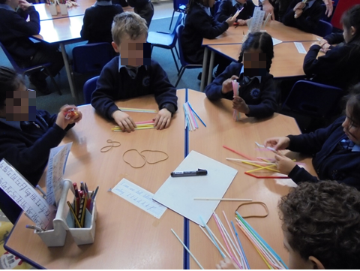
Comparing two objects
distinguish between an object and the material from which it is made
identify and name a variety of everyday materials, including wood, plastic, glass, metal, water, and rock
describe the simple physical properties of a variety of everyday materials
compare and group together a variety of everyday materials on the basis of their simple physical properties
The children were asked to explore the similarities and differences between plastic straws and rubber bands.
Plastic straws are bendy but not as flexible as rubber bands, You can just bend them but they are not stretchy. They are quite stiff and strong. Rubber bands are elastic and stretchy. You can easily make different shapes with them. Straws are also waterproof because you can drink through them.

Slide 14
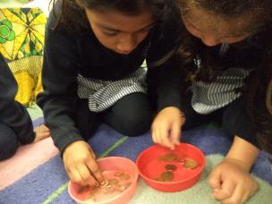
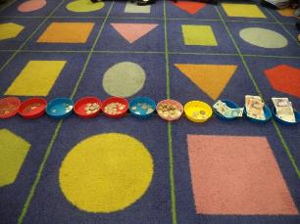
Sorting money
distinguish between an object and the material from which it is made
identify and name a variety of everyday materials, including wood, plastic, glass, metal, water, and rock
describe the simple physical properties of a variety of everyday materials
As part of their maths learning the children were given coins to classify
I sorted these coins into shiny and matt, which means not shiny. Some of these coins have 2 colours like gold and silver but in this set, they are only copper.
All of these coins are round and they are made out of metals, but quite different metals.
The class then looked at all the money (notes and coins) that had been sorted and they talked about similarities and differences.
We sorted the money into coins and notes. Coins are made of metals such as copper, gold and silver.
Notes are made of paper, but £5 and £10 feel different to £20. They are more shiny and smooth but £20 is quite soft.

Slide 15
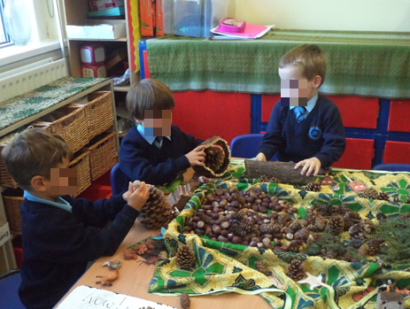
Exploring natural objects
distinguish between an object and the material from which it is made
identify and name a variety of everyday materials, including wood, plastic, glass, metal, water, and rock
describe the simple physical properties of a variety of everyday materials
compare and group together a variety of everyday materials on the basis of their simple physical properties
The children collected natural materials from the garden. They were asked to feel them and describe them.
All these things are nature treasure, because they come from nature. They are natural, not man made.
Conkers are round, smooth and hard.
Pinecones are hard too but a bit spiky and rough.
Wood is hard and rough and a bit crinkly.
Olivia describes some properties of the objects.

Slide 16
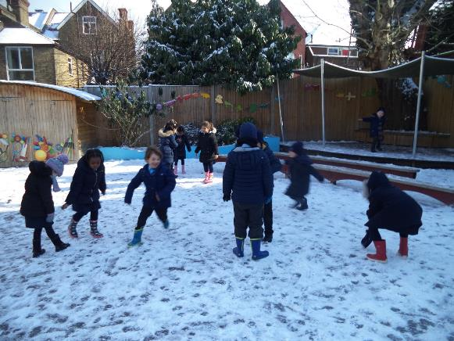
Exploring the snow
identify and name a variety of everyday materials, including wood, plastic, glass, metal, water, and rock
Whilst the children were outside exploring the snow, they were encouraged to hold snow in their hands to see what happened
Snow is made out of water because if you hold it in your hand it melts and all you can feel is water.
Snow is white, freezing cold and sometimes fluffy. But when you squeeze it hard it becomes as hard as ice.
Olivia describes snow and ice and recognises that they are water.

Slide 17
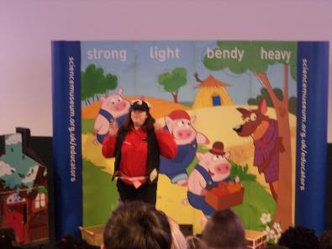
Trip to the science museum
distinguish between an object and the material from which it is made
identify and name a variety of everyday materials, including wood, plastic, glass, metal, water, and rock
describe the simple physical properties of a variety of everyday materials
As part of learning about Materials, the children visited the Science Museum and took part in the story telling about the Three Little Pigs.
When we went to the Science Museum, we learned a lot about different materials. I like the story of the 3 Little Pigs and we were learning about materials through the story.
The first little pig’s house was very weak because straw is very light and not waterproof and easy to blow out.
The second house was a bit more stronger but not the strongest. Sticks can easily snap and they are not bendy. Finally, the last house was the strongest because it was made out of bricks. Bricks are tough, waterproof, heavy and you can’t blow them down. My house is made out of bricks too and it is safe.

Slide 18
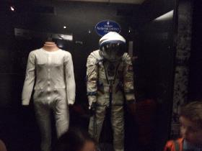
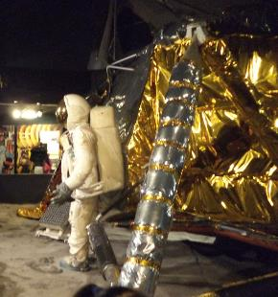
Trip to the science museum
distinguish between an object and the material from which it is made
identify and name a variety of everyday materials, including wood, plastic, glass, metal, water, and rock
describe the simple physical properties of a variety of everyday materials
compare and group together a variety of everyday materials on the basis of their simple physical properties
Linked to their topic about space the children visited the space exhibition at the museum. They particularly looked at the materials used for spacesuits.
These spacesuits are made out of a very special material. It’s a little bit like plastic and rubber. They are very flexible and they must be light so you can float up in the space. It must keep you warm but it can’t be too heavy.
Olivia describes the properties of the materials used for the spacesuit.

Slide 19
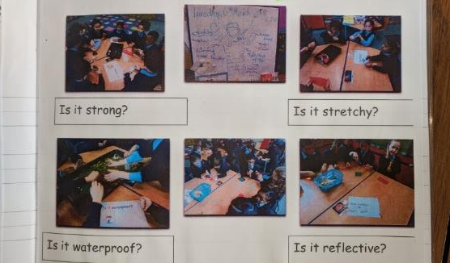
Testing materials for a space suit
describe the simple physical properties of a variety of everyday materials
compare and group together a variety of everyday materials on the basis of their simple physical properties
To help them choose materials to use for space suits they were going to design, the children were given some materials and questions to explore. They decided how to test the materials for each property and then classified the materials according to their finding.
We used a torch to see which material is shiny or reflective.
We pulled some materials to see if they stretch. We poured water over materials to see if it would go through or stay on top. We waited for 1 minute to see what would happen.
We had a brick to put on top to see which materials were strong and would not break.
Olivia tests the materials appropriately using the given resources. Olivia sorts the materials based on the outcome of the tests.

Slide 20
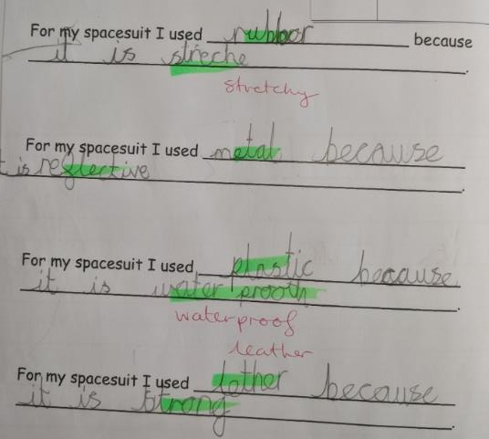
Selecting materials for a spacesuit
distinguish between an object and the material from which it is made
identify and name a variety of everyday materials, including wood, plastic, glass, metal, water, and rock
describe the simple physical properties of a variety of everyday materials
The children were asked to reflect on their tests and to consider what materials they might use when designing their own spacesuit, giving a reason why.
Olivia uses her test results to select which materials might be suitable giving a reason why.
Olivia continues to name materials and describe their properties.

Slide 21
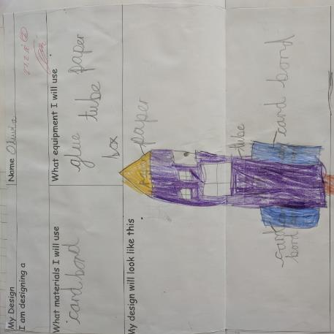
Designing a rocket
distinguish between an object and the material from which it is made
identify and name a variety of everyday materials, including wood, plastic, glass, metal, water, and rock
describe the simple physical properties of a variety of everyday materials
compare and group together a variety of everyday materials on the basis of their simple physical properties
As part of their space topic the children made space rockets in DT.
To make my rocket, I chose paper for the top because it was flexible and I could make a shape of the cone. I used a cardboard tube because it was strong and sturdy and it didn’t bend. But it was easy enough to make a hole with the scissors or a window.
I also used cardboard for the wings because it was stiff and didn’t flap like a paper or cloth.
Olivia talks about the materials she used, and their properties.

Slide 22
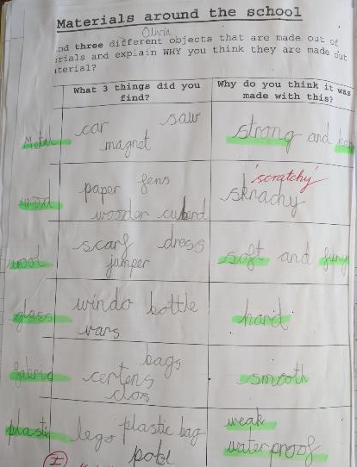
Designing a rocket
distinguish between an object and the material from which it is made
identify and name a variety of everyday materials, including wood, plastic, glass, metal, water, and rock
describe the simple physical properties of a variety of everyday materials
The children chose six materials and then went around the school to find objects made of these materials. They then also had to recall words to describe their properties.
Olivia recall six materials and can find objects made of these materials. She describes different properties associated with these materials.
Teacher: Were all the plastic objects weak?
I could tear the plastic bag but not the Lego. The Lego I strong. They are both waterproof though.

Slide 23
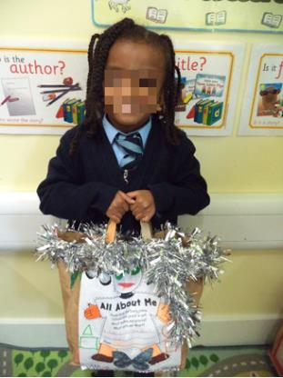
Decorating a bag
distinguish between an object and the material from which it is made
identify and name a variety of everyday materials, including wood, plastic, glass, metal, water, and rock
describe the simple physical properties of a variety of everyday materials
compare and group together a variety of everyday materials on the basis of their simple physical properties
The children prepared bags about themselves. They were asked to use a range of materials to decorate their bags.
Another child in the class
The children were asked to talk to their partner about their bag and the materials used.
This is my bag which is made of paper. I used tinsel to decorate my bag because it is shiny, glossy and you can easily bend it. It is also reflective because if you use a torch if will shimmer.

Slide 24
Overall Summary - Secure
Overall summary – secure
Olivia can confidently name a wide range of materials that she has handled during the year. She can find and name objects made of these different materials. She sort objects according to the materials that they are made from. She carries out simple tests and uses the results to classify the materials.
.

Slide 25
Acknowledgements
All materials were produced by the school

