Slide 1
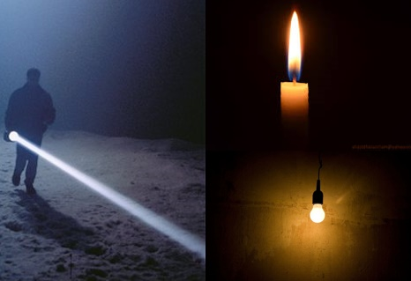

PLAN Primary Science – Supporting Assessment
Y3 Light-Max
© Pan London Assessment Network (PLAN) July 2019
This resource has been developed by the Pan London Assessment Network and is supported by the Association for Science Education.

Slide 2
PLAN Primary Science - Supporting Assessment
PLAN Primary Science is a set of resources produced to enable teachers to have a clearer understanding of National Curriculum expectations for meeting the standard. Annotated collections of children’s work provide examples of what working at the expected standard for primary science might look like for the knowledge and conceptual understanding statements of the programmes of study (POS).
It is not the intention of these resources to specifically exemplify the working scientifically statements. However, aspects of working scientifically have been shown as an integral part of the teaching and learning of the knowledge and concepts.
The resources provided have been cross moderated multiple times before publishing so that
they can be used with confidence by teachers and subject leaders.
Each collection of work shows one example of how a pupil has met National Curriculum statements for a particular area of content but these are not intended to be the definitive way of teaching these statements.

Slide 3
Structure of the resources
Each resource contains the relevant National Curriculum statements for the unit of work and prior learning, a planning matrix, annotated work and a summary sheet. The matrix provides an interpretation of the key learning of the National Curriculum statements, and suggestions of key vocabulary. In order to be meet the expectations pupils must firstly understand the key concept and then be provided with opportunities to apply that knowledge. This is a key planning tool.
 |  | Key Learning | Possible Evidence
Secure | Show understanding of a concept by using scientific vocabulary correctly | Overview paragraph describing curriculum Key vocabulary – list of words | Possible ways to demonstrate key learning, particularly correct usage of vocabulary
 | Apply knowledge in familiar related contexts | Suggestions of contexts to use. | Possible ways to demonstrate that a pupil has gone beyond recall of facts and can apply the key learning, for example using the vocabulary and basic principles to produce explanations, usually within Working Scientifically contexts.

Slide 4
Contents of the materials
Please note: The NC statements for each topic area for the relevant year group are stated on the slide. Only the statements in bold on that slide have been exemplified. In these cases the teachers have chosen to split the statements within the topic area to teach at different times.
The prior NC statements relevant to the topic area are also stated and use to determine pupils’ knowledge at the start of the unit.
Each slide has been annotated with coloured text. Please see key below:
Red Commentary to explain how evidence meets/does not meet NC statements
Blue Commentary to highlight features of working scientifically
Green Pupil Speak
Grey Other relevant information eg. vocabulary used

Slide 5
Year 1 Statements – Prior Learning
identify, name, draw and label the basic parts of the human body and say which part of the body is associated with each sense (1-Animals, including Humans)

Slide 6
Year 3 statements
Year 3 Statements
Pupils should be taught to:
recognise that they need light in order to see things and that dark is the absence of light (3-Light)
notice that light is reflected from surfaces (3-Light)
recognise that light from the sun can be dangerous and that there are ways to protect their eyes (3-Light)
recognise that shadows are formed when the light from a light source is blocked by an opaque object (3-Light)
find patterns in the way that the size of shadows change (3-Light)

Slide 7
Later Statements
Pupils do not need to be taught content they will learn in later year groups. They can be challenged by applying the content for their year group in broader contexts.
Pupils in Year 6 will be taught to:
Recognise that light appears to travel in straight lines (6-Light)
Use the idea that light travels in straight lines to explain that objects are seen because they give out or reflect light into the eye (6-Light)
Explain that we see things because light travels from light sources to our eyes or from light sources to objects and then to our eyes (6-Light)
Use the idea that light travels in straight lines to explain why shadows have the same shape as the objects that cast them. (6-Light)

Slide 8
 | Assessment guidance | Key learning | Evidence
 | Shows understanding of a concept using scientific vocabulary correctly | We see objects because our eyes can sense light. Some objects, for example the sun, light bulbs and candles are sources of light. We can see light sources shining directly into our eyes but to see other objects, light from a source must first shine on the object and then be reflected into our eyes. Some objects are easier to see as they are more reflective or shiny than other objects. Objects are easier to see if there is more light. Dark is the absence of light. We cannot see anything in complete darkness. Shadows are formed on a surface when an opaque or translucent object is between a light source and the surface and blocks some of the light. The size of the shadow depends on the position of the source, object and surface. If the light source and object move closer to each other, the shadow will become larger. Key vocabulary: Light, Light source, Dark, Absence of light, Transparent, Translucent, Opaque, Shiny, Matt, Surface, Shadow, Reflect, Mirror, Sunlight, Dangerous | Can describe how we see objects in light and can describe dark as the absence of light. Can state that it is dangerous to view the sun directly and state precautions used to view the sun, for example in eclipses. Can define transparent, translucent and opaque. Can describe how shadows are formed by objects blocking light.
 | Applying knowledge in familiar related contexts, including a range of enquiries | Explain why different objects are more or less visible in different lighting and for different object surfaces e.g. shiny vs matt. Explain how shadows vary as the distance between a light source and an object is changed. | Can describe patterns in visibility of different objects in different lighting conditions and predict which will be more or less visible as conditions change. Therefore can clearly explain that objects are not visible in complete darkness. Can describe patterns in how shadows vary due to blocking of light and predict what will happen as light source or object are moved.

Slide 9
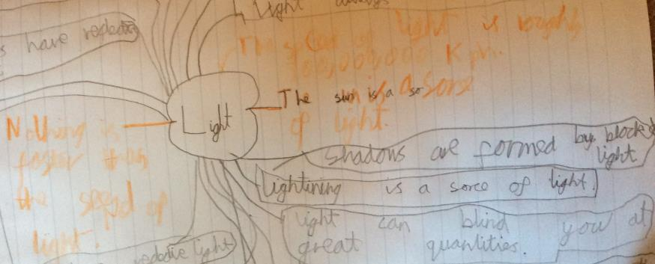
Initial assessment activity – to gauge starting point of new learning in year 3
recognise that they need light in order to see things and that dark is the absence of light
The children were asked to think about what they already knew about light. They were given a few key words to prompt them - dark, light, light source, reflection, shadow.
Max identifies the sun as a source of light. He does not choose to write anything about shadows or reflection but shares some facts about the speed of light that he knows from his own reading.

Slide 10
Odd one out
recognise that they need light in order to see things and that dark is the absence of light
The children were shown three light sources and asked to talk about which one they thought was the odd one out.
I thought it was the candle because it’s the only natural light. The others use electricity.
Actually, I think all of them because the candle is natural, the lightbulb is not portable, the torch has a powerful beam to help you see in the dark.
Max talks about the differences between light sources and shows an understanding that they help you to see in the dark.

Slide 11
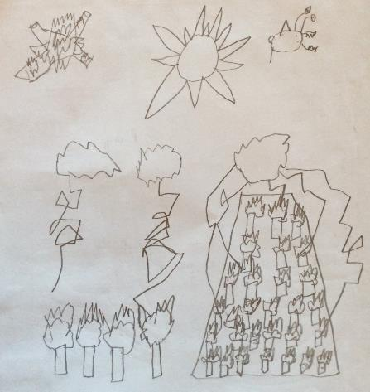
Identifying natural light sources
recognise that they need light in order to see things and that dark is the absence of light
The children were asked to name as many light sources as they could with their partner and to then draw those that were natural sources of light.
sun
angler fish
burning logs
Max identifies fire (burning logs and huge forest fire), the Sun, an anglerfish (the fish that make their own light as they live so deep in the ocean) and lightning as natural light sources.
The teacher then asked them to discuss the statement ‘What if there were no light sources.’
It would be dark all the time, everywhere. We wouldn’t know if it was day or night because there would be no sun.
Max knows that the sun is a light source and that without it, it would be dark all the time. He does not link this with not being able to see things at this point.
forest fire
lightning strike

Slide 12
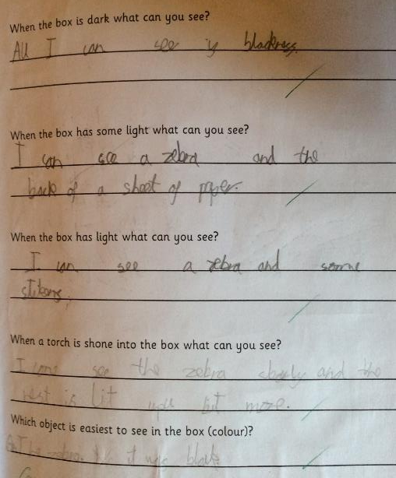
Exploring light boxes
recognise that they need light in order to see things and that dark is the absence of light
The children were given a large box that had some objects inside it. There was a small hole in the side of the box into which they could look. There were other holes in the top of the box which were covered by flaps which they could lift to let in more light. They also used a torch to shine more light into the box. Whenever the children were using torches the teacher reminded them about not shining the light in each other’s eyes.
When there was no light in the box I couldn’t see anything at all. It was just blackness.
Max observes that as there is more light going in to the box he can see more objects. He identifies the zebra as the easiest object to see.
Max recognises that without light we cannot see.

Slide 13
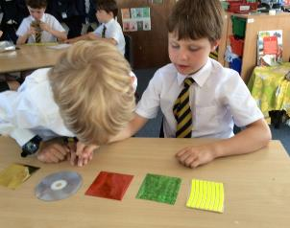
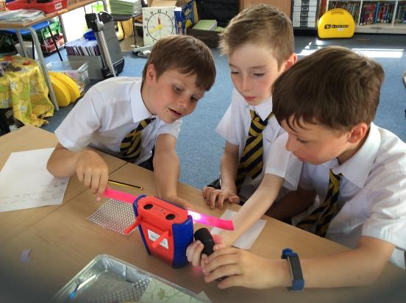
Testing reflectiveness
notice that light is reflected from surfaces
The children were studying the Ancient Egyptians and were asked to make a mirror for the Pharaoh. The teacher explained that for a material to make a good mirror it needed to be reflective and that light bounces off a reflective material causing it to look shiny. The children were given some materials and asked to sort them in order of reflectiveness. Different groups put them in different orders, so the teacher showed them how a datalogger can be used to measure light. They were then left to work out how to measure the light reflected from the surface of each material.
Max and his group use a torch to shine light onto each material and then measure the amount of light being reflected.

Slide 14
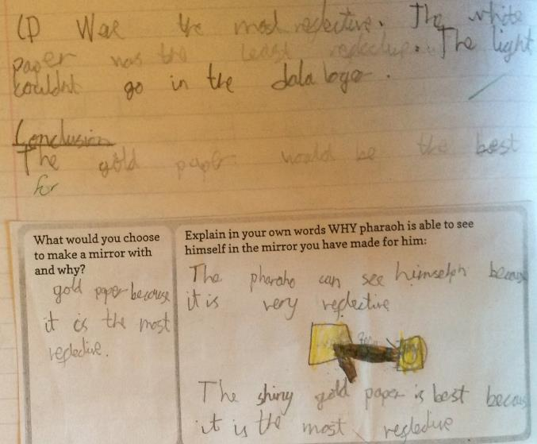
Testing reflectiveness (contd.)
notice that light is reflected from surfaces
How do you know the gold paper was the most reflective? Because the number on the datalogger was higher so more light was reflecting off the CD into it.
Gold paper
What do you mean by the light couldn’t go into the datalogger? The number on the datalogger was the same whether we shone the light on the paper or not.
Max interprets the readings from the datalogger taking into account the background reading of the light in the room. He uses his readings to make suggestions for the Pharaoh's mirror.

Slide 15
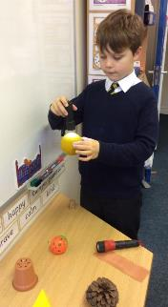
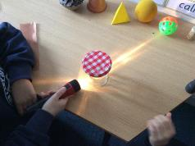
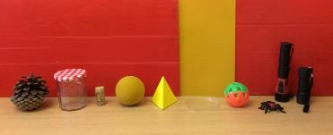
Exploring shadows
recognise that shadows are formed when the light from a light source is blocked by an opaque object
The children were given a collection of objects to explore making shadows with.
Ah, the cone has a lumpy shadow because of all the bits sticking out here. The shadow of the pyramid is pointy like the object. There is only one side of the object-It’s showing one face of the object. The jam jar is transparent. Actually it does make a kind of fuzzy shadow and lots of lines. It’s showing light through but it’s in long stripes. On top it makes a circle. [There is a lid on the top] The top is circular and opaque but the sides are transparent.
Plastic ball with holes - I can see holes where the light shines through.
[Max is talking about the circles of light he can see on the table.]
Max recognises that opaque objects make dark shadows, whereas transparent objects make very light shadows. He notices that light passes through the holes in an opaque object.

Slide 16
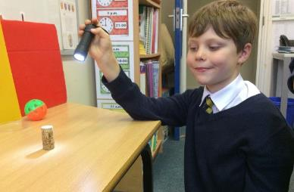
Exploring shadows
recognise that shadows are formed when the light from a light source is blocked by an opaque object
The cork is a cylinder shape. The shadow is like the cork itself and
yet it can be longer. [Max moves the torch to make a longer shadow] On top
it’s just a mini shadow…semi circle oh lying on the table it’s very long?
[Max continues moving the torch to different positions as he talks.]
Around here is the best shadow…about 45 degrees. It’s the same shape and the same length as the actual cork itself.
Yellow plastic folder – See the light. It’s translucent. It makes a shadow - the same shape…a rectangle. It’s not such a deep shadow.. Not as deep as the pyramid or the cork.
Max knows that the darkness of the shadow depends on whether the object casting the shadow is transparent, translucent or opaque. He has also observes that the shape of the shadow and the size of the shadow change according to the position of the light source.

Slide 17
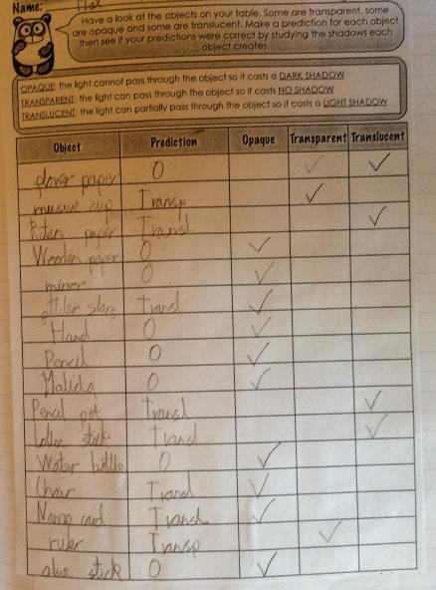
Making predictions about shadows
recognise that shadows are formed when the light from a light source is blocked by an opaque object
The children used their knowledge from the previous activity about the type of shadows formed by transparent, translucent and opaque objects blocking the light to make predictions about the shadows formed by other materials/objects in the classroom identifying each as transparent, translucent or opaque.
This tick is rubbed out
Max uses his knowledge from the previous activity to make predictions.
I was quite surprised by the flower paper because it was quite thick but then it was translucent.
The glitter stone was actually opaque. Because there were glittery bits I thought they would let the light through.

Slide 18
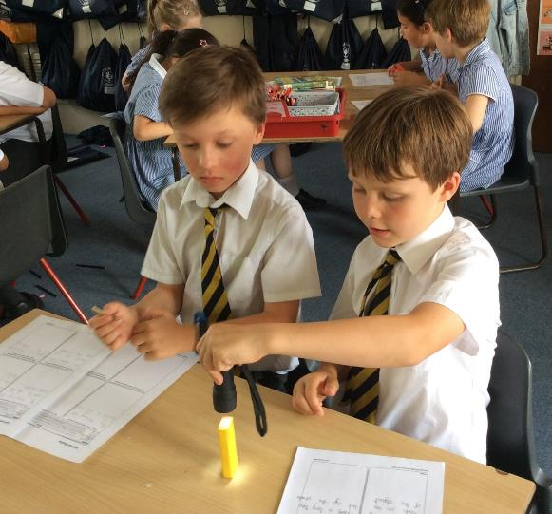
Exploring shadows (contd.)
find patterns in the way that the size of shadows change
The children were given a torch and asked to explore the four following questions.
How can you make shadows move?
How can you make shadows longer?
How can you make a shadow shorter?
What happens when you shine the light source from above the object?
The shadow changes if you put the torch in a different place.
Max changes the shadow by altering the position of the light source.

Slide 19
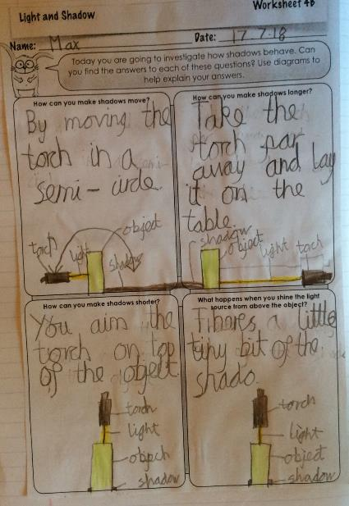
Exploring shadows (contd.)
find patterns in the way that the size of shadows change
Max records his observations using text and diagrams.
Max recognises that he can change the position or length of the shadow by moving the torch in relation to the object casting the shadow. He does not explicitly talk about the patterns at this stage.

Slide 20
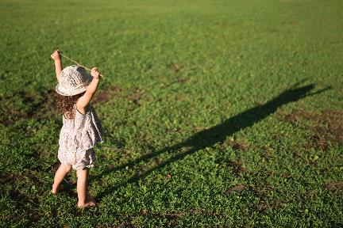
Exploring shadows created by the sun through the day
recognise that light from the sun can be dangerous and that there are ways to protect their eyes
find patterns in the way that the size of shadows change
The children went outside at different times during the day and stood on the same spot, facing the same direction and made the same shape with their bodies. A friend drew around their shadow each time. Before going outside, the teacher talked to them about not looking directly at the sun.
We used special glasses when we watched the eclipse. Sunglasses make it safer but you still shouldn’t look right at the sun.
Each time we came out the shadow had moved round on the floor. It also got smaller and then bigger.
NB Looking at how shadows caused by the sun change through the day can be left until year 5 when they are learning about how the sun appears to move across the sky.

Slide 21
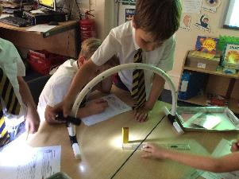
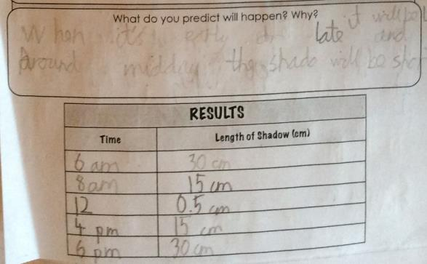
Exploring shadows created by the sun through the day (contd.)
find patterns in the way that the size of shadows change
The children were given different equipment to gather better data about how the length of a shadow changed with the position of the sun during the course of the day. The torch represents the sun and the arch is labelled with the sun position at different times of the day.
When it’s early or late it will be long and when it is midday it will be short.
Max uses his learning from the previous activities to predict how the shadow will change, which is then confirmed by the results.

Slide 22
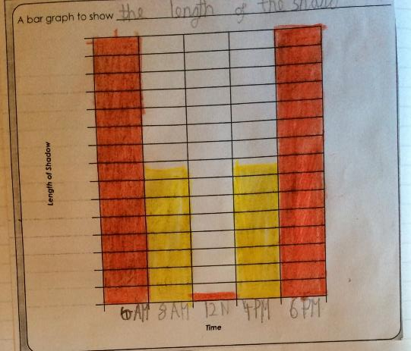
Presenting the results of the shadow investigation
find patterns in the way that the size of shadows change
Max chooses a suitable scale to fit the measurements, however he has not put the scale on the y axis.
NB Continuous data of this sort should be plotted as a line graph. However in year 3 this is not appropriate so would be better presented as a series of lines.

Slide 23
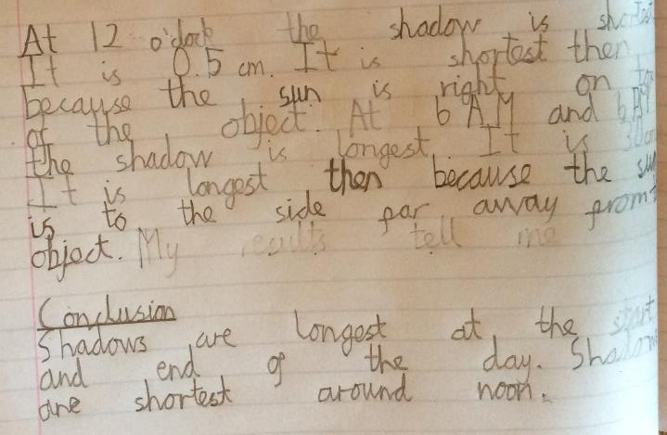
Interpreting the results of the shadow investigation
find patterns in the way that the size of shadows change
Max talks about a range of results and explains why the length changes based on the position of the sun.
Max identifies patterns in the data that he has gathered and can explain this by linking back to the position of the light source. He is secure on this objective.

Slide 24
Applying knowledge gained from the shadow investigation
find patterns in the way that the size of shadows change
The teacher talked to Max and his Partner about the investigation and how this knowledge could be used.
Teachers - Can we use what we know about the movement of shadows to tell the time?
You could use a big metal pole with numbers around. The shadow would move around so if it was small it would be between 11 and 12 o’clock. It would tell you roughly the time.
Teacher - That’s a good idea. How does that work?
Well what happens is the sun would be there and it would be the perfect spot at 5 o’clock. The sun is here and the shadow is here. [Points with hands and using one hand as the sun and the other on the table to make a shadow] You would need to use something to block the light like a pole.
Teacher - How would you know if it was morning or afternoon?
Well, on that side it would be morning and that side it would be the afternoon.
Teacher - And what about the night?
It’s night so there couldn’t be a shadow because there is no sun! [Looks at the teacher as though she’s gone mad]
Another child - I’ve seen a clock with a semi-circle and a big stick. You can tell the time by looking at the shadow.
Max - Oh yes, it’s a sundial-that’s what I was thinking of.

Slide 25
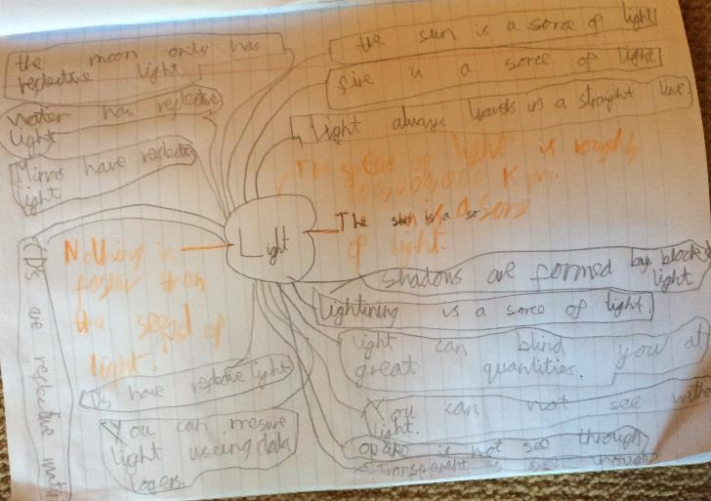
Final assessment activity
recognise that they need light in order to see things and that dark is the absence of light
notice that light is reflected from surfaces
recognise that light from the sun can be dangerous and that there are ways to protect their eyes
The children revisited their mind map from the first lesson and added their new learning.
Max names a number of objects that reflect light – water, the Moon and mirrors.
This is beyond the Year 3 curriculum
Max knows that the sun can be dangerous to the eyes that without light and that the without light we cannot see.

Slide 26
Overall Summary
Secure
By exploring how the amount of light entering a box affects what can be seen Max developed the understanding that without light you cannot see. He measures the light reflected by different materials using a datalogger and from this understands that shiny objects reflect light and that some materials reflect light better than others. He shows understanding of how to protect his eyes from being damaged by the sun. He shows a good understanding of the difference between opaque, transparent and translucent materials and how these affect the quality of a shadow produced. He is able to demonstrate how to change the size and shape of a shadow and can talk generally about the pattern he observed, linking shadow size and shape to relative positions of light source and object.

Slide 27
Acknowledgements
Slide 17, 19, 21 and 22 – worksheets from PlanBee

