Slide 1
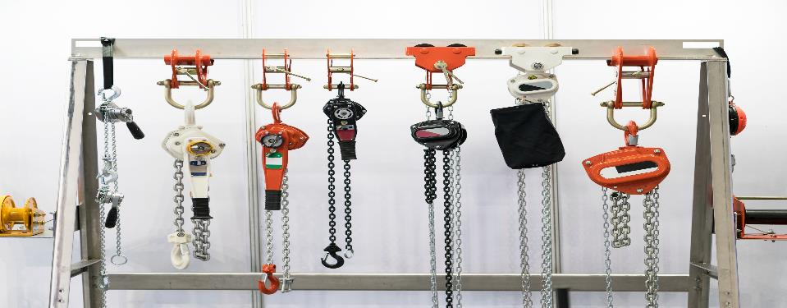
PLAN Primary Science – Supporting Assessment
Forces Year 5-Melissa
© Pan London Assessment Network (PLAN) July 2019
This resource has been developed by the Pan London Assessment Network and is supported by the Association for Science Education.

Slide 2
PLAN Primary Science - Supporting Assessment
PLAN Primary Science is a set of resources produced to enable teachers to have a clearer understanding of National Curriculum expectations for meeting the standard. Annotated collections of children’s work provide examples of what working at the expected standard for primary science might look like for the knowledge and conceptual understanding statements of the programmes of study (POS).
It is not the intention of these resources to specifically exemplify the working scientifically statements. However, aspects of working scientifically have been shown as an integral part of the teaching and learning of the knowledge and concepts.
The resources provided have been cross moderated multiple times before publishing so that they can be used with confidence by teachers and subject leaders.
Each collection of work shows one example of how a pupil has met National Curriculum statements for a particular area of content but these are not intended to be the definitive way of teaching these statements.

Slide 3
Structure of the resources
Each resource contains the relevant National Curriculum statements for the unit of work and prior learning, a planning matrix, annotated work and a summary sheet. The matrix provides an interpretation of the key learning of the National Curriculum statements, and suggestions of key vocabulary. In order to be meet the expectations pupils must firstly understand the key concept and then be provided with opportunities to apply that knowledge. This is a key planning tool.
 |  | Key Learning | Possible Evidence
Secure | Show understanding of a concept by using scientific vocabulary correctly | Overview paragraph describing curriculum Key vocabulary – list of words | Possible ways to demonstrate key learning, particularly correct usage of vocabulary
 | Apply knowledge in familiar related contexts | Suggestions of contexts to use. | Possible ways to demonstrate that a pupil has gone beyond recall of facts and can apply the key learning, for example using the vocabulary and basic principles to produce explanations, usually within Working Scientifically contexts.

Slide 4
Contents of the materials
Please note: The NC statements for each topic area for the relevant year group are stated on the slide. Only the statements in bold on that slide have been exemplified. In these cases the teachers have chosen to split the statements within the topic area to teach at different times.
The prior NC statements relevant to the topic area are also stated and use to determine pupils’ knowledge at the start of the unit.
Each slide has been annotated with coloured text. Please see key below:
Red Commentary to explain how evidence meets/does not meet NC statements
Blue Commentary to highlight features of working scientifically
Green Pupil Speak
Grey Other relevant information eg. vocabulary used

Slide 5
Prior Learning - Year 3 Statements
Pupils should be taught to:
compare how things move on different surfaces (3-Forces)
notice that some forces need contact between two objects, but magnetic forces can act at a distance (3-Forces)
observe how magnets attract or repel each other and attract some materials and not others (3-Forces)
compare and group together a variety of everyday materials on the basis of whether they are attracted to a magnet, and identify some magnetic materials (3-Forces)
describe magnets as having two poles (3-Forces)
predict whether two magnets will attract or repel each other, depending on which poles are facing (3-Forces)

Slide 6
Year 5 statements
Year 5 Statements
Pupils should be taught to:
explain that unsupported objects fall towards the Earth because of the force of gravity acting between the Earth and the falling object (5-Forces)
identify the effects of air resistance, water resistance and friction, that act between moving surfaces (5-Forces)
recognise that some mechanisms, including levers, pulleys and gears, allow a smaller force to have a greater effect (5-Forces)

Slide 7
Later Statements
Pupils do not need to be taught content they will learn in later year groups. They can be challenged by applying the content for their year group in broader contexts.
Pupils in Key Stage 3 should be taught about:
forces as pushes or pulls, arising from the interaction between two objects
using force arrows in diagrams, adding forces in one dimension, balanced and unbalanced forces
moment as the turning effect of a force
forces: associated with deforming objects; stretching and squashing – springs; with rubbing and friction between surfaces, with pushing things out of the way; resistance to motion of air and water
forces measured in newtons, measurements of stretch or compression as force is changed

Slide 8
 | Assessment guidance | Key learning | Possible evidence
SECURE | Shows understanding of a concept using scientific vocabulary correctly | A force causes an object to start moving, stop moving, speed up, slow down or change direction. Gravity is a force that acts at a distance. Everything is pulled to the Earth by gravity. This causes unsupported objects to fall. Air resistance, water resistance and friction are contact forces that act between moving surfaces. The object may be moving through the air or water or the air and water may be moving over a stationary object. A mechanism is a device that allows a small force to be increased to a larger force. The pay back is that it requires a greater movement. The small force moves a long distance and the resulting large force moves a small distance, e.g. a crowbar or bottle top remover. Pulleys, levers and gears are all mechanisms, also known as simple machines. Key vocabulary Force, gravity, Earth, air resistance, water resistance, friction, mechanisms, simple machines, levers, pulleys, gears | Can demonstrate the effect of gravity acting on an unsupported object Can give examples of friction, water resistance and air resistance Can give examples of when it is beneficial to have high or low friction, water resistance and air resistance Can demonstrate how pulleys, levers and gears work
 | Applying knowledge in familiar related contexts, including a range of enquiries | Investigate the effect of friction in a range of contexts e.g. trainers, bath mats, mats for a helter-skelter Investigate the effects of water resistance in a range of contexts e.g. dropping shapes through water, pulling shapes e.g. boats along the surface of water Investigate the effects of air resistance in a range of contexts e.g. parachutes, spinners, sails on boats Explore how levers, pulleys and gears work Make a product that involves a lever, pulley or gear Create a timer that uses gravity to move a ball Research how the work of scientists such as Galileo Galilei and Isaac Newton helped to develop the theory of gravitation | Can explain the results of their investigations in terms of the force, showing a good understanding that as the object tries to move through the water or air or across the surface, the particles in the water, air or on the surface slow it down Can demonstrate clearly the effects of using levers, pulleys and gears
Notes:
Update with final version

Slide 9
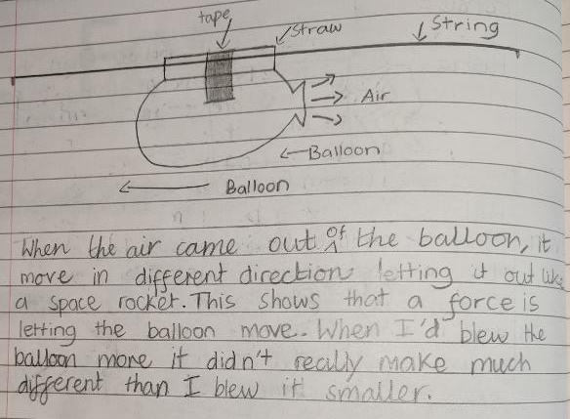
Initial hook activity
The children were given instructions to make a balloon rocket and were then given time to explore how it works and how the movement could be changed.
Melissa understands that the air coming out of the balloon is making the balloon move. She uses the term force.
Melissa changes a variable (the amount of air in the balloon and notices that this does not have much of an impact on the movement of the balloon.

Slide 10
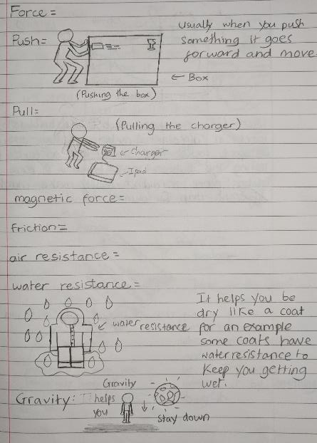
Initial activity to engage prior learning
The children were given the key vocabulary for the topic and asked to explain the words using diagrams and text.
Melissa is confident with the basic concept of pushes and pulls and understands that gravity keeps things on the ground. It is not clear at this point that she recognises that gravity pulls on all objects and causes unsupported objects to fall. She writes about a water resistant material rather than water resistance.

Slide 11
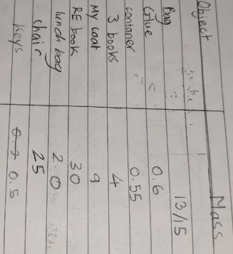
Using forcemeters
The children were not familiar with using forcemeters, so this activity was included to give them practice at selecting the appropriate forcemeter and reading the scales. They were asked to record the weight of different objects in the classroom.
Children do not need to distinguish between mass and weight at this stage but should be reading the correct scale on forcemeter.
How did you know which forcemeter to use for each object?
I estimated how heavy it was and then chose. I wanted the measurement to be in the middle [of the scale]. If it was right near the top or bottom I changed the forcemeter.
Melissa constructs her own table to record the mass of each object that her group weighed. She chooses the appropriate forcemeter to give her measurements. Sha has not recorded units and it is not clear that she is always reading the grams or Newtons scale.

Slide 12
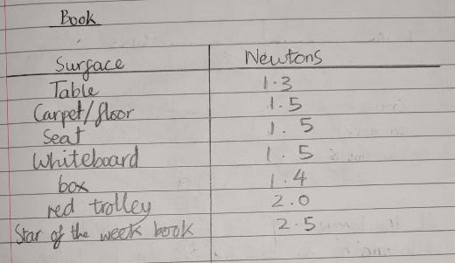
Investigating friction – moving an object on different surfaces
compare how things move on different surfaces (year 3 statement)
identify the effects of air resistance, water resistance and friction, that act between moving surfaces
The children were asked to measure the force required to move an object on different surfaces. The teacher explained that a force is measured in Newtons and that they should think about this when using their forcemeters
Melissa chooses an appropriate forcemeter to use and this time uses the Newton scale.
The book moved most easy on the table – 1.3. It took the biggest force to move it on the star of the week book as it was plastic and a bit sticky. It took about the same to move it on the carpet, seat, whiteboard and box.
At this point, Melissa understands that things move differently on different surfaces (year 3 objective) but is not using the term friction to explain this.

Slide 13
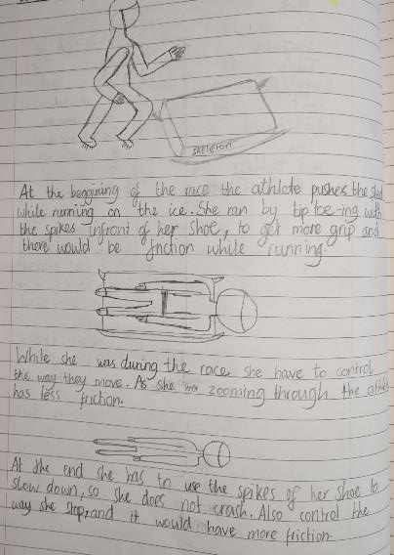
Investigating friction – moving an object on different surfaces
compare how things move on different surfaces (year 3 statement)
identify the effects of air resistance, water resistance and friction, that act between moving surfaces
Building on the previous activity the teacher introduced the term friction and asked the children to consider examples that they come across, in their everyday lives, that involve high friction and low friction.
When you go down a slide you want low friction so you can go fast. You want good friction with your trainers so you don’t slip. They have grips on the bottom to make friction.
She then showed them a video clip of a toboggan run and asked them to discuss how friction affects this.
In this writing and her comments Melissa shows that she understands that the type of surface affects the amount of friction which has an impact on how easily things move over each other.

Slide 14
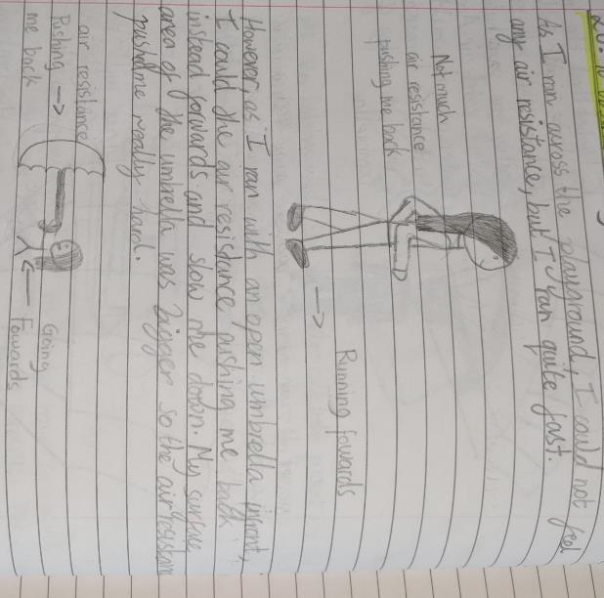
Exploring air resistance
identify the effects of air resistance, water resistance and friction, that act between moving surfaces
Outside, the children ran across the playground. They then repeated this with an open umbrella held in front of them to feel the effect of this. They discussed this back in the classroom and the teacher introduced the concept of air resistance.
This shows an understanding that air resistance makes it harder for an object to move. She also recognises that air resistance increases with size.

Slide 15
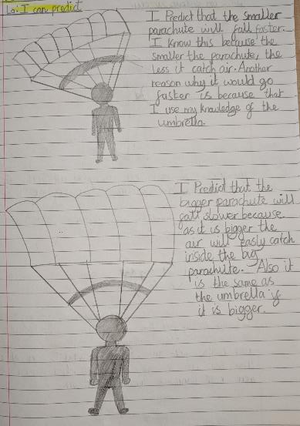
Making predictions about air resistance based on prior learning
identify the effects of air resistance, water resistance and friction, that act between moving surfaces
explain that unsupported objects fall towards the Earth because of the force of gravity acting between the Earth and the falling object
The teacher showed the children a video clip of a parachutist descending, and asked them to use their knowledge about air resistance to predict what would happen if the parachute was a different size.
Melissa uses her previous experience of running with the umbrella and her new knowledge of air resistance to make predictions.
Melissa does not use the words air resistance but her explanations show that she has a good grasp of the concept. This combined with her previous writing about the umbrella activity is sufficient to indicate that she is secure.
Why does the parachutist fall down? Because gravity pulls him.
She is secure about gravity.

Slide 16
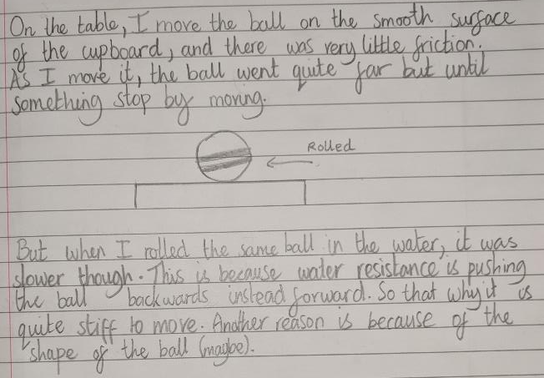
Exploring water resistance
identify the effects of air resistance, water resistance and friction, that act between moving surfaces
The children were given time to explore the difference between rolling a ball on the table and rolling it in a tray of water. The concept of water resistance was then introduced.
Melissa understands that the water resistance is slowing the ball down and suggests that this may also be linked to the shape of the object.
Writes about friction unprompted.
As the idea of shape affecting water resistance came up during the lesson the teacher asked the children to research how shape may affect water resistance for homework.

Slide 17
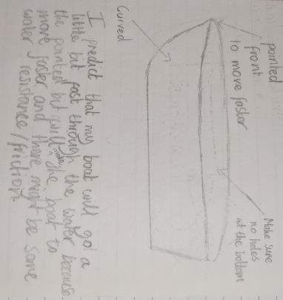
Designing a boat
identify the effects of air resistance, water resistance and friction, that act between moving surfaces
The children were asked to design a boat that they would make out of paper that they thought would move well through the water.
I have got a pointed front because lots of boats are like that. Lots of fish also have pointy noses. This helps them move quickly.
Melissa uses her research at home to help her design her boat to reduce water resistance.
They then made and tested their boats. Melissa compared her boat with another child’s.
Leon’s boat was square. It floated well but it didn’t move as well as mine because it didn’t have the point at the front to make water resistance little.
Melissa shows a good understanding that water resistance slows an object down and that it is dependent on the shape of the object.

Slide 18
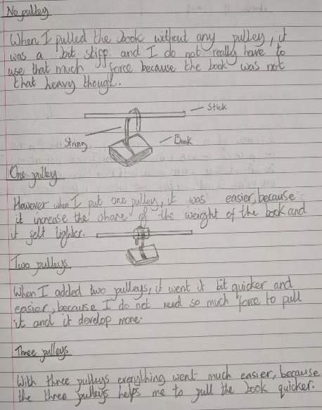
Exploring pulleys
recognise that some mechanisms, including levers, pulleys and gears, allow a smaller force to have a greater effect
The children were given time to explore the effect of lifting an object using different numbers of pulleys.
Melissa links the weight of the book to the force required to lift it.
Melissa notices that it is easier to lift using the pulley.
Melissa comments that it is easier to lift because the force needed is less.
Melissa notices that using the pulleys means that less force is required to lift the object.

Slide 19
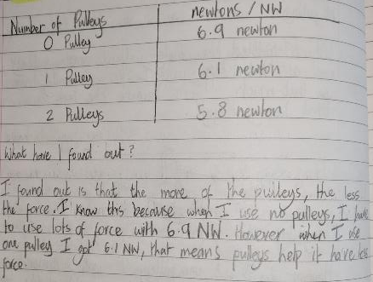
Measuring forces when using pulleys
recognise that some mechanisms, including levers, pulleys and gears, allow a smaller force to have a greater effect
The children were asked to measure the force required to lift an object when using different numbers of pulleys.
Melissa uses the incorrect abbreviation for Newtons.
Melissa again chooses the appropriate forcemeter to use and records her results in a table.
Melissa links the number of pulleys to the amount of force required to lift the object.

Slide 20
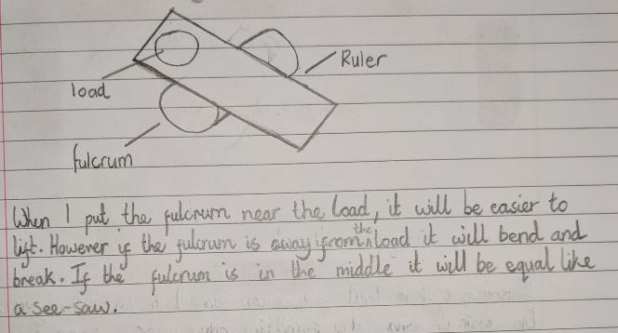
Exploring levers
recognise that some mechanisms, including levers, pulleys and gears, allow a smaller force to have a greater effect
The children were shown a labelled diagram of a lever and then given time to explore how it works and to investigate the effect of moving the fulcrum.
Through exploration Melissa identifies that the lever can make it easier to lift the load. This is dependent on the position of the fulcrum.
A push meter could have been used to measure the force during this activity and this could have provided an opportunity for the teacher to clarify the abbreviated form of Newtons.
Melissa understands that the lever makes it easier to lift an object.

Slide 21
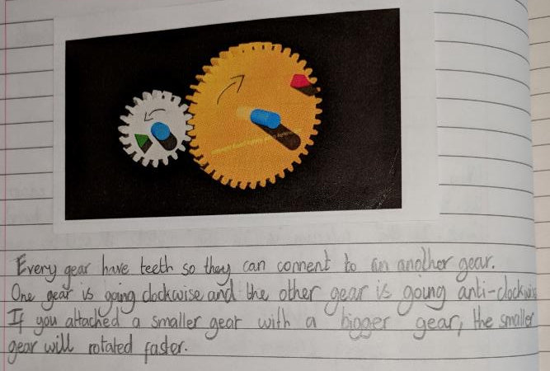
Learning about gears
recognise that some mechanisms, including levers, pulleys and gears, allow a smaller force to have a greater effect
The children watched computer animations showing how gears work, explored some toy gears and were then given an image to write about.
Melissa notices that adjacent gears move in opposite directions and that gears of different sizes move at different speeds.

Slide 22
Overall Summary - Secure
Melissa understands that objects fall due to gravity pulling them down. She has carried out a number of investigations to explore friction, water resistance and air resistance and can explain the effect of these on moving objects. She has also explored levers, gears and pulleys and recognises that these enable a smaller force to have a greater impact.

Slide 23
Acknowledgements

