Slide 1
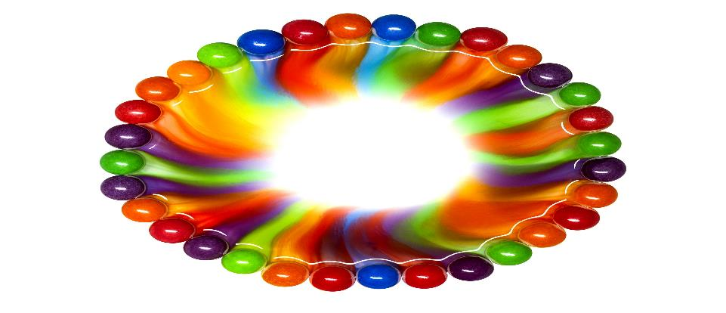
PLAN Primary Science – Supporting Assessment
Materials Year 5 -Melissa
© Pan London Assessment Network (PLAN) July 2019
This resource has been developed by the Pan London Assessment Network and is supported by the Association for Science Education.

Slide 2
PLAN Primary Science - Supporting Assessment
PLAN Primary Science is a set of resources produced to enable teachers to have a clearer understanding of National Curriculum expectations for meeting the standard. Annotated collections of children’s work provide examples of what working at the expected standard for primary science might look like for the knowledge and conceptual understanding statements of the programmes of study (POS).
It is not the intention of these resources to specifically exemplify the working scientifically statements. However, aspects of working scientifically have been shown as an integral part of the teaching and learning of the knowledge and concepts.
The resources provided have been cross moderated multiple times before publishing so that they can be used with confidence by teachers and subject leaders.
Each collection of work shows one example of how a pupil has met National Curriculum statements for a particular area of content but these are not intended to be the definitive way of teaching these statements.

Slide 3
Structure of the resources
Each resource contains the relevant National Curriculum statements for the unit of work and prior learning, a planning matrix, annotated work and a summary sheet. The matrix provides an interpretation of the key learning of the National Curriculum statements, and suggestions of key vocabulary. In order to be meet the expectations pupils must firstly understand the key concept and then be provided with opportunities to apply that knowledge. This is a key planning tool.
 |  | Key Learning | Possible Evidence
Secure | Show understanding of a concept by using scientific vocabulary correctly | Overview paragraph describing curriculum Key vocabulary – list of words | Possible ways to demonstrate key learning, particularly correct usage of vocabulary
 | Apply knowledge in familiar related contexts | Suggestions of contexts to use. | Possible ways to demonstrate that a pupil has gone beyond recall of facts and can apply the key learning, for example using the vocabulary and basic principles to produce explanations, usually within Working Scientifically contexts.

Slide 4
Contents of the materials
Please note: The NC statements for each topic area for the relevant year group are stated on the slide. Only the statements in bold on that slide have been exemplified. In these cases the teachers have chosen to split the statements within the topic area to teach at different times.
The prior NC statements relevant to the topic area are also stated and use to determine pupils’ knowledge at the start of the unit.
Each slide has been annotated with coloured text. Please see key below:
Red Commentary to explain how evidence meets/does not meet NC statements
Blue Commentary to highlight features of working scientifically
Green Pupil Speak
Grey Other relevant information eg. vocabulary used

Slide 5
Year 1 Statement – Prior learning
Pupils should be taught to:
distinguish between an object and the material from which it is made (1-Everyday materials)
identify and name a variety of everyday materials, including wood, plastic, glass, metal, water, and rock (1-Everyday materials)
describe the simple physical properties of a variety of everyday materials (1-Everyday materials)
compare and group together a variety of everyday materials on the basis of their simple physical properties (1-Everyday materials)

Slide 6
Year 2 Statement – Prior learning
Pupils should be taught to:
identify and compare the suitability of a variety of everyday materials, including wood, metal, plastic, glass, brick, rock, paper and cardboard for particular uses (2-Uses of Everyday materials)
find out how the shapes of solid objects made from some materials can be changed by squashing, bending, twisting and stretching (2-Uses of Everyday materials)

Slide 7
Prior Learning Year 4 statements
Year 4 Statement – Prior learning
Pupils should be taught to:
compare and group materials together, according to whether they are solids, liquids or gases (4-States of Matter)
observe that some materials change state when they are heated or cooled, and measure or research the temperature at which this happens in degrees Celsius (°C) (4-States of Matter)
identify the part played by evaporation and condensation in the water cycle and associate the rate of evaporation with temperature (4-States of Matter)

Slide 8
Year 5 statements
Year 5 Statements
Pupils should be taught to:
compare and group together everyday materials on the basis of their properties, including their hardness, solubility, transparency, conductivity (electrical and thermal), and response to magnets (5-Properties and changes of Materials)
know that some materials will dissolve in liquid to form a solution, and describe how to recover a substance from a solution (5-Properties and changes of Materials)
use knowledge of solids, liquids and gases to decide how mixtures might be separated, including through filtering, sieving and evaporating (5-Properties and changes of Materials)
give reasons, based on evidence from comparative and fair tests, for the particular uses of everyday materials, including metals, wood and plastic (5-Properties and changes of Materials)
demonstrate that dissolving, mixing and changes of state are reversible changes (5-Properties and changes of Materials)
explain that some changes result in the formation of new materials, and that this kind of change is not usually reversible, including changes associated with burning and the action of acid on bicarbonate of soda (5-Properties and changes of Materials)

Slide 9
Later Statements
Pupils do not need to be taught content they will learn in later year groups. They can be challenged by applying the content for their year group in broader contexts.
Pupils in Key Stage 3 should be taught about:
chemical reactions as the rearrangement of atoms
representing chemical reactions using formulae and using equations
combustion, thermal decomposition, oxidation and displacement reactions
defining acids and alkalis in terms of neutralisation reactions
the pH scale for measuring acidity/alkalinity; and indicators

Slide 10
 | Assessment guidance | Key learning | Possible evidence
SECURE | Shows understanding of a concept using scientific vocabulary correctly | Materials have different uses depending on their properties and state (liquid, solid, gas). Properties include hardness, transparency, electrical and thermal conductivity and attraction to magnets. Some materials will dissolve in a liquid and form a solution while others are insoluble and form sediment. Mixtures can be separated by filtering, sieving and evaporation. Some changes to materials such as dissolving, mixing and changes of state are reversible, but some changes such as burning wood, rusting and mixing vinegar with bicarbonate of soda result in the formation of new materials and these are not reversible. Key vocabulary Thermal/electrical insulator/conductor, change of state, mixture, dissolve, solution, soluble, insoluble, filter, sieve reversible/non-reversible change, burning, rusting, new material | Can use understanding of properties to explain everyday uses of materials. For example, how bricks, wood, glass and metals are used in buildings Can explain what dissolving means, giving examples Can name equipment used for filtering and sieving Can use knowledge of liquids, gases and solids to suggest how materials can be recovered from solutions or mixtures by evaporation, filtering or sieving Can describe some simple reversible and non-reversible changes to materials, giving examples
 | Applying knowledge in familiar related contexts, including a range of enquiries | Investigate the properties of different materials in order to recommend materials for particular functions depending on these properties e.g. test waterproofness and thermal insulation to identify a suitable fabric for a coat Explore adding a range of solids to water and other liquids e.g. cooking oil, as appropriate Investigate rates of dissolving by carrying out comparative and fair test Separate mixtures by sieving, filtering and evaporation, choosing the most suitable method and equipment for each mixture Explore a range of non-reversible changes e.g. rusting, adding fizzy tablets to water, burning Carry out comparative and fair tests involving non-reversible changes e.g. What affects the rate of rusting? What affects the amount of gas produced? Research new materials produced by chemists e.g. Spencer Silver (glue of sticky notes) and Ruth Benerito (wrinkle free cotton) | Can create a chart or table grouping/comparing everyday materials by different properties Can use test evidence gathered about different properties to suggest an appropriate material for a particular purpose Can group solids based on their observations when mixing them with water Can give reasons for choice of equipment and methods to separate a given solution or mixture such as salt or sand in water Can explain the results from their investigations involving dissolving and non-reversible change
Notes:
Update with final version

Slide 11
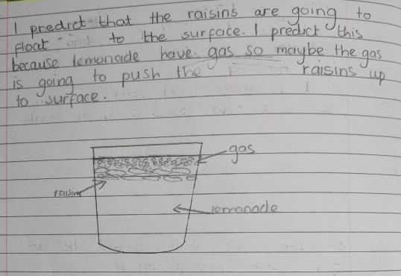
Hook activity – to engage the children
The children were given some raisins to handle and then shown a bottle of lemonade and asked to think what might happen when the raisins are added to the lemonade.
Key vocabulary: gas. This is used correctly the writing shows a good understanding of the word
Melissa uses the word gas in her prediction.

Slide 12
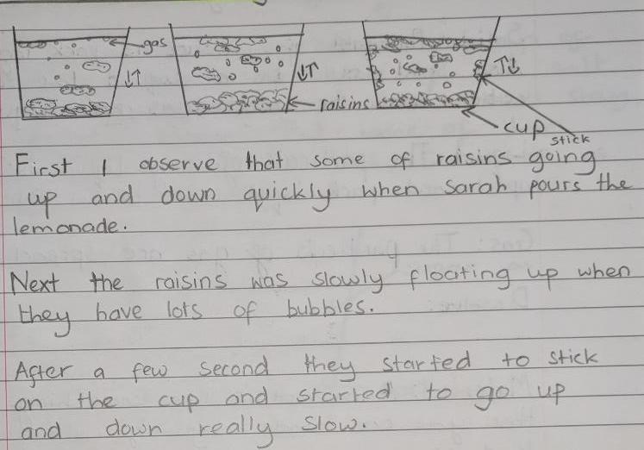
Hook activity – to engage the children (contd.)
The children made close observations of adding the raisins to the lemonade.
Melissa has made a close observation and has noticed the effect the bubbles have on how quickly the raisins float.

Slide 13
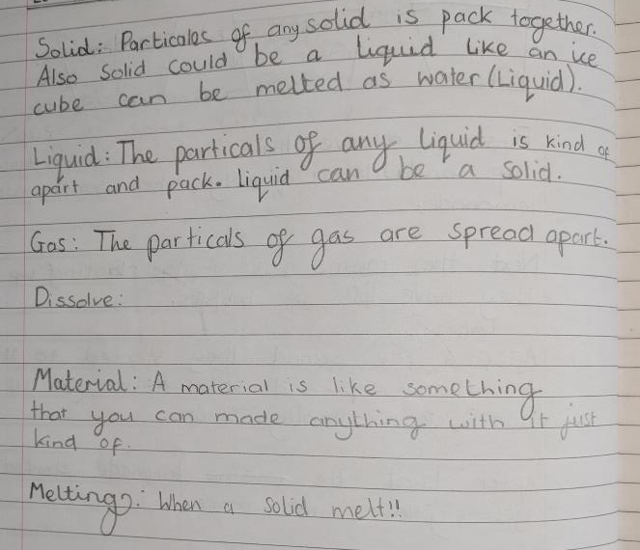
Initial assessment activity – to check on previous learning from year 4 and to gauge starting point of new learning in year 5
The children were given the key words for the topic on cards. They sorted these with their partner into words they had heard before and new words. Starting with the words they felt most familiar with they were asked to write definitions for each word.
Melissa was familiar with the words dissolve and melt but struggled to write clear definitions for these words.

Slide 14
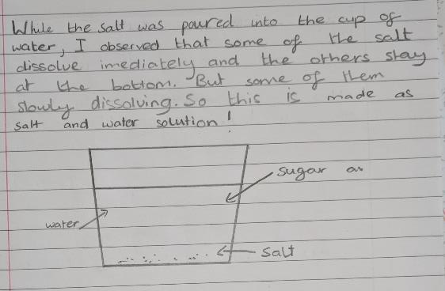
Close observation of adding sugar to water
know that some materials will dissolve in liquid to form a solution, and describe how to recover a substance from a solution
The children were asked to add some salt to water and observe it closely. During the discussion that followed the teacher ensured that the children understood that the salt had not disappeared, but had dissolved and was still in the cup. She also explained that the salt and water had now become a solution.
Melissa makes good observations and includes the words dissolve and solution in her description.
Melissa shows an awareness that a solid can dissolve in a water. She has used the word solution in her explanation. This is not sufficient evidence to show that she is secure with the concept of dissolving yet.

Slide 15
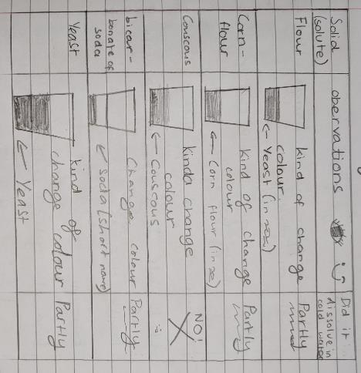
Close observation of adding different solids to water
know that some materials will dissolve in liquid to form a solution, and describe how to recover a substance from a solution
The children could select solids of their choice from a range provided. They were then asked to add them to water and make careful observations, choosing how to record these observations.
Melissa chose to draw a table to record her observations. She independently added a column to indicate whether the solid dissolved or not.
Why have you said they partly dissolved?
Because there was less at the bottom than what I put in, so some must of dissolved.
Melissa is not familiar with suspensions at present which is causing her confusion.

Slide 16
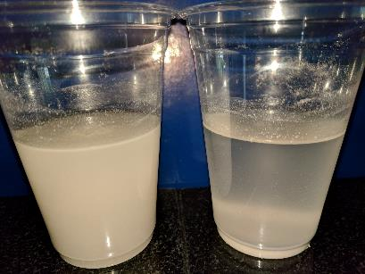
Observation of a suspension over time
know that some materials will dissolve in liquid to form a solution, and describe how to recover a substance from a solution
The children were given two cups of flour in water and asked to stir them both up. They made close observations. One they continued to stir and they other they left. They continued to make observations.
When you stir it all the little bits of flour float around in the liquid and make it look more white. When you stop stirring you can see them falling to the bottom and the water gets clearer. You can see some bits of flour stuck to the side of the cups.
The teacher then introduced the word suspension and explained that the solid has not dissolved.
So what do you think about the corn flour now?
It was like the flour. It did not dissolve to make a solution but made a suspension.
Melissa is now clear about the difference between a solution and a suspension.

Slide 17
Planning and carrying out a comparative test
know that some materials will dissolve in liquid to form a solution, and describe how to recover a substance from a solution
The children were asked to discuss in small groups and write down what they could change that may affect the speed of sugar dissolving. Using these ideas and the fair test planning board each group chose their own investigation. Melissa’s group chose to investigate how the type of container affected the rate of dissolving.
Each group was then given time to complete their chosen investigation and asked to interpret their results.
We put the same amount of water and sugar in each container and waited to see which dissolved first. Not all the sugar dissolved in any of them so we tried stirring. This helped the sugar to dissolve more quickly. We couldn’t stir the cylinder cos the spoon didn’t fit so we moved it about. That helped a bit but not as good as stirring. I think the stirring made more difference than the container.
Melissa was able to carry out the investigation controlling variables appropriately, initially before going on to explore the effect of stirring.
Melissa talks confidently about the sugar dissolving and understands that there are variables that affect the rate of dissolving.

Slide 18
Further dissolving investigations
know that some materials will dissolve in liquid to form a solution, and describe how to recover a substance from a solution
The children place sugar coated sweets into shallow water and observed the change over time.
The colour from the sweets spreads out into the water. The chocolate is covered in a shell made of coloured sugar. This dissolves in the water to form a solution. When you turn the sweet over, it looks like an eye. There is a bit of the outside left as it was on the bottom of the tray and the water couldn’t get to it to dissolve it.
Add image
Melissa applies her understanding of dissolving to this new situation and explains it using the expected key vocabulary..

Slide 19
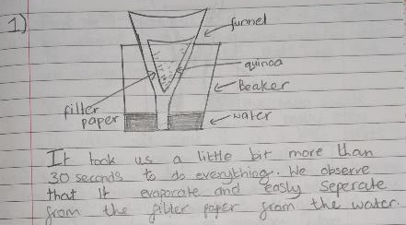
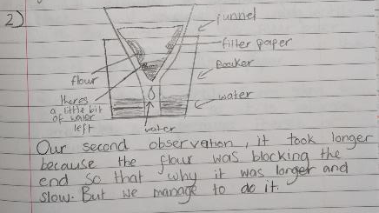
Exploring filtering
know that some materials will dissolve in liquid to form a solution, and describe how to recover a substance from a solution
use knowledge of solids, liquids and gases to decide how mixtures might be separated, including through filtering, sieving and evaporating
The children were shown how to filter by folding the paper correctly, placing it in the funnel and carefully pouring water through it so that it did not go over the sides of the filter paper. They were then asked to make a mixture of three different solids in water and to see what happened when they filtered these.
Incorrect use of the word evaporate

Slide 20
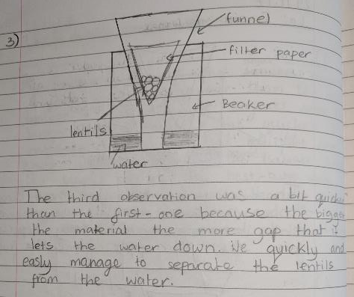
Exploring filtering (contd.)
know that some materials will dissolve in liquid to form a solution, and describe how to recover a substance from a solution
use knowledge of solids, liquids and gases to decide how mixtures might be separated, including through filtering, sieving and evaporating
Melissa makes careful observations and suggests reasons the differences.
Melissa successfully separates the solids from the mixture by filtering but does not use the term ‘filter’ as part of her observations.

Slide 21
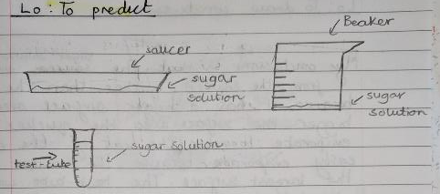
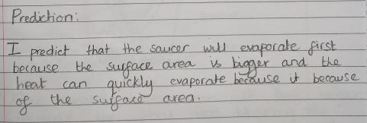
Exploring evaporation
know that some materials will dissolve in liquid to form a solution, and describe how to recover a substance from a solution
use knowledge of solids, liquids and gases to decide how mixtures might be separated, including through filtering, sieving and evaporating
The teacher first recapped on their prior learning about evaporation in year 3. Then the children were given a sugar solution and asked to think about what may affect the speed of evaporation. Melissa’s group chose to put the same amount of the solution into different types of containers. They were asked to make a prediction using their understanding of evaporation.
This shows that she has the required knowledge about evaporation from year 3 and is able to apply this to separating mixtures.

Slide 22
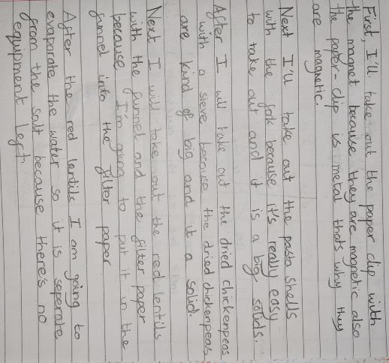
Separating a mixture
know that some materials will dissolve in liquid to form a solution, and describe how to recover a substance from a solution
use knowledge of solids, liquids and gases to decide how mixtures might be separated, including through filtering, sieving and evaporating
The children were given a mixture of pasta shells, paper clips, chickpeas, lentils and salt in water and a range of equipment to use. They were asked to plan how they would separate the mixture.
There is a possible misconception here that ALL metals are magnetic.
Melissa uses her knowledge to successfully separate the given mixture and explains her method using all the expected vocabulary correctly.

Slide 23
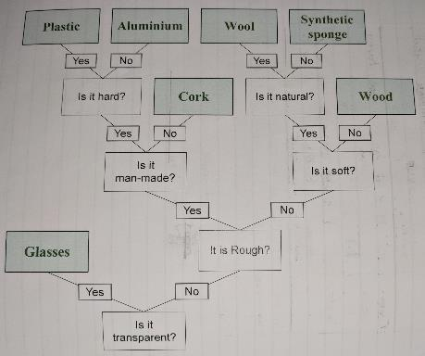
Creating a classification key
give reasons, based on evidence from comparative and fair tests, for the particular uses of everyday materials, including metals, wood and plastic
compare and group together everyday materials on the basis of their properties, including their hardness, solubility, transparency, conductivity (electrical and thermal), and response to magnets
The children were given objects made of different materials and asked to design a classification key to separate them focusing on the material rather than the object.
Melissa asks appropriate questions to create the key but there are gaps in her subject knowledge which lead to incorrect classification.
Aluminium is not man made but the foil had been manufactured, which caused confusion.
Here Melissa is using the everyday meaning of hard and soft.
Melissa has used the object rather than the material here.

Slide 24
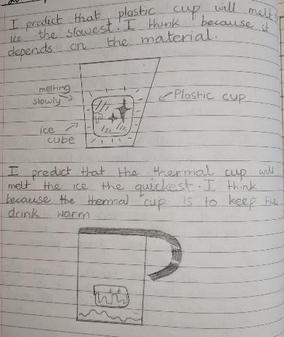
Investigating thermal insulation
give reasons, based on evidence from comparative and fair tests, for the particular uses of everyday materials, including metals, wood and plastic
compare and group together everyday materials on the basis of their properties, including their hardness, solubility, transparency, conductivity (electrical and thermal), and response to magnets
The children were asked to set up an investigation to explore how ice melted in different types of cups.
Melissa’s group used three different cups into which they put one ice cube and added warm water.
This shows an understanding that the temperature will be affected by the material of the container.
Melissa is familiar with the use of thermal cups to keep drinks warm and applies this correctly when predicting the speed at which the ice will melt.

Slide 25
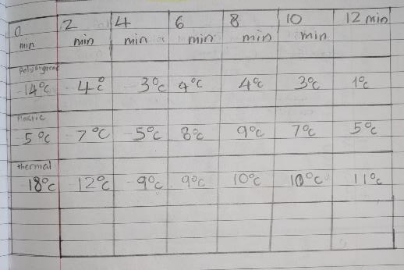
Investigating thermal insulation (contd.)
give reasons, based on evidence from comparative and fair tests, for the particular uses of everyday materials, including metals, wood and plastic
compare and group together everyday materials on the basis of their properties, including their hardness, solubility, transparency, conductivity (electrical and thermal), and response to magnets
They decided to record the temperature in each cup every two minutes and observe how long the ice took to melt.
The ice did melt quickest in the thermal cup because it kept the water warmer.
Other groups had not put water in the cups, only the ice cubes. For these groups the ice melted more slowly in the thermal cup. The children were asked to think why the results were different.
The thermal cup kept our water warm so the ice melted more quickly, but it kept their ice cube cold, so it melted more slowly.
Melissa shows a good understanding of thermal insulators.

Slide 26
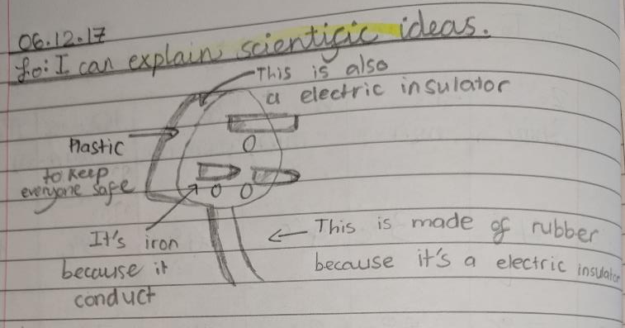
Evaluating products
give reasons, based on evidence from comparative and fair tests, for the particular uses of everyday materials, including metals, wood and plastic
compare and group together everyday materials on the basis of their properties, including their hardness, solubility, transparency, conductivity (electrical and thermal), and response to magnets
The children were given some objects to explore and identify the materials they were made from and consider why these materials were chosen.
This shows a good understanding of electrical conduction and insulation.

Slide 27
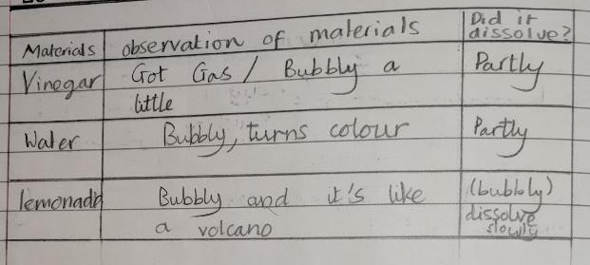
Creating gases
demonstrate that dissolving, mixing and changes of state are reversible changes
explain that some changes result in the formation of new materials, and that this kind of change is not usually reversible, including changes associated with burning and the action of acid on bicarbonate of soda
The children were given a white powder (bicarbonate of soda) and asked to observe what happens then it was added to different liquids.
Melissa chose to note whether the powder dissolved or not, showing recollection of her prior knowledge.
The teacher then explained that the solid is reacting with the liquid to create a new material – the gas. The children then observed a fizzy tablet in water and the teacher demonstrated using this reaction to launch a cannister.
The tablet reacts with the water to make a gas. When there is too much gas to fit in the pot the lids flies off.
Melissa applies her knowledge of a chemical reaction to this new situation.

Slide 28
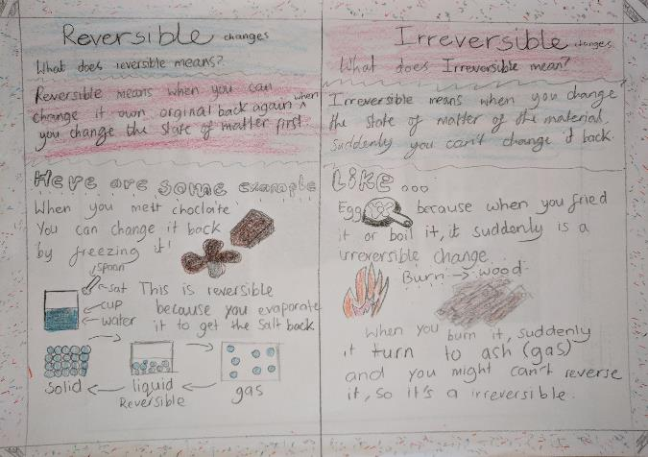
Summarising learning
demonstrate that dissolving, mixing and changes of state are reversible changes
explain that some changes result in the formation of new materials, and that this kind of change is not usually reversible, including changes associated with burning and the action of acid on bicarbonate of soda
The children were given time to research reversible and irreversible changes using the internet and then to present their understanding.
Melissa gives two examples of reversible changes (melting and dissolving) and explains how to change them back also two examples an irreversible changes (cooking and burning). She recognises that the wood has turned into a new material (ash).

Slide 29
Overall Summary - Secure
Overall summary – secure
Melissa talks about the properties of the materials used for different objects based on her prior knowledge and testing, explaining why a material is suitable for a particular purpose. She sorts materials using a range of criteria. She understands that some solids dissolve in water to form a solution. She has carried out investigations into the rate of dissolving and can relate her results to her understanding. She can separate mixtures using a range of techniques. She can explain which changes are reversible and which are not reversible.

Slide 30
Acknowledgements
Title slide from Shutterstock images

