Slide 1
EYFS
Collage

Slide 2
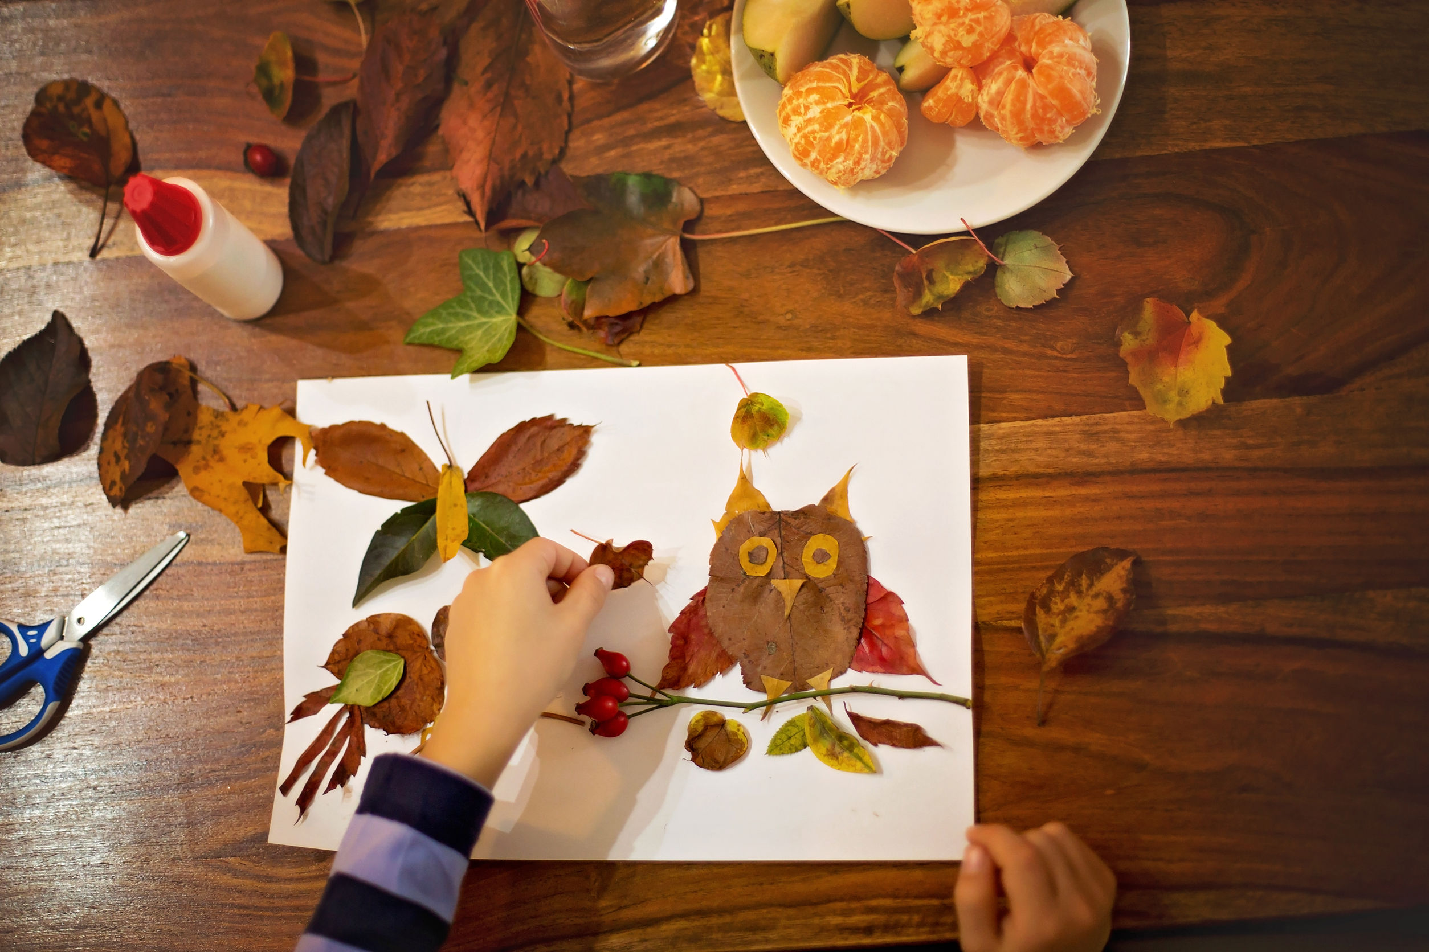
First Collage
Enjoy an exploratory art activity gluing anything and everything on a sturdy backing.
Materials
Paper plate or cardboard
Glue
Brush or cotton swab
Jar lid
Collage materials
Process
Collect on-hand collage items from the garage, outdoors or from your home. Sort through them and find those that will be used in a glue on collage.
HINT: For collage beginners, limiting a collage to one or two materials helps keep the collage under control. Select combination pairs, such as cotton balls and confetti.
Dip the item in a bit of glue and stick it on the paper plate or cardboard. Fill the backing with items in any fashion or design. More glue may be squeezed from the bottle if needed, or can be painted onto the item with a brush or cotton swab. Then let the collage dry over night.

Slide 3
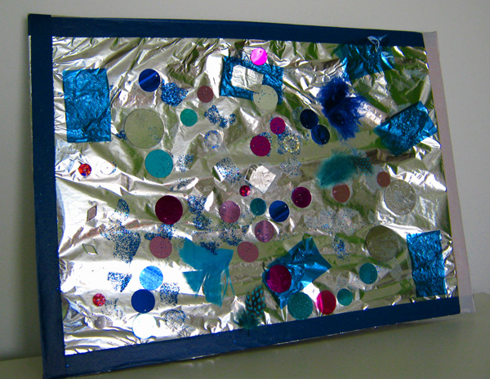
Inside out fancy collage
Create a fancy collage adding an array of shiny and sparkly material in a pattern that starts in the center and builds its way out to the edges of a cardboard square.
Materials
Cardboard square for backing
Wrapping paper
Tape
Glue
Jar lip
Brush
Choices of glittery collage materials, such as:
Beads, bits of aluminum foil, buttons, confetti, glitter, ribbon, sequins, gold, silver or copper paint.
Process
Think fancy and shiny! First, cover a piece of cardboard with wrapping paper. Metallic paper or designs with metallic components work well. Fold the edges of the wrapping paper over the cardboard’s edges and tape on the back.
To create the design, begin in the center of the board and work outwards. Glue a choice of shiny, fancy materials to the board. Covering the entire board is not necessary. Letting the background design adds to the design.
When the collage has dried a bit, take a small paintbrush and lightly highlight the collage with spots and dots of metallic paint. Glue and glitter may also be touched to specific spots for more shine.
When everything is dry, an adult can spray the collage with a light coating of hair spray to hood it all together.

