Slide 1
Express Yourself With Drawing
KS1 - Lesson 1
Mark Making – Handy Design

Slide 2
Learning Objective To experiment with making different marks.
Success Criteria
To use different marks to create a design
Key Words
marks, wavey, dots, lines, cross, overlapping, thick, thin, zigzags

Slide 3
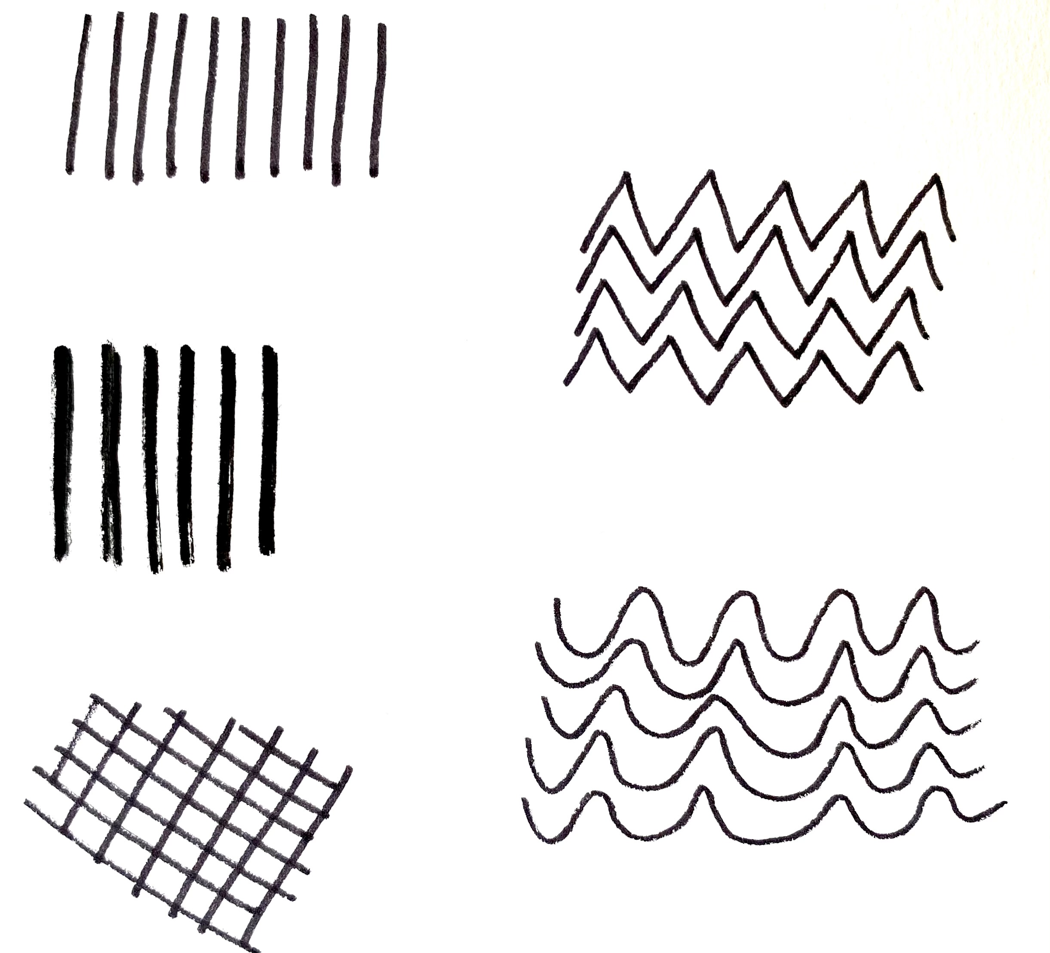
Different Types of Marks
In today’s lesson we would like you to create a design using five different types of marks.
Please watch the ‘How-to’ video.
Click on the link below.
Zig-zag Lines
Thin Lines
Wavey Lines
Thick Lines
Overlapping Lines

Slide 4
Activity 1- Practise making marks
Activity 1 – Practise making marks by copying the lines in each box using a drawing tool of your choice, such as: crayons, felt tips, pencils etc.

Slide 5
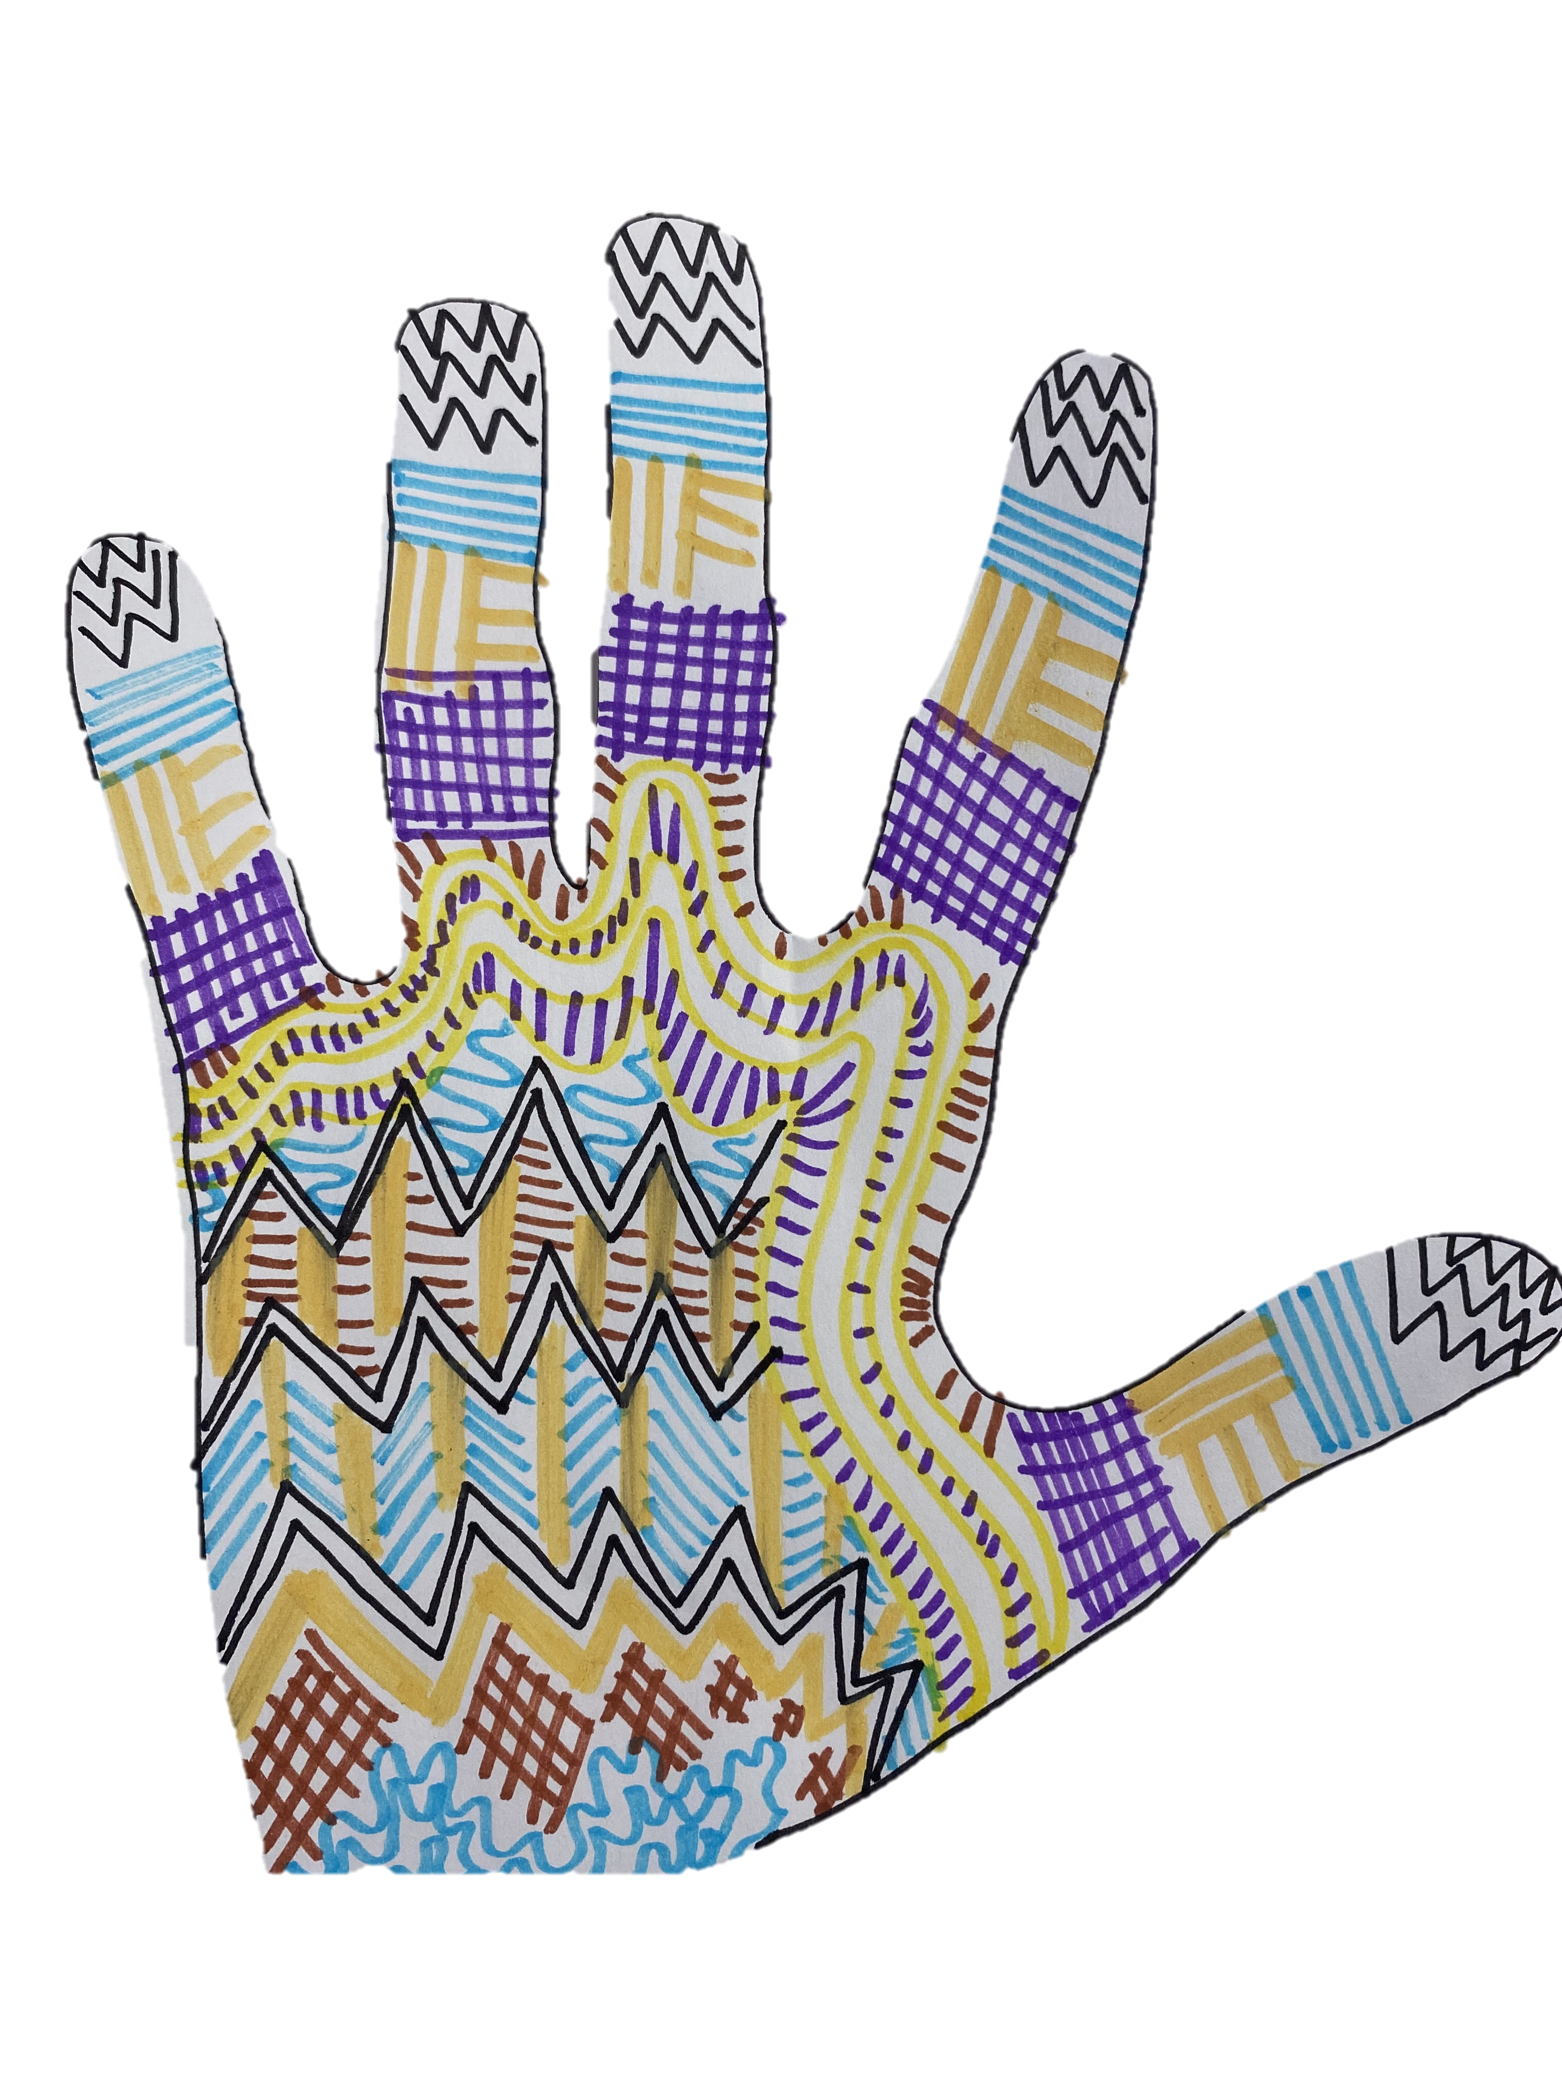
Activity 2 – Handy Design
Activity 2- Carefully, trace around your hand.
Fill in the traced shape with an interesting design using some of the marks you have been practising.
Remember:
Have fun and be creative with your design.
Try experimenting with different drawing tools and patterns.
You can find some examples of the next slide.

Slide 6
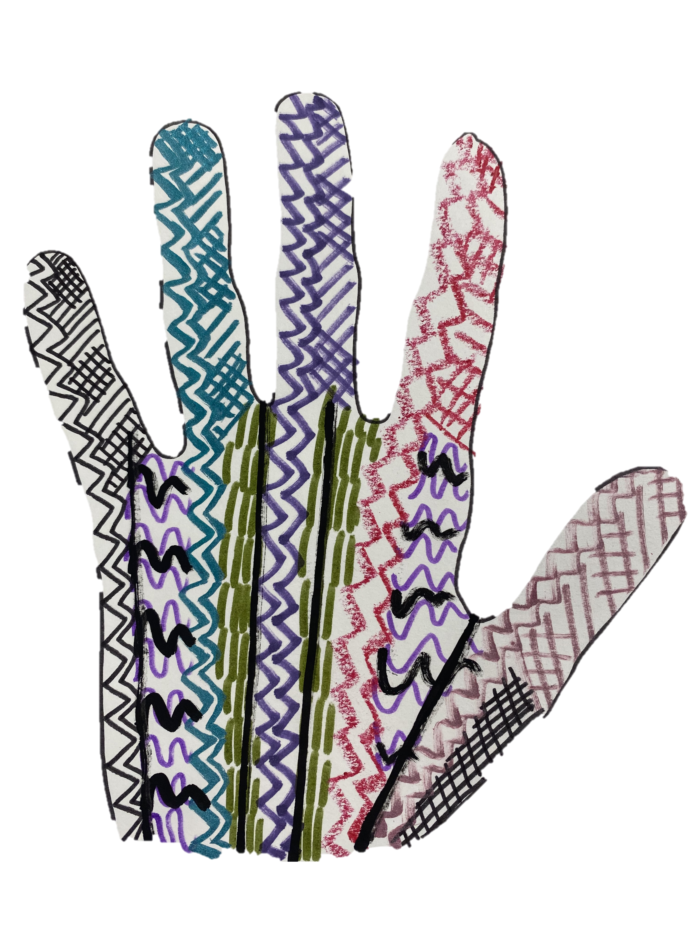

Slide 7
Think about…
Look at your finished piece.
How many marks did you use in your design?
Think about one new thing you have learnt
today.
Can you explain what you have
learnt to another person?
Today I have learnt …………….

