Slide 1
Lower KS2
Paint & Print

Slide 2
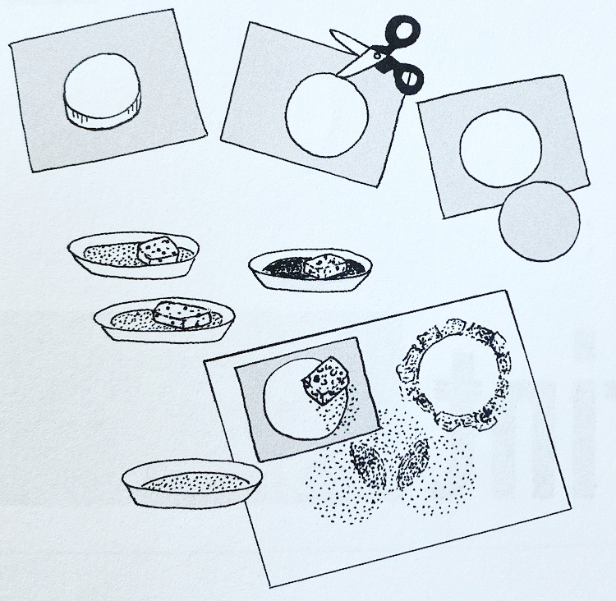
Lesson 1 - Sponge dabbed stencil
Create positive and negative stencil prints from traced jar lid. Dab the stencils with sponges dipped in paint.
Material
Paints
One paper plate for each colour of paint.
Sponge cut into roughly 5cm squares or other shapes.
Jar lid
Paper
Scissors
Pencil
Oil pastels (or crayons)
Process
Pour a puddle of paint on a paper plate. Each plate will have a different colour.
Moisten sponge squares with water and squeeze them dry. Place one sponge next to each plate of paint.
Place the lid of the jar in the center of a piece of paper leaving a good sized (5cm) border or paper around the jar lid. Trace the lid with a pencil.
Adult help required- To preserve both positive and negative stencils, slowly and carefully poke the point of a pencil through the paper on the point of the circle pencil line. Carefully cut out the circle. When finished, there will be a circle, which is positive stencil, and the frame, which is a negative stencil.
Place one of the stencils on the paper. Lightly dab a sponge in the paint. Then dab paint around the outside edges of the positive stencil or the inside edges of the negative stencil. Make a pattern of paint using different colours and both stencils as desired. Let colours and stencil shapes overlap.
Then let the paint dry.
For additional design interest, highlight and add details to the dry painting with oil pastels (or crayons).

Slide 3
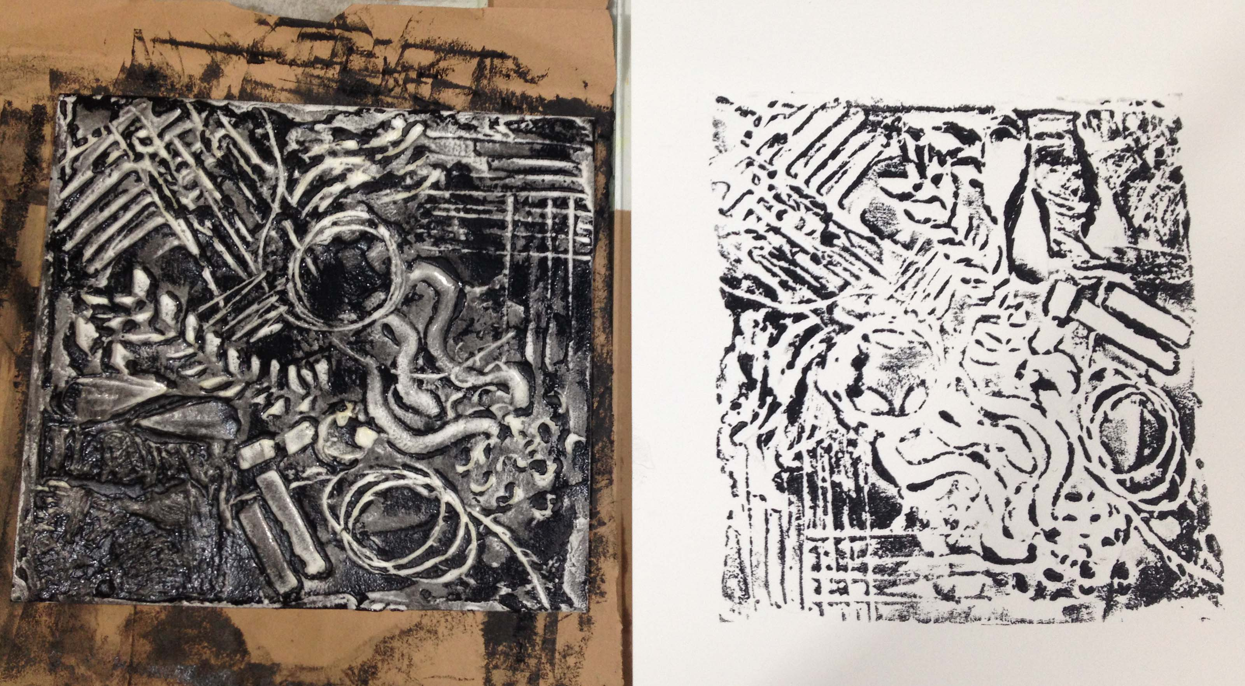
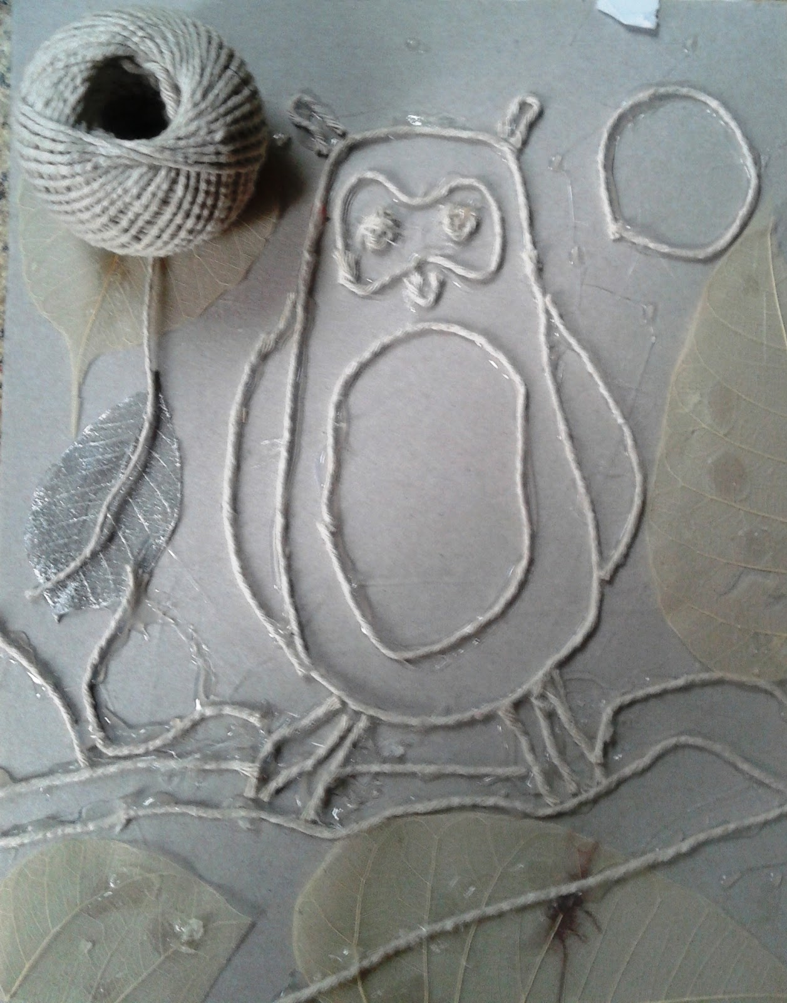
Lesson 2- String Print
Glue string in any design on a paper plate or piece of thick cardboard. Roll ink over the string and lift string collograph (collage and graphics combined) on paper.
Material
Paper plate
String
Glue
Printing ink or thick paint
Brayer or roller (small rolling pin, paint roller with handle)
Oven tray
Sheets of paper (white copier paper is perfect)
Water colour paints and brush, or markers (optional)
Process
Glue string to a paper plate in any design. Dry for several days or over a weekend.
Squeeze a blob of printing ink or think paint on a baking tray. Roll a brayer (rolling pin) back and forth over the sheet to spread and smooth the ink and cover the brayer. Roll the inked brayer over the string design. Roll in more ink and add extra ink to the string if needed.
Press a sheet of paaper to the inky string, pat with the palms of the hands. To pick up a print, peel the paper from the design from the corner. Make as many rpints from each inking as possible. Then re-ink and make more prints!
When prints are dry, hightlight with water colour paints or coloured markers.

Slide 4
Lower ks2
Draw and Design

Slide 5
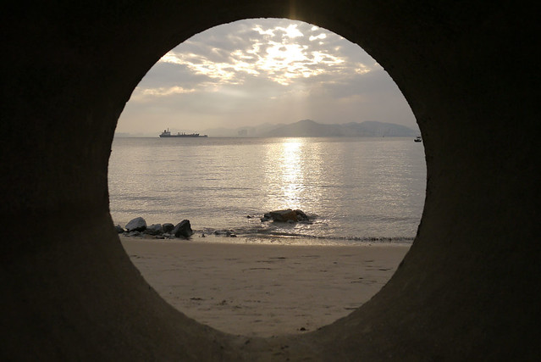
Lesson 1-Circle peek-a-view
Peek through a cardboard tube and spot an interesting subject to draw. Notic how it fits within the circle. Visualise it and remember it. Draw the same image within a black line circle on drawing paper.
Material
Cardboard tube (or sheet of paper rolled into a tube)
Drawing paper
Thick black marker
Circle template (bowl, plate or other round object)
Coloured pencils, coloured markers or crayons
Process
Look through a cardboard tube or rolled up paper, indoors or outdoors.
Spot something interesting and remember it as it looks within that circle.
Next, trace a large black circle in the center of the sheet of white paper (this is the frame of the ‘circle view’).
Insode the circle boundaries, draw what was seen through the tube.
Circle Ideas
Draw what is seen inside the circle view and also what is seen around it.
Draw four circles on the paper to chow views from one location looking North, South, East and West.

Slide 6
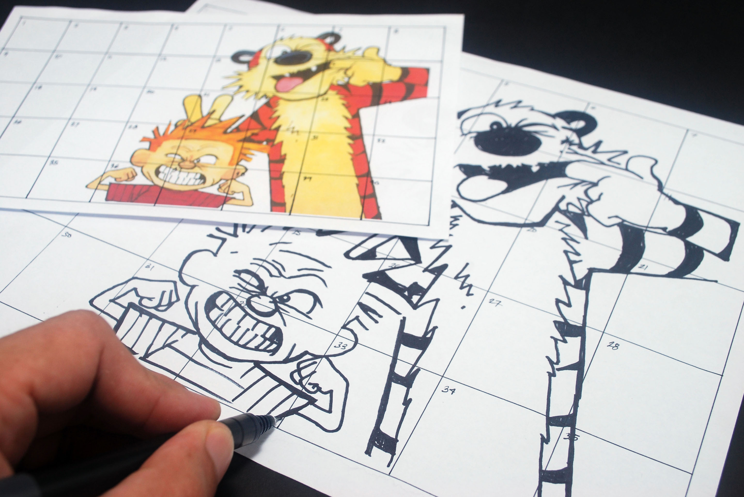
Lesson 2- Simple grid enlargement
Make an enlargement of an original drawing using a simplified grid approach. This is a technique artists use.
Process
Trim the child’s drawing to a square shape (not a rectangle).
To make the grid: Fold the square drawing into 16 sections by folding the drawing in half four times. Fold it in half, in half again, and one last time. Then unfold. Sixteen sections should show, four by four. With a ruler draw a straight pencil line along each fold line to make a grid. Set aside.
To make the enlarged grid: With adult help, draw 16 equal sections, four by four, on the larger sheet of paper, at least double the size of the smaller grid sections. For example, if the original sections are 2cm wide, the larger sections should be at least 4cm wide.
Look at the first section of the drawing with the pencil line grid. Draw the same lines in the enlarged grid in the first section, but draw them larger to fit the section. Do this for each grid section, one at a time. Soon all the sections will come together to form one enlarged copy of the original.
Colour the enlarge drawing to match the original.
Material
Child’s original drawing (simple, bold, few details)
Scissors
Pencil
Ruller
Large sheet of white drawing paper (about double the size of the drawing)
Crayons

