Slide 1
Upper ks2
Draw, Collage & Design

Slide 2
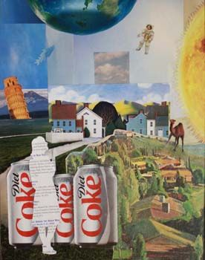
Lesson 1- Surreal Clipping
Incorporate enlarged and reduced copies of a magazine picture into a surreal drawing composition.
Process
Select one interesting image from a magazine or catalogue. Tear or cut out the image.
Hint: Choose a picture clipping that inspires imagination.
Place the clipped image on a photocopier or scanner and reproduced several enlarged images and several reduced images. Experiment with different sizes of reproduction. Save them all for the next step.
Cut out a selection of different images in different sizes. Arrange them on the drawing paper while imagining how they might work together in one picture. For example, a flower enlarged and reduced many times might become a garden full of dancing flowers, both grown up and dancing flowers.
Or reproductions of a lion in different sizes might become a basket full of lion kittens with a large mother and father lion.
When an idea is forming, creating a drawing the incorporate the cut-out images. Draw details and features to add to the drawing. (Begin with either drawing or with gluing.)
Hint: Use minimal glue to prevent glue from smearing on the drawing.
Material
Catalogue and magazines
Scissors
Scanner
Drawing paper
Glue stick
Choice of drawing tools, such as coloured markers, coloured pencils and crayons.

Slide 3
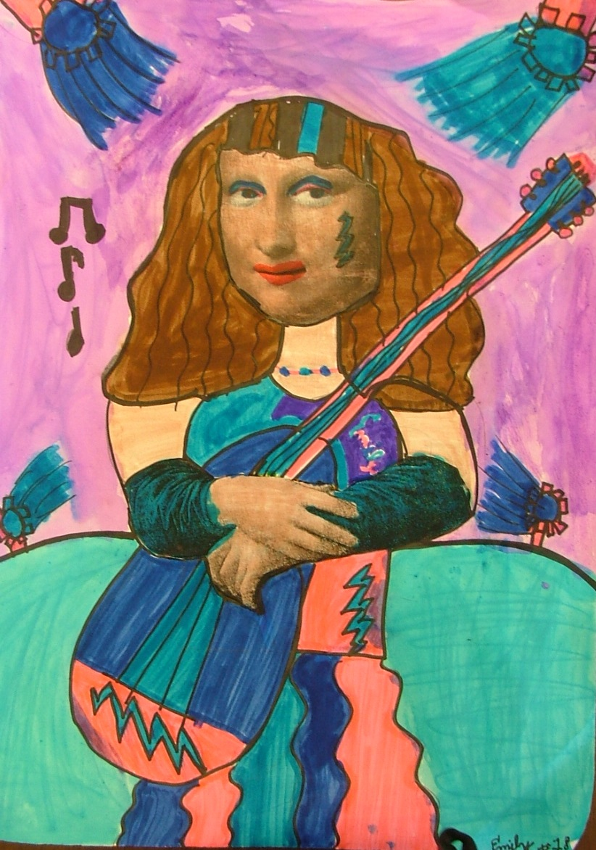
Lesson 2- Master of parody
A parody is a work that imitates another artist’s style, often in a humorous way. Using a portion of a fine art print, create a new work of art that is a parody.
Process
Cut out the centrals figure’s shape or portrait from the fine art picture. Glue it to drawing paper. Let the glue dry.
Decorate and embellish the figure in some way both on or around the figure with drawing and collage materials. Changing the original figure creates a ‘parody’ or changed likeness of the original. For example, add lace and fabric trims, beads and sequins to the figures clothing.
Crete a background scene or patterned background. Accent with pens and paints if desired.
Fashion a frame for the parody from another sheet of coloured paper. Draw fancy designs on the frame to resemble ornately carved frames of long ago. Tape of glue the frame to the parody.
Material
Fine art print of a figure or person (from the renaissance or other long-ago era)
Drawing paper
Glue
Coloured markers
Collage materials, such as: fabric trim, lace, magazines clippings, wall paper scraps, wood curls
Collected items, such as: bottle caps, corks, dried flowers, hair clips, shells, toothpicks.
Additional coloured paper
Scissors

Slide 4
Upper ks2
Sculpt & Construct

Slide 5
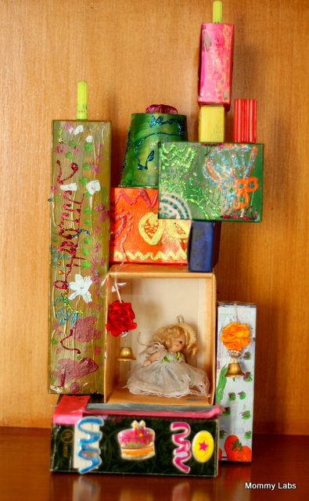
Lesson 1- box sculpture
Collect large cardboard boxes and build a sculpture with a message to share
Process
Create a box sculpture with large boxes stacked and joined together in an interesting shape or assembly. Think of ways to make the boxes balance in unexpected ways. Boxes may be joined together with glue, tape, string or hot glue gun (with adult assistance). Holes poke with a pencil allowing for string to tie them together.
When the box sculpture is assembled, think of how to use the sides of the boxes to communicate a message or let others know about something important. For example, convey feelings like sadness, joy or anger, or strong messages such as ‘I believe in recycling!’ ‘I believe in saving animals!’ ‘I believe in exercise!’ ‘I believe in family!’ Then represent the message with collage, paint or slogans. Paint or further decorate the boxes in any chosen way.
Material
Large boxes
Glue, string or tape
Hot glue gun (adult help)
Pencil
Scissors
Decorating choices, such as:
Coloured markers
Mementos or collected items
Paint
Pens
Photo or magazine cut outs
Wide permanent marker

Slide 6
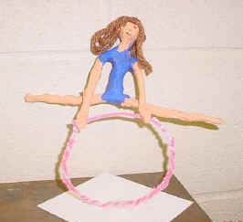
Lesson 2- Foil Figure
Squeeze and bend aluminium foil in the shape of a person or figure, wrap in making tape and add paint and decorations to create hair and clothing.
Material
Aluminium foil
Masking tape
Acrylic paint and brush (or coloured markers)
Glue
Decorations and embellishments, such as:
Feathers, wool, string, fabric
Additional props (optional)
Think cardboard or wooden base
Hot glue gun (optional, adult only)
Process
Scrunch, crumple and bend aluminium foil into a human or animal shape. Bend the figure into a pose or posture.
Wrap the fissure in masking tape to cover. Tear small pieces and strips of masking tape to cover the entire figure.
Add details such as facial features, expression to the figure with acrylic paint or coloured permanent markers. Glue pieces of string, fabric and other decorations to create clothing and hair. Additional props can also be added to express more about the figure, such as a ball, tiny toys walking stick.
Place the cardboard or wooden base flat on the table top. Attached the sculpted person with tape. Add enough tape for the person to stand and be strong! (If necessary, use a hot glue gun with adult supervision.)

