Slide 1
Drawing Using Tone
Lower KS2 - Lesson 1

Slide 2
Learning Objective To be able to understand how to create tone using pencil
Success Criteria
To use cross hatching to achieve tone.
Key Terms
tone, light, medium, dark, shadow, highlight

Slide 3
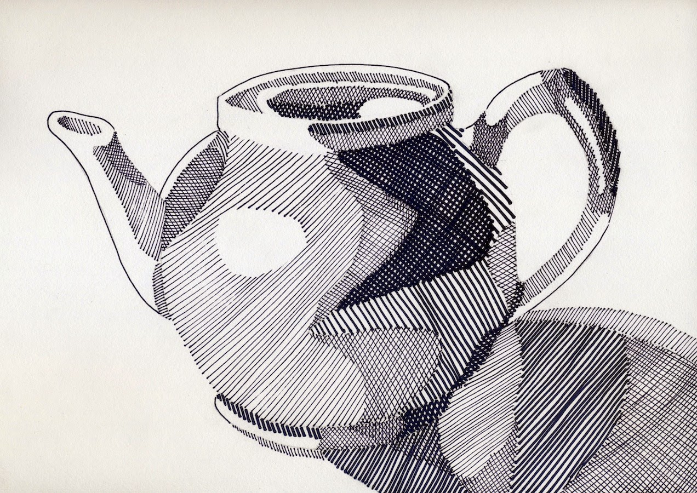
What is tone?
Artists use tone to create observational drawings.
An observational drawing could be a portrait, architecture (buildings) or still life (bowl of fruit).
Artists use layers of shading to achieve light, medium and dark tones. You may also use cross-hatching to achieve tone. Cross-hatching is when an artists uses layers of line to create highlights and shadows within a drawing.
You achieve a light tone with a light pressure on the pencil, so you achieve a darker tone with a heavier pressure.

Slide 4
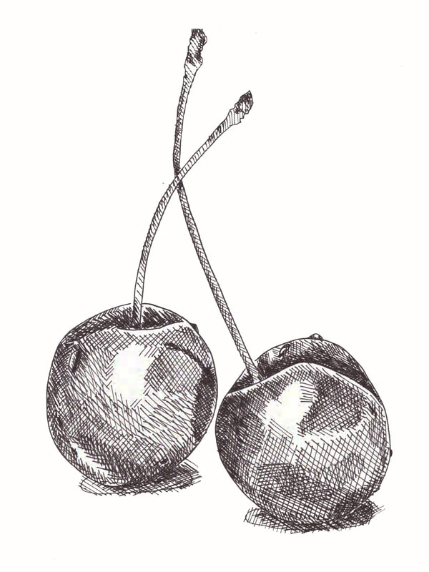
Examples of Tone

Slide 5
Activity – Using Tone
Before you begin the activity watch the ‘How to’ shading and cross-hatching video.
Click on the link below.

Slide 6
What have you learnt today?
Look at your work and write down one new thing you have learnt today in the thought bubble. Below are some sentence starters to help you.
Today I have learnt to…………….
Cross hatching is used to…………….
I enjoyed……………because………

