Slide 1
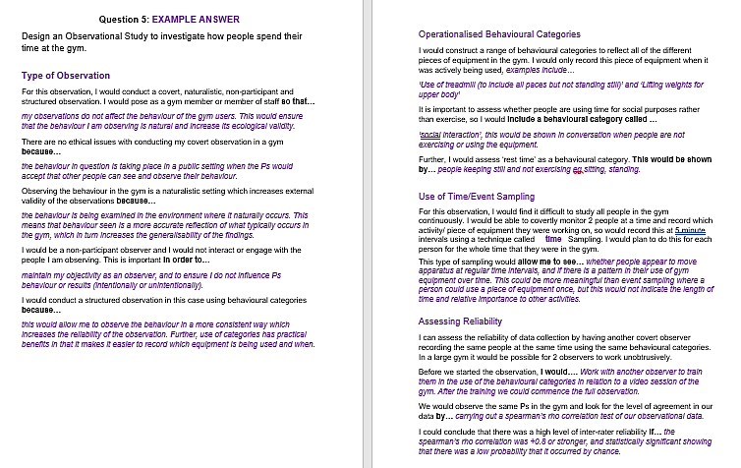
Refine:
Encouraging pupils to act on feedback::
Refining answers using a skeleton gap fill …
Type of Observation
For this observation, I would conduct a covert, naturalistic, non-participant and structured observation. I would pose as a gym member or member of staff so that…
There are no ethical issues with conducting my covert observation in a gym because…
Observing the behaviour in the gym is a naturalistic setting which increases external validity of the observations because…
Notes:
LS.

Slide 2
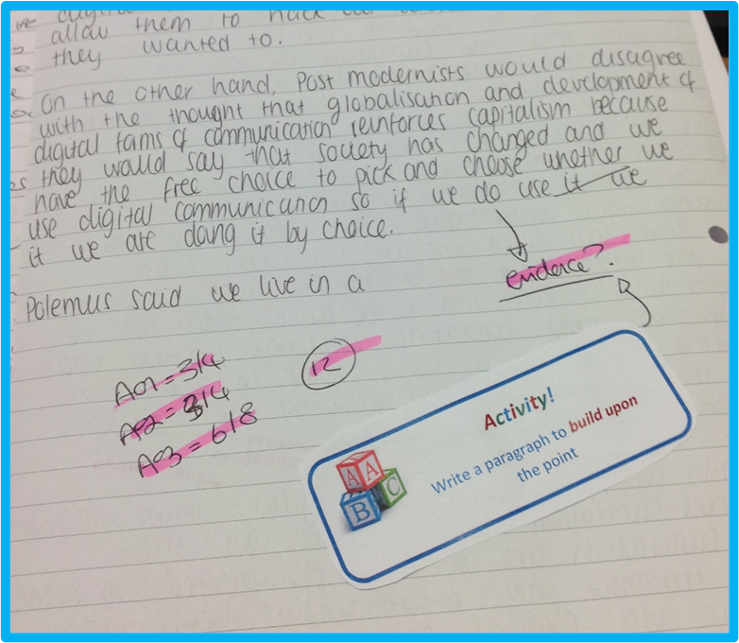
Refine: ABC questioning in sociology
Can be used to get pupils to build on their work, agreeing with a point in their essay or challenging a point in their essay…to increase their mark.

Slide 3
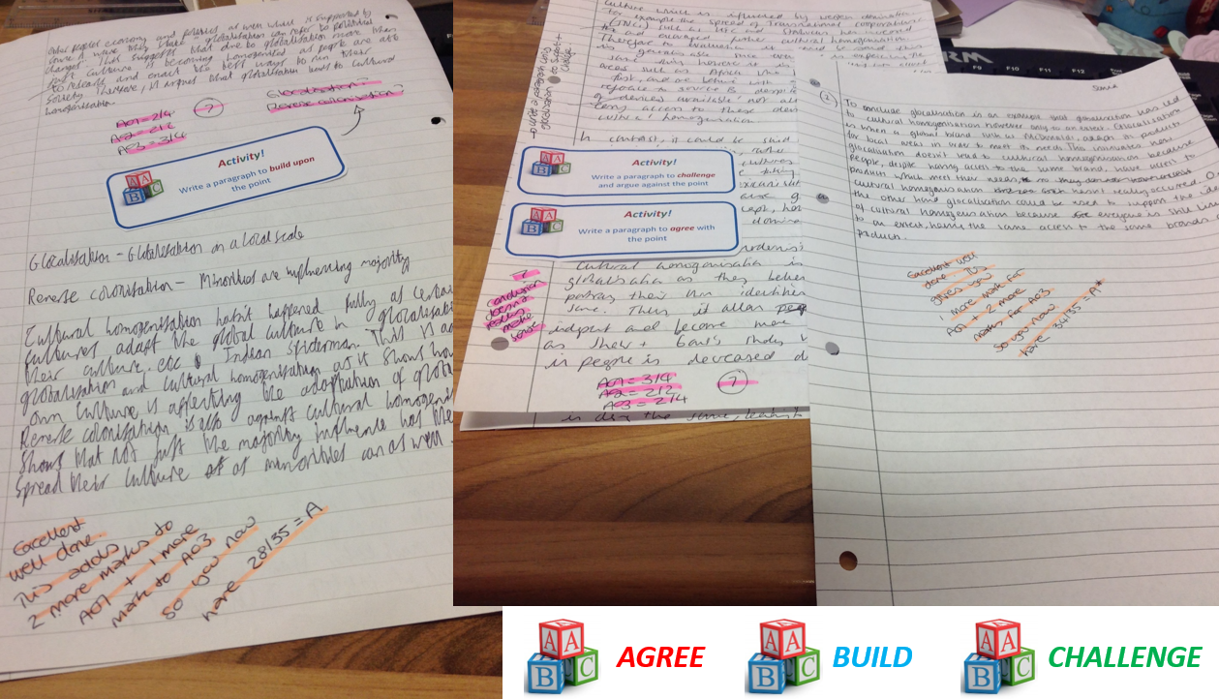
Refine: ABC questioning in sociology

