Slide 1
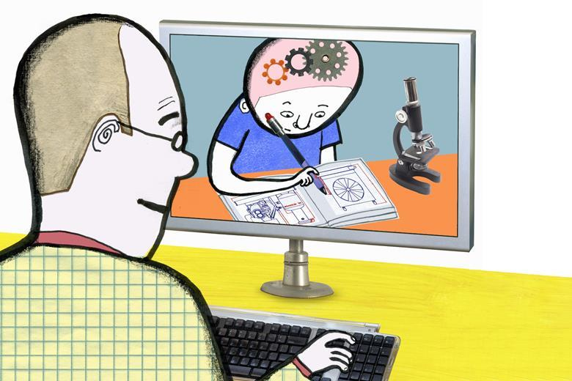
Feedback
at
The Marist

Slide 2
Pre-lockdown feedback
1-to-1 feedback at a pupil’s desk
Individual written feedback
Whole-class verbal feedback
Notes:
Not just about deepening knowledge and promote optimal learning

Slide 3
How are we going to keep children engaged and feeling part of a learning community?
Notes:
We cannot teach in a vacuum – children need to feed connected and to feel that their work is recognised and valued.

Slide 4
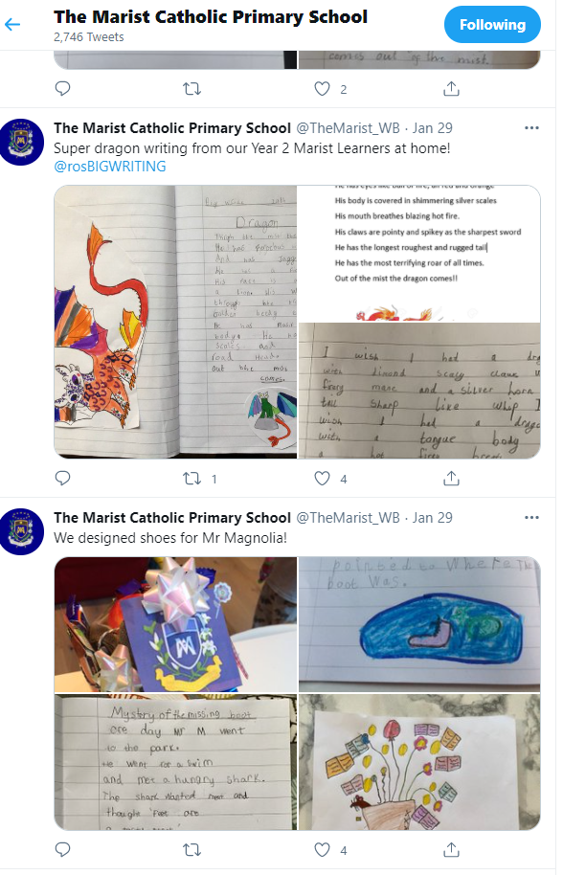
Twitter - Teachers and parents upload work on to Twitter and this serves as a celebration of good work as well as providing models for others.

Slide 5
Work of the Week Teachers share good work during Celebration Assemblies

Slide 6
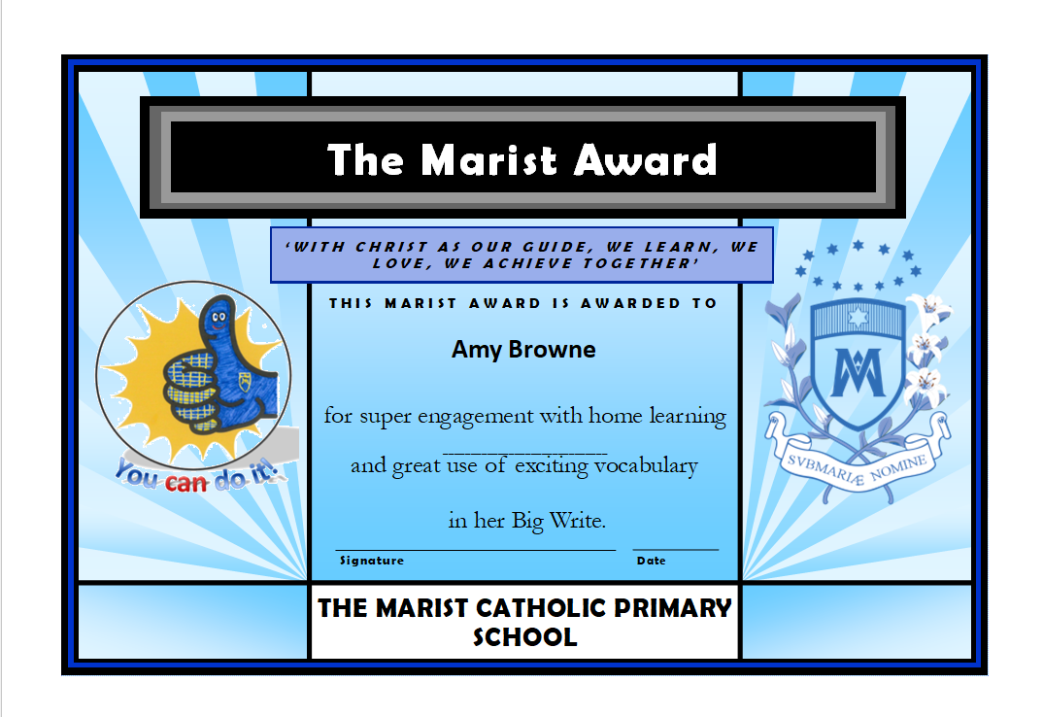
Merit Certificates are awarded and posted out

Slide 7
Responding to work completed remotely – how can we ensure effective feedback??

Slide 8
Emails
Parents and pupils e-mail work to teachers who respond with brief feedback e-mails celebrating the work and providing one ebi.
Teams
Children upload work onto Daily Assignments page and individual feedback is given. Where appropriate, children are requested to act on feedback and return edited work.
We are also using Class Notebook to give feedback to older children.

Slide 9
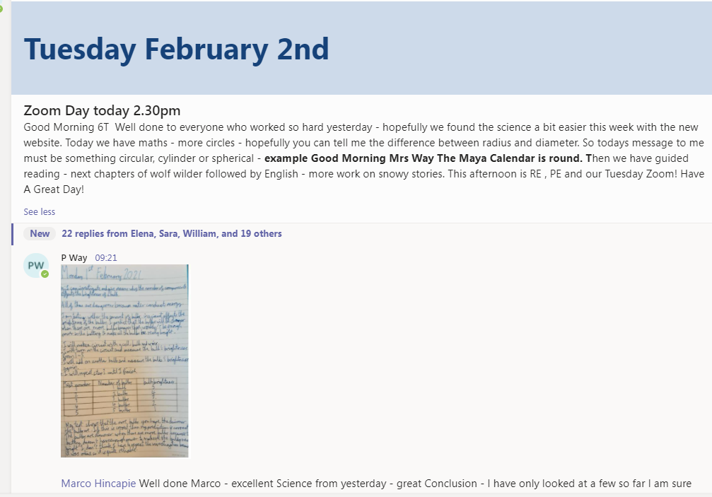
Daily Videos
Each morning teachers use a short video for check-in on Teams during which they will give feedback (instructional and/or motivational) on the previous day’s work.
Examples in the chat
Weekly phone calls

Slide 10
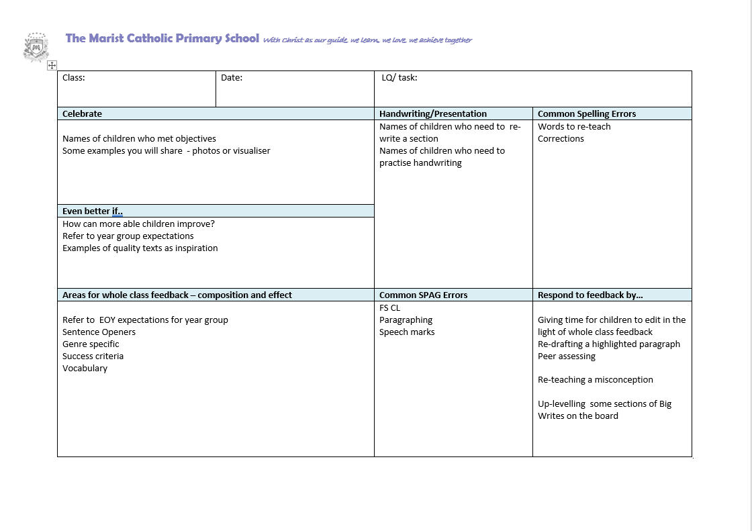
Whole Class Feedback on the Big Write

Slide 11
Teams Quiz

Slide 12
Frontloading – how to build feedback into lessons

Slide 13
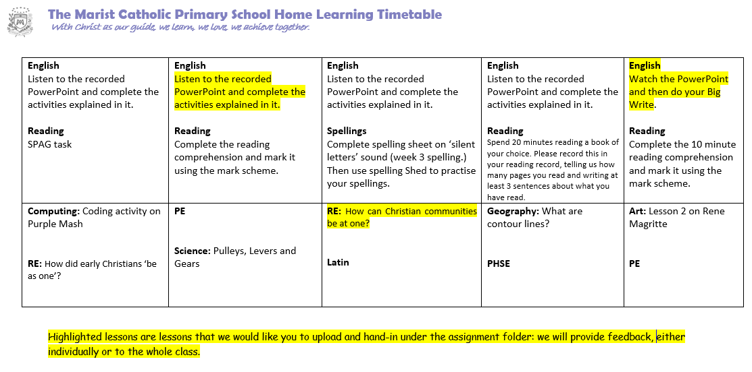
Plan in advance where you are giving feedback
Plan in advance what you will give detailed feedback on (this is included on Weekly timetables)

Slide 14
Top Tips
Share clear success criteria. Share these at the beginning of the lesson and keep referring back. At the end give time for the pupils to check their work against these success criteria.
Use Rubrics to make your job easier – also award points

Slide 15
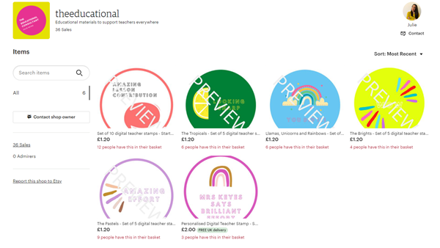
3. Bring feedback into the lesson e.g. by displaying two anonymous pieces of writing and ask pupils to critique and compare them. Discuss which is most successful and why.
4. Encourage the children to self mark as much as possible and incorporate this into live and recorded lessons i.e live marking, stop the video now, Tick and Fix, (send out answers with task).
5. For younger children use digital stickers (or save some in a word document).
6. If using Class Notebook, give audio feedback.
Notes:
An opportunity to build much greater independence

Slide 16
Metacognition
Encourage pupils to share various stages of their drafting and talk through their editing process. Teachers will need to demonstrate how they do this on a regular basis.
Give the pupils an opportunity to reflect and compare their finished work against models shown.
Notes:
Maybe this is the perfect time to support our students with developing their self-regulation skills. Students (and their parents) are feeling frustrated with ‘being stuck’ and ‘not knowing what to do’. So instead of focusing feedback just on concept development, also use it to develop independent working skills.

Slide 17
Finally…
We needed to think about how we get
feedback about our offer from the pupils!!
Set a challenge question – children respond in chat.
Build in time for children to talk about their learning eg What did you find tricky? What have you learnt before that helped you with this?
What else could the teacher have done to help?
Notes:
The most important feedback is that which pupils provide to their teacher and not the other way around.
It can be hard to pick up the cues in remote learning? What opportunities are you giving the pupils to feedback to you. Feedback is a 2 way process.
One way might be to ask each person to post an exit card ‘What did you find tricky today?’ Or include a challenge question or task.

Slide 18
To think about…..
We have all adapted the way we teach and give feedback.
What are we going to keep when the children return to school?
How will our practice be different going forward?

