Slide 1
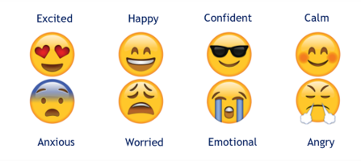
How are you feeling today?
On learning tools, select an emoji to represent how you are feeling today
Notes:
One idea is to use emojis to help students identify their feelings. It is useful to provide students with a key like the one above.
On learning tools, please can you select an emoji that represents how you are feeling today?

Slide 2
You are performing in the next school show...
On your iPad select a colour to describe how you are feeling about this
Notes:
Another idea is to use colours.
On your iPad, please select a colour to describe how you would feel if you were told you were performing in the next school show

Slide 3
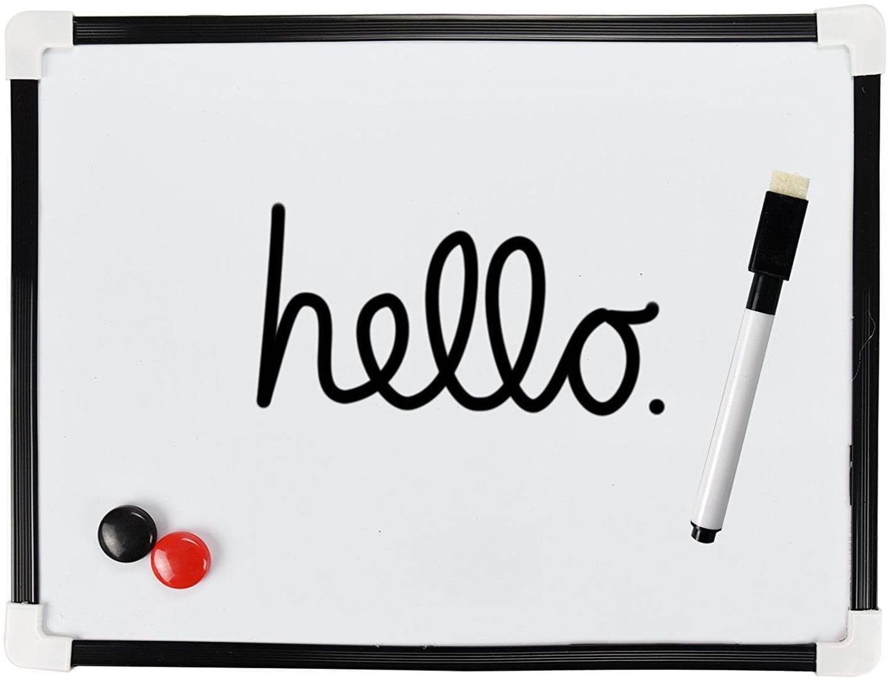
You are running a parent information evening TONIGHT
Write one word to describe how you are feeling about this
“ I am feeling ____________”
Notes:
Some students may prefer to write down how they are feeling.
Please write down one word to describe how you would feel if you were running a parent information evening tonight.

